Slide 1
Deadline: 1 February 2013
www.basileus.ugent.be

Slide 2
Our EU-partners:
Ghent University, Belgium (coordinator)
Sofia University St. Kliment Ohridski, Bulgaria
University of Nice Sophia Antipolis, France
University of Heidelberg, Germany
Alexander Technological Educational Institution of Thessaloniki, Greece
University of Rome La Sapienza, Italy
University of Ljubljana, Slovenia
University of Deusto, Spain
Lund University, Sweden

Slide 3
Our Western Balkan partners:
University of Novi Sad, Serbia (joint coordinator)
University of Tirana, Albania
University of Sarajevo, Bosnia & Herzegovina
South East European University Tetovo, Macedonia
Ss. Cyril and Methodius University Skopje, Macedonia
University St. Kliment Ohridski Bitola, Macedonia
University of Montenegro, Montenegro
University of Prishtina, Kosovo
University of Belgrade, Serbia
University of Kragujevac, Serbia

Slide 4
Available grants
 | BA | MA | PhD | Postdoc | Staff | Total | %
AL | 6 | 8 | 4 | 1 | 3 | 22 | 8
BA | 8 | 10 | 4 | 2 | 4 | 28 | 10
MK | 14 | 16 | 7 | 2 | 7 | 46 | 17
Kos | 4 | 5 | 2 | 1 | 2 | 14 | 5
ME | 8 | 10 | 4 | 2 | 4 | 28 | 10
RS | 26 | 30 | 11 | 4 | 12 | 83 | 31
EU | 16 | 15 | 8 | 2 | 8 | 49 | 18
Total | 82 (30%) | 94 (35%) | 40 (15%) | 14 (5%) | 40 (15%) | 270

Slide 5
Available grants
 | Albania |  |  | Kosovo
 | TG1 | TG2 | TG3 | TG1 | TG2 | TG3
BA 6m | 3 | x |  | 2 | x
BA 10m | 3 | x |  | 2 | x
MA 6m | 2 | 1 |  | 1 |  | 1
MA 10m | 1 | 2 |  | 2
MA 22m | 1 | 1 |  |  | 1
PhD 6m | 1
PhD 10m | 1 | 1 |  | 1
PhD 36m |  | 1 |  |  | 1
PD 6m | 1 |  |  | 1
PD 10m
Staff 1m | 1 | 2 | x | 2 |  | X

Slide 6
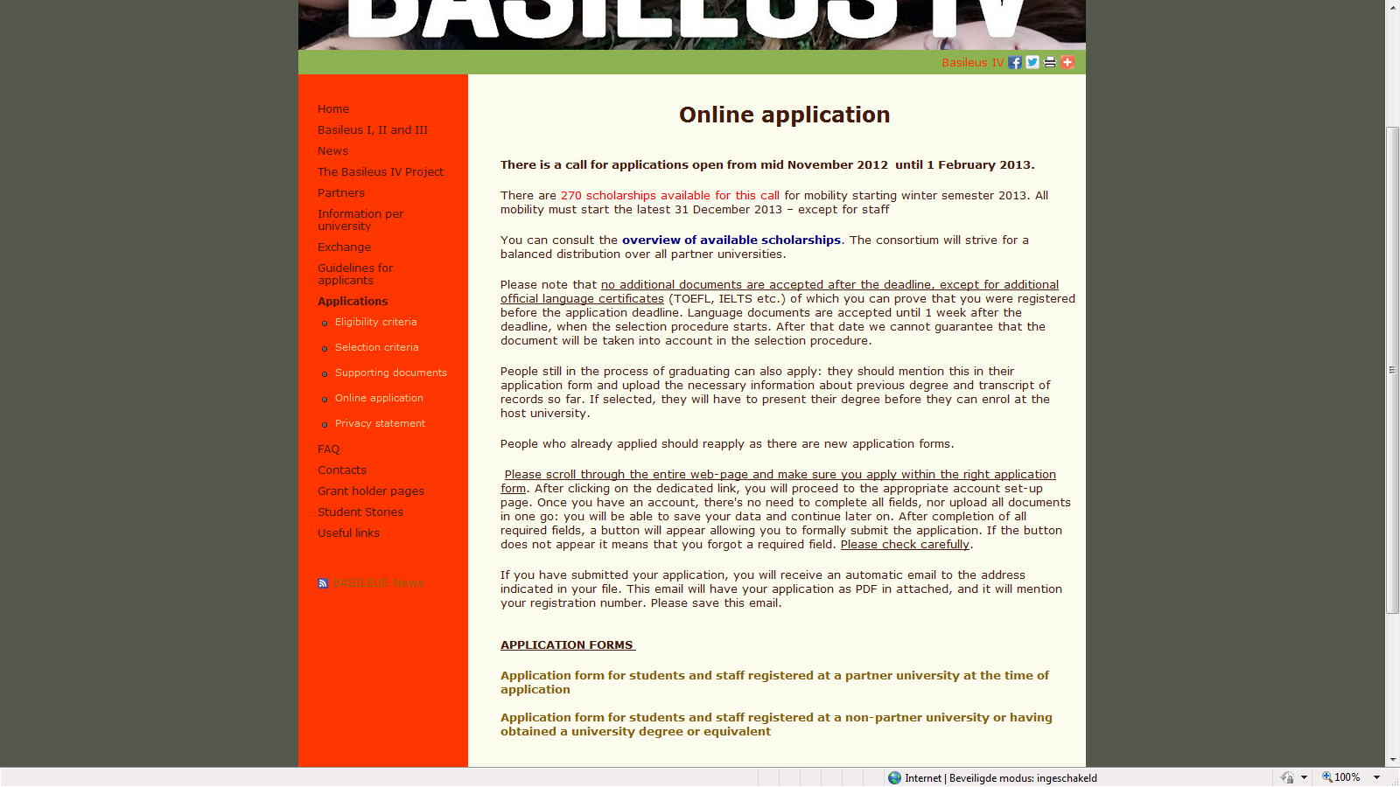
Online application
Application forms

Slide 7
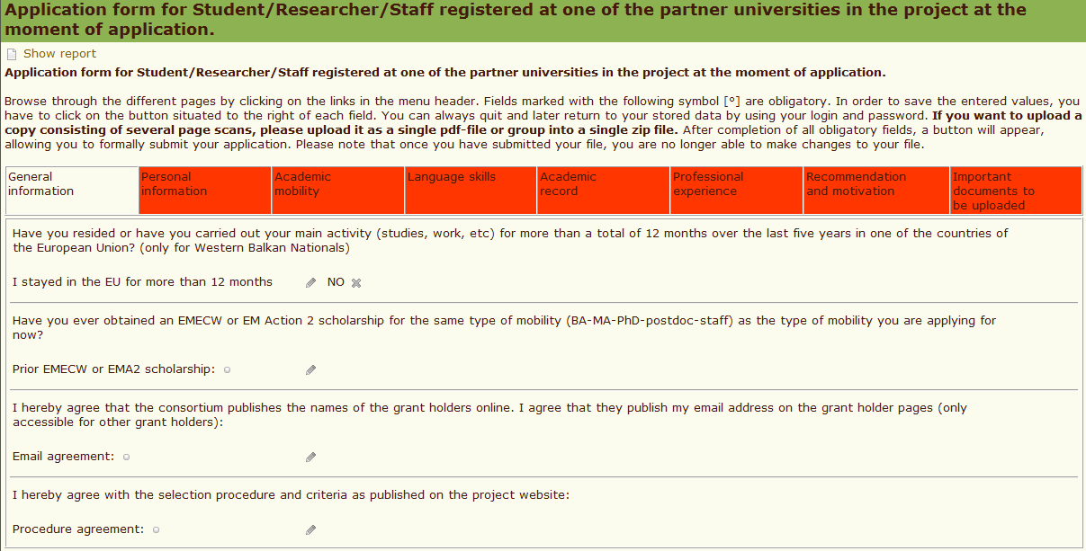
Online application

Slide 8
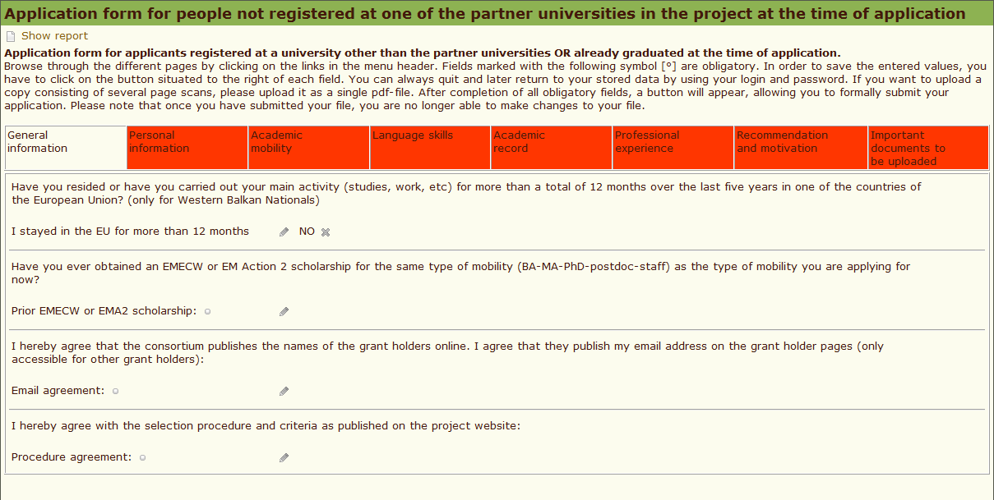
Online application

Slide 9
Study/research plan
Template on the project website
A plan with a list of courses (research) you would like to take abroad. This is not final yet => after selection a learning agreement is signed.
Info? Course catalogues online
No signature from the host at application phase, only from the applicant and the home university

Slide 10
Selection
Academic merit (40 points)
Language capacity (30 points)
Motivation (30 points)
TG 1 = first validated by home university
All TG’s = ranking by host university and final selection by project selection committee

Slide 11
Tips
Carefully read the project website and the guidelines for applicants before contacting the project contact persons
Contact your home IRO or basileus@ugent.be if you have further questions
Write a good and original motivation letter
Make sure you have all supporting documents

Slide 12
All mobilities should start before 31 December 2013
(except for staff)

Slide 13
Ghent, Belgium

Slide 14
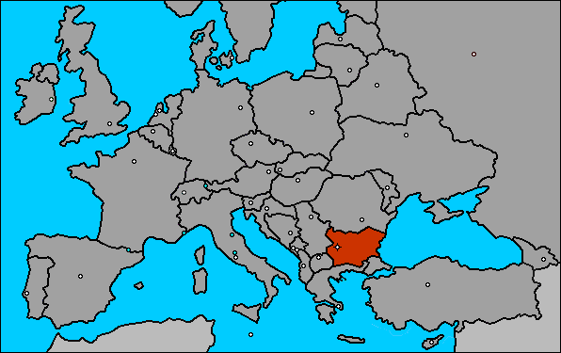
Sofia, Bulgaria

Slide 15
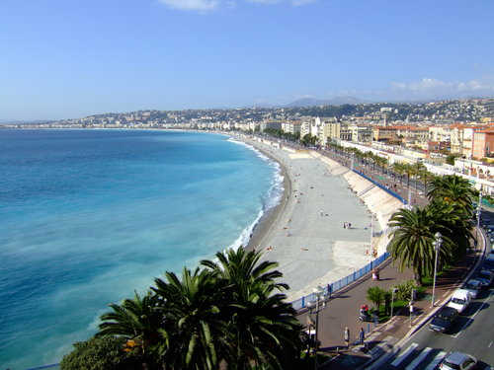
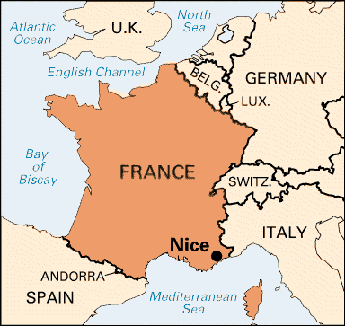
Nice, France

Slide 16
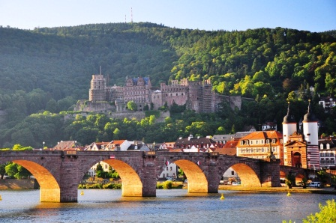
Heidelberg, Germany

Slide 17
Thessaloniki, Greece

Slide 18
Rome, Italy

Slide 19
Ljubljana, Slovenia

Slide 20
Deusto, Spain

Slide 21
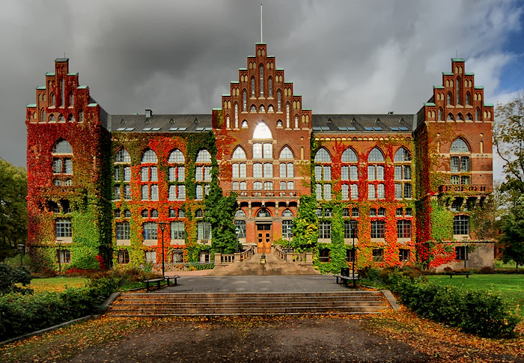
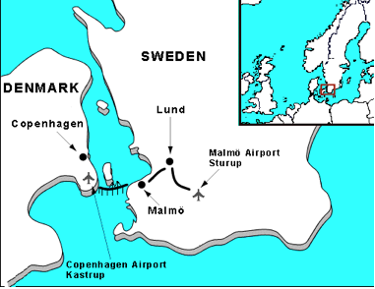
Lund, Sweden

Slide 22
Deadline: 1 February 2013
www.basileus.ugent.be

