Slide 1


Meeting of the Steering Platform on R&D for Western Balkan Countries
Svatopluk Halada
EUREKA Secretariat
Ohrid, 26 May 2011

Slide 2

EUREKA in WBCs: Activities 11/2010-05/2011
Events, meetings, training activities, etc.
Albania, Tirana, 14-15 December 2010
  Meeting with R&D Policy making representatives
    Ministry of Education and Science
    Academy of Sciences
  Meeting with representatives of business sphere
    Chamber of Commerce
    Confindustria
  Meeting between the EUREKA Secretariat and the Agency of Research, Technology and Innovation
    EUREKA Information Day
    Training session for R&D project managers
Notes:
Our mission statement is quite self-explanatory and I guess you’re all aware of what EUREKA’s main mission is.

Slide 3
EUREKA in WBCs: Activities 11/2010-05/2011
Events, meetings, training activities, etc.
  Bosnia and Herzegovina, Sarajevo, 1 February 2011
  EUREKA Information Day
  /ESE, SI HLR, Umbrella EUREKABuild/
Kosovo (under UNSCR 1244)
  EUREKA co-operation and its support for European innovation
  /written overview prepared by the ESE on request of the Department for Science and Technology – MEST/
Notes:
Our mission statement is quite self-explanatory and I guess you’re all aware of what EUREKA’s main mission is.

Slide 4
EUREKA in WBCs: Planned activities 07/2011-12/2011
Events, meetings, training activities, etc.
Montenegro
  EUREKA Information Day
Serbia
  Eurostars Programme (possibilities for Serbian R&D performing SMEs)
Notes:
Our mission statement is quite self-explanatory and I guess you’re all aware of what EUREKA’s main mission is.

Slide 5
EUREKA in WBCs: Incoming EUREKA Hungarian Chair
Programme priorities
EUREKA in the ERA
  Positioning EUREKA as a key player in the European R&D and innovation policy.
  Fostering European SME support through EUREKA (strengthening and improving the Eurostars Programme).
  Co-operation with other European R&D platforms, programmes and organizations, in particular with the European Institute of Innovation and Technology (EIT) based in Budapest.
Supporting follow-on activities of EUREKA projects
  Financing innovation: continuing the work started under the IL Chairmanship.
  Improving additional financial instruments and services.
Notes:
Our mission statement is quite self-explanatory and I guess you’re all aware of what EUREKA’s main mission is.

Slide 6
EUREKA in WBCs: Incoming EUREKA Hungarian Chair
Programme priorities
Promoting bottom-up R&D co-operation projects: focus on project generation
  Increasing co-operation with the ETPs, build on the added value of cross-disciplinary approach.
  Choice of focus areas by addressing the Grand Challenges: agro-food, manufacturing, biotech.
Promoting regional dimension of EUREKA
  Enhancing cross-border co-operation with the aim to generate industry-driven R&D and innovation projects.
  Promoting synergies and coherence with strategies and funds at regional levels.
Notes:
Our mission statement is quite self-explanatory and I guess you’re all aware of what EUREKA’s main mission is.

Slide 7

EUREKA website www.eurekanetwork.org

Slide 8
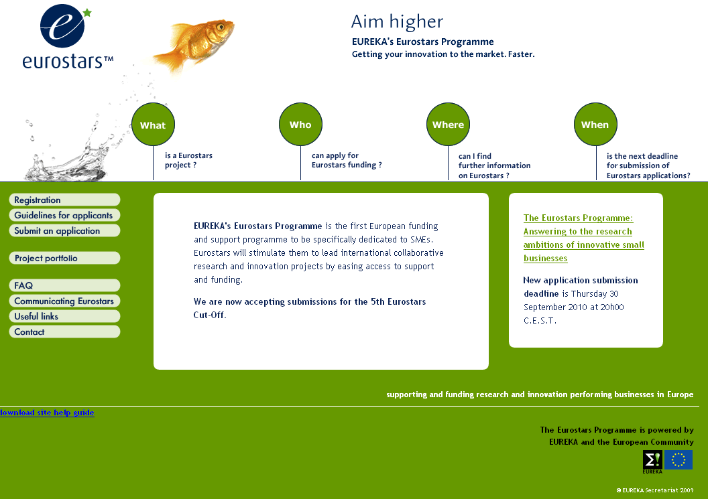
Information website > www.eurostars-eureka.eu

Slide 9
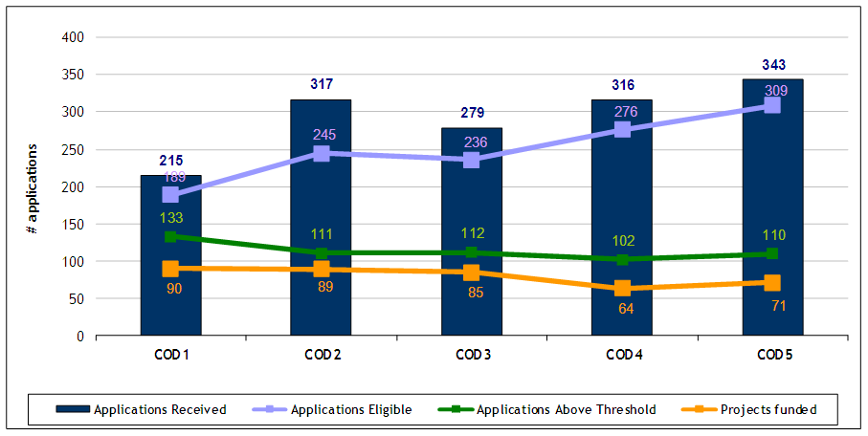
Eurostars Programme:
Application, Eligibility and Funding

Slide 10
Thank you for your listening
Svatopluk Halada
EUREKA Secretariat
rue Neerveld 107, B-1200 Brussels
svatopluk.halada@eurekanetwork.org
www.eurekanetwork.org
www.eurostars-eureka.eu

