Slide 1
Steering Platform on Research for Western Balkan Countries
12th December 2013, Zagreb, Croatia
Knowledge and technology transfer:
Modernization of WBC universities through strengthening of structures and services for knowledge transfer, research and innovation
Prof. Dr Vesna Mandić
University of Kragujevac, Faculty of Engineering
mandic@kg.ac.rs

Slide 2
Project CV – basic information
Contract number 530213-TEMPUS-1-2012-1-RS-TEMPUS-JPHES
Project acronym WBCInno
Project name Modernization of WBC universities through strengthening of structures and services for knowledge transfer, research and innovation
Project duration 15th October 2012 – 14th October 2015
Programme TEMPUS IV, DG for Education and Culture
Thematic priority Higher education and society
Total cost of the project 766 094 €
Commission funding 689 484 €
Coordinator Prof. Dr. Vesna Mandic
University of Kragujevac
Jovana Cvijica bb
34000 Kragujevac, Serbia
e-mail: mandic@kg.ac.rs
tel. +381 34 501 201, fax. +381 34 501 901
www.wbc-inno.kg.ac.rs
wbc-inno@kg.ac.rs

Slide 3

Consortium
TUHH
UB
ZSI
TUG
UNS
UBL
UZ
BINS
ICBL
BITF
BSC
UKG
BIC
UP
INT
BIPG
UA

Slide 4
Priority and overall objective
The project is in compliance with TEMPUS IV objective "Higher education and society" and addresses regional prioritiy for Western Balkans, „Knowledge triangle of education, research and innovation“
The WBCInno project has an overarching aim to contribute to the modernization of WBC universities through the strengthening of their management structures and services for cooperation with the world of work in the areas of knowledge transfer, research and innovation.
It has as its ultimate goal the creation of strong entrepreneurial universities and innovative regions.

Slide 5
Specific objectives
To establish a University Innovation Platform (UIP) at five WBC universities for integration and focusing of innovation potential and for fostering technology transfer and commercialization, by M12
To reinforce existing and to establish new university structures and services in the areas of knowledge transfer, research and innovation, in line with UIP requirements, by M18
To support the development of Business Incubators and Science Technology Parks in the WBCs, through mobilizing university resources
To develop a methodology for innovation management and networking of different stakeholders from universities and busi-nesses, utilising collaborative software platform/tools, by M18
To facilitate the creativity of young people and involvement of public and private stakeholders in all modernization processes based on the Triple Helix model of cooperation

Slide 6
Main focus
To develop the University Innovation Platform …
…supported by collaborative software tool for innovation management…
…with the intention of gathering new ideas from university staff and students…
…and boosting knowledge transfer and commercialization of R&D results.
University structures and services will be developed and modernized for efficient support in the development of Business Incubators and Science Technological Parks in WBCs.

Slide 7
From CHALLENGES…
Traditional organization of WBC universities has created a fragmentation of resources, with the absence of agreed priorities and focus
There is no strategic innovation platform to provide the capitalizing of knowledge and research potential, or its coordination and mobilization to facilitate the development of an innovative region
Linkages with enterprises are sporadic and individual, since there is no university office or other mechanism which provides single-point of access to university services
There is no efficient web-based collaboration tool to facilitate the promotion of existing university resources and new ideas of students, or for matching them with financial facilitators

Slide 8

… To ACHIEVEMENTS
Regional University Innovation Platform
Five Business Support offices at WB universities
Five Catalogues of university innovation potential
Ten WB university units/centres reinforced
Regional development strategy for BIs and STPs
Sustainability strategy of WBC universities
Methodology for innovation management
Innovation management software platform (stage-gate)
Innovative Ideas Competition for students
25 dissemination and training events in WBCs
Increased number of start-ups, spin-offs, and new projects/services/businesses
Enhanced innovation culture within scientific community
Increased number of students/researchers demonstrating entrepreneurial spirit
2013
2014
2015

Slide 9

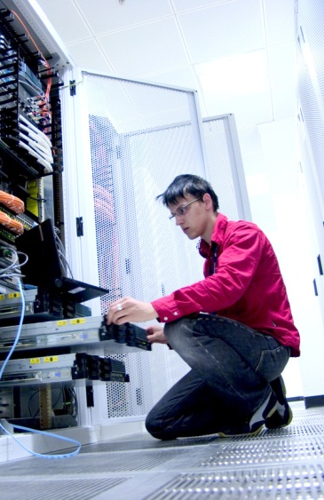


Impact
WBCInno is designed to have an ongoing and sustained impact on the region and multiplier effects for the universities and BIs/STPs, as follows:
Forming an innovation culture within the scientific community and boosting entrepreneurial spirit
Students can promote their ideas, resulting in new business streams and an increased number of start up companies
Researchers will have the opportunity to focus on research areas demanded by the market.

Slide 10



Impact (continued)
Investors will find new opportunities in a pool of fresh ideas, precisely evaluating prospects, and abandon poor projects early
BI/STP management can find innovative new businesses, thus creating new jobs
An ever improving culture of university/company collaboration
Increasing levels of employment within the region

Slide 11

Some results and achievements until now

Slide 12

Knowledge And Technology Transfer Between Science And Businesses - Report on Academic KTT Offices’ Experience And EU Good Practice
TUG | TUG (R&T House) TU Delft (Valorization Centre)
TUHH | Fundación Zaragoza Logistics Center Politecnico di Milano (Servizio Valorizzazione Ricerca) Hamburg University of Technology (TuTech Innovation GmbH)
UA | University of Alicante (Oficina de Transferencia de Resultados de Investigación)
UB | University of Brighton (Centre for Collaboration and Partnership) University of the West of England, Bristol (Faculty of Environment & Technology) University of Wales (Global Academy)
ZSI | TU Vienna (Research and Transfer Support) University of Vienna (DLE Research Services and Career Development)

Slide 13
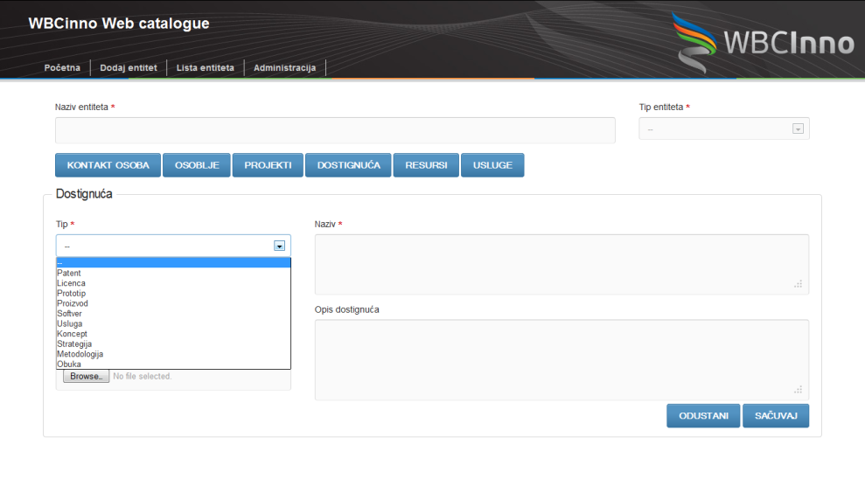
Mapping of universities' innovation potential
Methodology for mapping of universities’ innovation potential with Questionnaire
5 Catalogues of WBC universities with presentation of 108 RTDI units&teams
HTML catalogue – web publishing of collected data, browsing and easy preparing different reports
Presentation of:
  valuable research results,
  developed technologies,
  software,
  patents and licences,
  specific methodologies,
  trainings,
  commercial services,
  laboratory tests

Slide 14



Mapping of universities' innovation potential
Catalogues on Research and Innovation potential
University of Kragujevac, Serbia
University of Novi Sad, Serbia
University of Montenegro, Montenegro
University of Banja Luka, Bosnia & Herzegovina
University of Zenica, Bosnia & Herzegovina
108
RTDI units presented

Slide 15
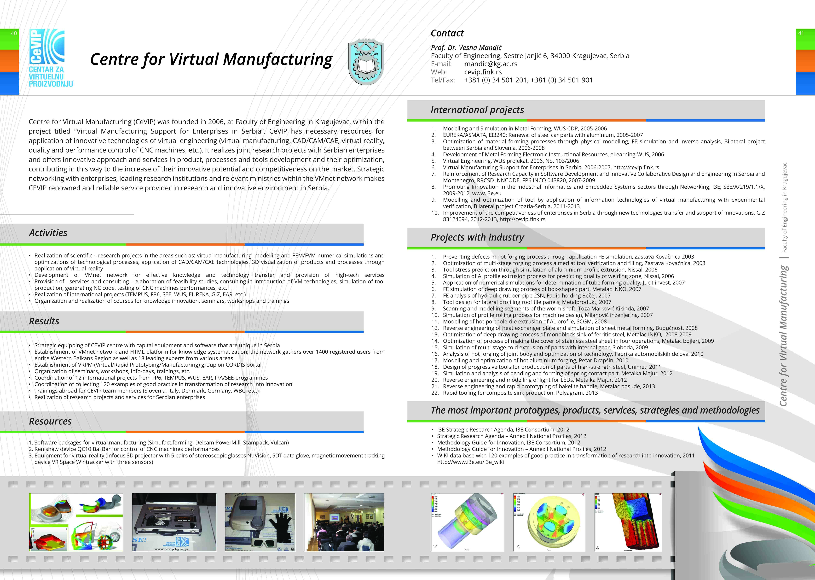
Mapping of universities' innovation potential
Catalogues on Research and Innovation potential

Slide 16
Benchmarking assessment of existing university structures and services in the areas of knowledge transfer, research and innovation
Benchmarking metrics defined
  - Metrics for Investment in Knowledge Transfer, Innovation and Research
  - Metrics for Knowledge Transfer through Co-operation
  - Metrics for Knowledge Transfer through Exploitation or Commercialization of Research Results
  - Metrics for Knowledge Transfer through People
Questionnaire for benchmarking assessment and interview questions developed
Five reports (UKG, UNS, UBL, UM, UZ) with set of recommendations prepared by UB, TUG, UA, ZSI and TUHH

Slide 17
Five Bussines Support Offices (Kragujevac, Novi Sad, Banja Luka, Zenica, Podgorica)
collating the data ont research and innovation potential of university
promoting the university research and services using and updating the Catalogue on research and innovation potential of university
establishing and maintenance a resource database as HTML catalogue, with on-line browsing and preparing specific reports
providing a single-point of access to university resources, equipment, trainings, research findings, patents and licensing
developing partnerships with enterprises connecting researchers and students with business partners
supporting liaisons with business incubators and science and technolocal parks
encouraging students to creative thinking and articulating ideas;
maintenance of innovation management web-platform
joint market participation with other KTT university units
improvement of the university regulatory documents

Slide 18
TSNA and market analysis
TSNA questionnaires modified, adjusted
  Questionnaire for employees
  Questionnaire for employers
680 questionnaires collected in the field
TSNA statistical tool developed by UKG, excel files with predefined graphical presentations
TSNA statistical processing is ongoing by 10 WBC partners
TSNA reports completed
The university addresses and promotes primarily R&D collaboration / contract research projects and scientific/technical services.

Slide 19
Regional University Innovation Platform (UIP)
- at five WBC universities
- Introduction
- Review of Findings to Date
- Strategic measures and recommendations for establishment of Regional UIP
Defining of priority research areas by university, focusing on mapping results and identified needs of the region
Capitalizing of university knowledge and research potential
Assessment and efficiency monitoring of KTT modes through defined metrics
Commercialization of research results and their transformation in innovation
Efficient innovation management supported by collaborative software platform
Development of cooperation between universities and enterprises
Encouraging students/researchers to establish start-ups and spin-offs
Strengthening the university capacity to support the development of BIs and STPs

Slide 20
Regional Development Strategy for Business Incubators and Science Technology parks
1. Executive summary
2. Introduction
3. Trends in development of BIs/STPs in EU and in the world
4. Current state of BI/STP in WBC
  4.1 Introduction
  4.2 Benchmarking surveys of BIs/STPs metrics in WBC region within WBCInno project
  4.3 Perceived problems and challenges
5. Strategic goals and suggested measures
6. Next steps and implementation of strategy through institutional support

Slide 21
Regional Development Strategy for Business Incubators and Science Technology parks
5. Strategic goals and suggested measures
1. Improvement of organisational and financial framework of BIs/STPs
2. Infrastructure development that suited to meeting start-up and spin-off needs
3. Application of ICT tools and e-cloud platforms for improved communication and innovation management
4. Improvement of services for tenants of BIs/STPs
5. Application of new incubation models – virtual business incubators
6. Establishment of creative and entrepreneurial framework with schools and universities
7. Creation of mechanisms and structures for high-tech innovations in cooperation with universities and research centres
8. Organisation of competitions and awards for best business plans, best student’s/researcher’s ideas
9. Improving visibility, promotion and internationalization of BIs/STPs for their sustainable development
10. Networking among BIs and with STPs and universities on local, regional and EU level

Slide 22
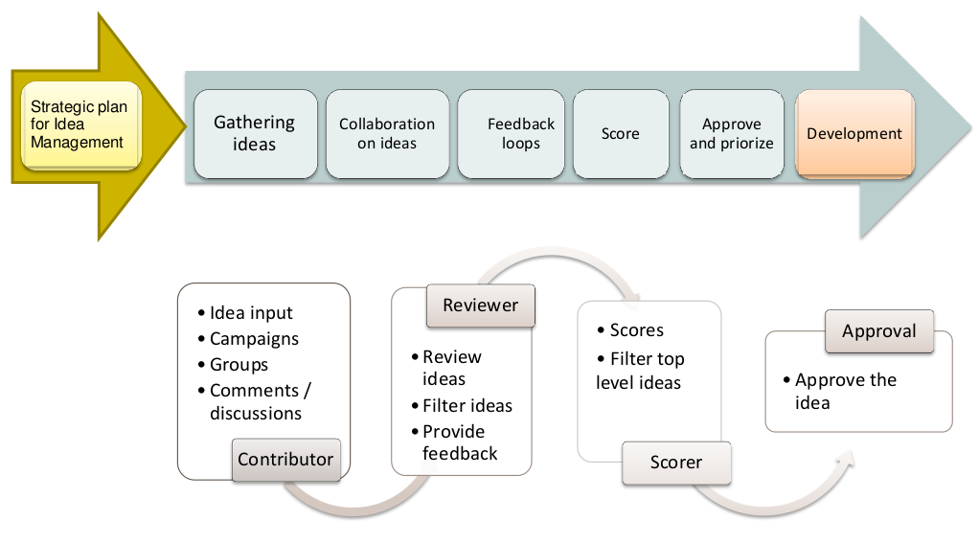
Methodology for Innovation Management at WBC universities
3. Innovation management techniques
4. Intelectual Property rights, types, EU and national legislation
5. Innovation cycle with financial tools
6. On-line collaborative Platform for Innovation management, based on gate-stage methodology

Slide 23
Thank you
for your attention
Prof. Dr Vesna Mandić
University of Kragujevac
mandic@kg.ac.rs

