Slide 1

CEI-PRAISE Framework Programme to Promote
Research, Technology Transfer and Innovation through Excellence in Science
First Stakeholders Workshop of Danube-INCO.NET:
Enhancing Synergies in Research and Innovation Programmes in the Region
Budapest, 8 June 2015
F
Presentation by Giorgio Rosso Cicogna
Special Advisor to CEI Secretary General
www.cei.int
…regional cooperation for European integration and bridge between macroregions…

Slide 2
Background of CEI-PRAISE Framework Programme
In September 2014, the CEI Ministerial Meeting for Science and Technology endorsed objectives and envisaged measures of CEI-PRAISE, a comprehensive Framework Programme to Promote Research, Technology Transfer and Innovation in all CEI Member Countries, through centres of excellence and advanced research groups expressing the best potential of their communities.
The Ministers also mandated the CEI Secretariat to establish a strong cooperation with the EC in order to ensure the most effective synergy with EU Strategies in this field, with similar on-going regional initiatives and with other efforts by CEI Member Countries.
CEI-PRAISE is built upon linking to other initiatives in the European dimension and it will complement on-going efforts, also through regional strategies, with specific purposes: • to increase and develop the stock of science and technology human capital through a cooperation targeted at excellence in research and smart specialization strategies; • to offer short/medium term opportunities to involve scientific communities in state of the art research, to facilitate their participation to Horizon 2020.
It is worth emphasizing here the concept that from CEI point of view a strong complementarity between CEI-PRAISE and WISE (as soon as it will be operational).

Slide 3
Players and Partnership within CEI-PRAISE
CEI-PRAISE is based on recognized strengths of 11 institutions belonging to the CEI Science and Technology Network, which are either international by statute, or Italian by statute and international by vocation. Most of them have decades of experience in international cooperation in physics, mathematics, geophysics, chemistry, biology, biotechnology, molecular medicine and other related fields/disciplines.
The CEI Network represents a unique interdisciplinary hub whose most advanced/state of the art infrastructures are traditionally open for collaboration with foreign scientists.
An example: CERIC Consortium based at Elettra Sincrotrone, established according to a new EU legislation, has already nine signatories among CEI Member Countries: more ERIC Consortia for research infrastructures in other fields may be promoted for disciplines as Hydro Meteorology/ Climate Change and Genetic Engineering/Biotechnology
CEI-PRAISE partnership as on 31 May 2015:
  80 confirmed partners to CEI-PRAISE in all CEI Member Countries
  Over 200 additional potential partners with experience in FP7 in all CEI Countries

Slide 4
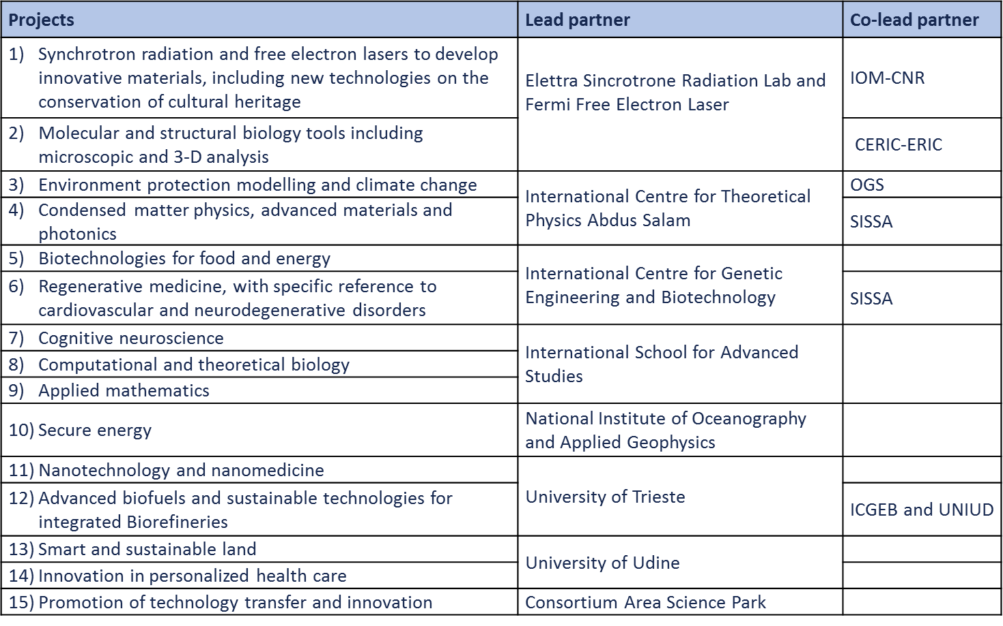
Interdisciplinary spectrum of projects in CEI-PRAISE

Slide 5
Activities for each of the 15 CEI-PRAISE Projects
Activities to be carried out for each of 15 projects implemented in the framework of CEI-PRAISE Programme: traditional activities for international cooperation in S&T, but all necessary to develop the existing human capital, also according to other regional initiatives, and in line with specific actions by the EC within Horizon 2020:
Cooperative and specific advanced research projects;
fellowships for graduate and post-graduate (doctoral) promising young talents in laboratories of the CEI S&T Network, of JRC in other countries;
grants to group leaders or other promising scientists to remain in (or return to) their home laboratories, in order to implement a specific CEI-PRAISE research;
grants for the organization of high level scientific events or aimed at supporting scientific travel to such events, as well as to scientific exchanges;
support to the consistent purchase of consumables, software, literature, etc;
support to e-learning, e-conferencing, e-tutoring, scientific podcasting, e-laboratory, etc. ;
activities related to technology transfer/ innovation always linked with 14 projects: participating scientists as tutors in order to establish long term relationship with industry.

Slide 6
Variable Geometry of CEI-PRAISE Funding
Various funding instruments, mostly –but not only- from EU sources, must be efficiently combined in view of the implementation of a unity of objectives, taking into account CEI own consolidated experience in project management of EU funded activities.
• EC funds will be utilized through a variable geometry, according to the respective eligibility of CEI Member Countries depending on their status vis-à-vis the EU: i.e. Horizon 2020, EU Structural Funds, IPA II, ENI, other.
• Overall cost for seven years (same duration of H2020) estimated in Euro 45 million: only an order of magnitude referred to the full potential of CEI-PRAISE, which has been drafted with a modular flexibility, in order to be implemented also with limited resources.
• Examples of on-going fundraising to support pilot activities:
CERES BIS fellowships managed by CEI within Marie Skłodowska-Curie Programme;
Cooperation Agreement under discussion with DG NEAR and DG R&I to be implemented with JRC with which CEI is establishing a strong cooperation;
Structural Funds (in cooperation with Governments of Member Countries);
Other EU Instruments to support scientific communities in less performing countries;
CEI own Cooperation Fund and Know-how Exchange Programme

Slide 7
Some Pilot Activities
Ad hoc workshops to promote specific Horizon 2020 Programmes: no contribution for travel and accommodation (!); 80 CEI-PRAISE confirmed partners plus 220 potential partner invited.
February 2015, promoting Twinning Programme in cooperation with EC: results
37 participants from 11 countries, (8 institutions from outside CEI region) plus CEI S&T Network
8 project proposals submitted,
€ 1 million to be expected for each successful project;
June 2015, promoting COST Actions in cooperation with COST Secretariat
30 participants, expected at least 15/20 proposals,
August 2015, promoting Marie Sklodowska-Curie individual fellowships:
“open house” of Centers in Trieste willing to host scientists from CEI countries,
Announcements about positions available in laboratories of the CEI S&T Network will be circulated soon to 80 CEI-PRAISE partners and other 220 potential partners;
September 2017, submitting again the CERES TWO proposal under Marie Sklodowska-Curie Program in order to host more researchers in institutions of the CEI S&T Network: the previous proposal was approved and ranked first among those which could not be financially supported due to unavailability of funds.

Slide 8
Pilot Activities (2)
CEI Know-how Exchange Programme
  2014, OGS, with Serbia, Albania, Montenegro: capacity building for future planning in efficient energy;
  2015 ongoing, CNR (Photonics and Nanotech Institute) with University of Niš: technology transfer for food packaging in controlled/secure atmosphere;
  2015 ongoing, Milano Politechnic with University of Novi Sad: development of new sensors to monitor air pollution;
  more…
CEI Cooperation Fund
  2015 March, CEI High Level Workshop on Advanced Biofuels, Biorefinery and Added Value Bio-byproducts held in Bratislava, in cooperation with EC-JRC, ICARST and University of SS. Cyril and Methodius in Trnava (85 participants): Slovak Government engaged to organize a follow up Conference under its EU Presidency in 2016;
  2015 July, ICGEB High Level Workshop on DNA tumor virus;
  other events: Academy of Science of Belarus (on Applied Mathematics); University of Novi Sad (on Logics and Applications); University of Padova (European Symposium on Plasma Chemistry);
  more…

Slide 9
CEI Participation in EU funded S&T Projects
Establishing the Secretariat as the focal point for Member Countries vs. European Commission, CEI is participating in three relevant FP7 projects in the field of renewable energy. These partnerships in high level European consortia are instrumental to build political and public awareness through direct contacts with governments, public institutions, scientific and business communities at all levels.
S2BIOM, on cost efficient supply chain for optimized use of non food biomass;
EBTP-SABS, on support of european biofuels technology platform;
DR-INCO.NET on R&D to meet societal challenges of energy efficiency and renewable energy in a Bio-based economy in the Danube Region. Through this project, CEI is also committed toward the development of joint funding mechanisms contributing directly to one of the most important milestones of the EUSDR for this priority area: namely the establishment of the Danube Region Research and Innovation Fund. In this context, the experience already acquired and a role of regional Focal Point for the new Public Private Partnership in this field could provide a strategic support to CEI Member Countries.

Slide 10
Envisaged Steady-State Governance
Project Committee, each of them under the responsibility of a Project Leader belonging to the lead institution(s) of the CEI S&T Network, with the participation of centers/groups involved in CEI Member Countries will define and coordinate the scientific activities of the respective project, meeting at least twice a year (distance conferencing as often as necessary): in other words, scientific management is delegated to a large extent to participating scientists.
Advisory Committee will support the overall implementation of CEI-PRAISE, meeting once a year, chaired by CEI Secretary General or his/her Delegate:
  CEI National Focal Points for Science and Technology;
  representatives of CEI Science and Technology Network;
  a few independent experts nominated by CEI upon proposals from the scientific community.
Executive Committee, with a maximum of 7 members nominated for two years from the Advisory Committee (renewable) will ensure the support to the actual management.
CEI Secretariat, responsible for overall management, promotion, fundraising and reporting.

Slide 11
Conclusion
CEI-PRAISE Framework Programme is not a traditional kind of Programme with an established allocation of financial resources. It is rather a container of experience, competences and project ideas, all of which may be realistically implemented by applying existing instruments through a variable geometry according to the eligibility of the recipients.
CEI-PRAISE is a Programme with a long term perspective, which will be managed by scientists to upgrade the performance of the CEI scientific communities and their participation to Horizon 2020: following an innovative approach concerning funding and actual implementation of scientific activities.
The CEI Secretariat and the CEI Science and Technology Network have started the implementation of pilot activities in the framework of CEI-PRAISE, in partnership with almost eighty institutions in CEI Member Countries. The support of all stakeholders is essential, specifically for fundraising: we are active in promoting CEI-PRAISE with the European Commission and supporting pilot activities with our own financial instruments (CEI Cooperation Fund, CEI Know-How Exchange Programme) and other resources which may be available.

Slide 12

CEI-PRAISE Programme is not in competition with other instruments to promote Science, Technology Transfer and Innovation: its resources are totally dedicated to the direct support of the Scientific Communities of CEI Member Countries: thus, by definition, CEI-PRAISE is complementary to other efforts and commitments by CEI Member Countries and Regional Institutions!
MANY THANKS FOR YOUR KIND ATTENTION!
Giorgio Rosso Cicogna
Special Advisor to CEI Secretary General
EMAIL: asg@cei.int
CEI-PRAISE PROGRAMME: PRAISE@cei.int
Notes:
12

