Slide 1
Open Access in a European Policy Context
Workshop on Enlargement countries for Research and Innovation
Brussels, 10-11 March 2016
Daniel Spichtinger, Senior Policy Officer
European Commission, DG RTD, A.6. daniel.spichtinger@ec.europa.eu

Slide 2
What is Open Access (OA)?
OA = online access at no charge to the user
  to peer-reviewed scientific publications
  to research data
Two main OA publishing business models
  Self-archiving: deposit of manuscripts & immediate/delayed OA provided by author ("Green OA")
  OA publishing: costs covered & immediate OA provided by publisher ("Gold OA")
  What OA is NOT
  Not an obligation to publish
  Not at odds with patenting
  OA publications go the same peer review process

Slide 3
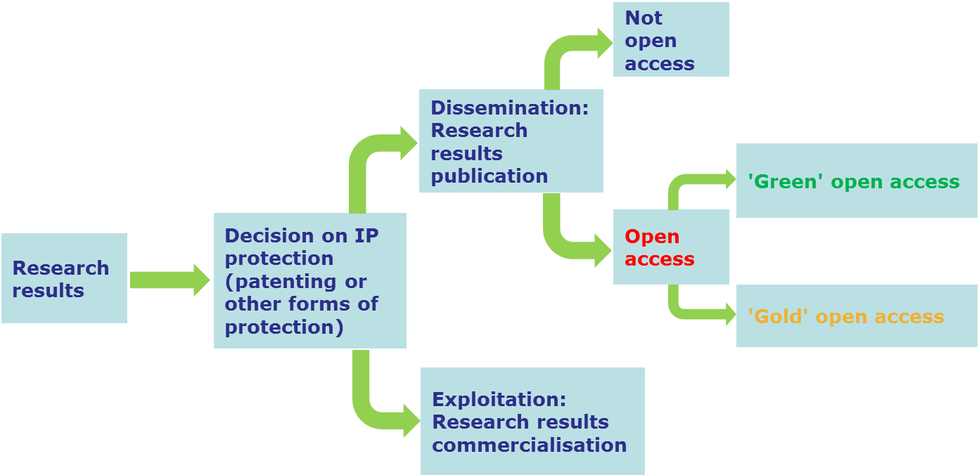
Dissemination and exploitation

Slide 4
The Commission objective
Optimise the impact of publicly-funded scientific research
  At European level (FP7 & Horizon 2020)
  At Member State level
One way to get there: open access
Expected benefits:
  Better and more efficient science
  Economic growth
  Broader, faster, more transparent and equal access for the benefit of researchers, industry and citizens
… in the European Research Area and beyond

Slide 5

The European Commission is a...
Policy maker
  It proposes EU legislation & legislates with other EU institutions
  It invites Member States to act
Funding agency
  It sets its own access and dissemination rules for EC-funded research
Capacity builder
  It funds projects that support EC/EU policy
Policy developed jointly in DG RTD and CNECT, with input from the research family

Slide 6
Three key documents (16.07.2012)
Communication 'A reinforced European Research Area partnership for excellence and growth'
Communication 'Towards better access to scientific information: boosting the benefits of public investments in research'
Recommendation on access to and preservation of scientific information

Slide 7
Communication 'ERA'
The ERA is based on the internal market in which researchers, scientific knowledge and technology circulate freely
Five priority areas:
  More effective national research systems
  Optimal transnational cooperation and competition
  An open labour market for researchers
  Gender equality and gender mainstreaming in research
  Optimal circulation, access to and transfer of scientific knowledge (including digital ERA)

Slide 8
Communication 'ERA'
MS are invited to coordinate their policies on access to and preservation of scientific information
→ Recommendation on access to and preservation of scientific information (C(2012)4890)
SHO are invited to adopt and implement open access measures for publications and data resulting from publicly funded research
→ Signed Memorandum of Understanding with LERU, EARTO, EUA, NORDFORSK and Unilateral Statement by Science Europe and CESAR
The Commission will adopt establish open access to scientific publications as a general principle for all EU funded research projects in Horizon 2020. For research data the EC will develop a flexible approach that takes into account different scientific areas and business related interests. The Commission will continue to fund projects related to open access
→ Communication 'Towards better access to scientific information', COM(2012)401

Slide 9
Open access policies across the EU (I)
NPR report: based on 2012 Recommendation and assorted reporting mechanism (the National Points of Reference for scientific information)
open access to scientific peer-reviewed publications
most EU Member States reported a national preference for one of the two types of open access,
Preference for the Green model: Belgium, Cyprus, Denmark, Estonia, Greece, Ireland, Lithuania, Malta, Norway, Portugal, Slovakia and Spain.
Preference for the Gold model: Hungary, the Netherlands, Romania, Sweden and the United Kingdom.
Other Member States support both models equally, such as Germany, France, Croatia, Italy, Luxembourg, Poland and Finland.
However, there is generally a system of predominance of one model with the possibility of using the other model, so a mixture of both routes results.
In most cases based on soft-law, not national legislation

Slide 10
Open access policies across the EU (II)
open access to research data
policies less developed across EU countries than for OA to publications. However, general acknowledgement of the importance of open research data
little or no open access to research data policies in place and no plan for a more developed policy in the near future:
Cyprus, Latvia, Luxembourg, Malta, Poland.
little or no open access to research data policies in place, but some plans in place or under development:
Austria, Belgium, Croatia, Czech Republic, Estonia, Hungary, Italy, Portugal, Romania, Slovakia, Sweden, Turkey.
Open access policies/institutional strategies or subject-based initiatives for research data already in place:
Denmark, Finland, France, Germany, Ireland, Lithuania, the Netherlands, Norway, Slovenia, the United Kingdom.

Slide 11

Open Access in Horizon 2020

Slide 12
From FP7 to H2020: OA to publications
From a pilot to underlying principle!
FP7
  Green open access pilot in 7 areas of FP7 with 'best effort' stipulation
  Allowed embargoes: 6/12m Gold open access costs eligible for reimbursement as part of the project budget while the project runs
Horizon 2020
  Obligation to provide OA, either through the Green or Gold way in all areas (deposition mandatory either way)
  Allowed embargoes: 6/12m Gold open access costs eligible for reimbursement as part of the project budget while the project runs & post-grant support being piloted through OpenAIRE
  Authors encouraged to retain copyright and grant licences instead

Slide 13
EC (II): OA to research data
FP7
  No action (ERC guidelines)
Horizon 2020
  A flexible pilot, covering selected areas of Horizon 2020
  Targeted primarily towards data underlying publications (other data as specified in DMP)
  Opt outs are possible for IPR, confidentiality/privacy and security reason as well as if OA runs against the main objective of the project
  Voluntary opt ins (in areas not covered by the pilot) are possible on an individual project basis.
  a Data Management Plan is obligatory for projects participating in the pilot (optional for others), to be created within the first six months of the project

Slide 14
Open Research Data Pilot in H2020 (I)
Areas of the 2016-2017 Work Programme participating in the Open Research Data Pilot are:
  Future and Emerging Technologies
  Research infrastructures – (new: coverage of the whole area)
  Leadership in enabling and industrial technologies – Information and Communication Technologies
  Nanotechnologies, Advanced Materials, Advanced Manufacturing and Processing, and Biotechnology: ‘nanosafety’ and ‘modelling’ topics (new)
  Societal Challenge: Food security, sustainable agriculture and forestry, marine and maritime and inland water research and the bioeconomy - selected topics as specified in the work programme (new)

Slide 15
Open Research Data Pilot in H2020 (II)
Cont'
  Societal Challenge: Climate Action, Environment, Resource Efficiency and Raw materials – except raw materials
  Societal Challenge: Europe in a changing world – inclusive, innovative and reflective Societies
  Science with and for Society
  Cross-cutting activities - focus areas – part Smart and Sustainable Cities (moved from Energy WP)
Projects in other areas are encouraged to participate on a voluntary basis!

Slide 16
Ongoing coordination and support actions (H2020 funded)
  PASTEUR4OA (Open Access Policy Alignment Strategies for European Union Research) Started 2014
  FOSTER (Foster Open Science Training for European Research) Started 2014
RECODE - (Policy Recommendations for Open Access to Research Data in Europe) – 2013, finishing
OpenAIRE supporting the implementation of Open Access in Europe (publications and data)
Infrastructure projects (with OA components), e.g. GEO/GEOSS, ELIXIR, EUDAT, CLARIN etc…

Slide 17

We welcome your input!
Contact us
Mail: RTD-open-access@ec.europa.eu
Web: http://ec.europa.eu/research/openscience/index.cfm
Twitter: @OpenAccessEC
Ressources
OpenAIRE: https://www.openaire.eu/
EC Central Library: http://www.netvibes.com/open-access
Public consultation: http://scienceintransition.eu
Study to measure growth of OA: http://science-metrix.com/en/publications/reports
NEW NPR report
https://ec.europa.eu/research/openscience/pdf/openaccess/npr_report.pdf#view=fit&pagemode=none
NEW H2020 guidance updated on the portal:
http://ec.europa.eu/research/participants/docs/h2020-funding-guide/cross-cutting-issues/open-access-dissemination_en.htm

