Slide 1
Open Innovation
- latest developments
Tuomas Nousiainen
Open Innovation unit
European Commission
Research & Innovation

Slide 2
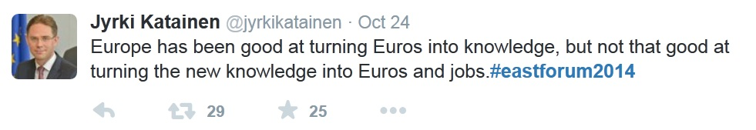
Jyrki Katainen
Vice-President
Jobs, Growth, Investment and Competitiveness

Slide 3
Carlos Moedas
Commissioner for Research, Science and Innovation
        "We are moving into a world of open innovation and user innovation. A world where the digital and physical are coming together. A world where new knowledge is created through global collaborations involving thousands of people from across the world and from all walks of life."
"Open innovation is about involving far more actors in the innovation process, from researchers, to entrepreneurs, to users, to governments and civil society. We need open innovation to capitalise on the results of European research and innovation. This means creating the right ecosystems, increasing investment, and bringing more companies and regions into the knowledge economy."

Slide 4
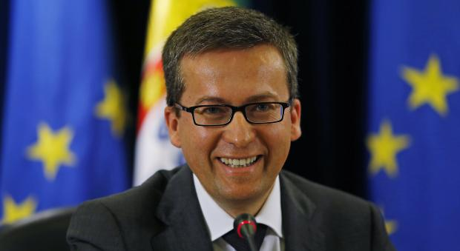
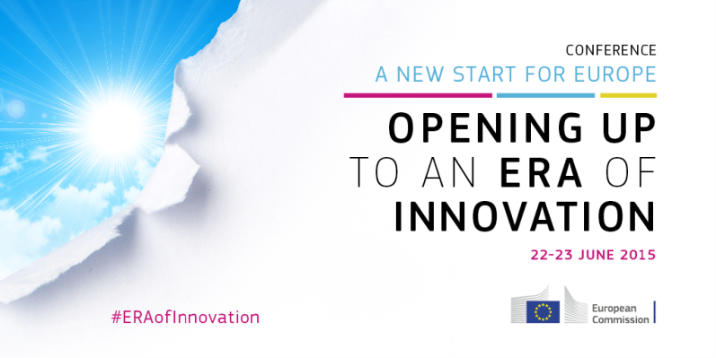
Commissioner Moedas' 3 strategic priorities for R&I policy
'Open innovation'
'Open science'
'Openness to the world'
Priorities presented at the Conference 'Opening up to an ERA of Innovation', 22-23 June 2015

Slide 6
Open Innovation – impact from research
Open Innovation was defined as the use of purposive inflows and outflows of knowledge to accelerate internal innovation, and expand the markets for external use of innovation, respectively (Chesbrough, 2003).
The European Commission DG RTD uses a definition of Open Innovation characterised by:
  the combined power of ideas and knowledge from different actors (whether private, public or third sector) to co-create new products and find solutions to societal needs;
  the creation of shared economic and social value, including a citizen and user-centric approach;
  the implications of mega-trends such as digitisation, mass participation and collaboration, and sustainability.

Slide 7
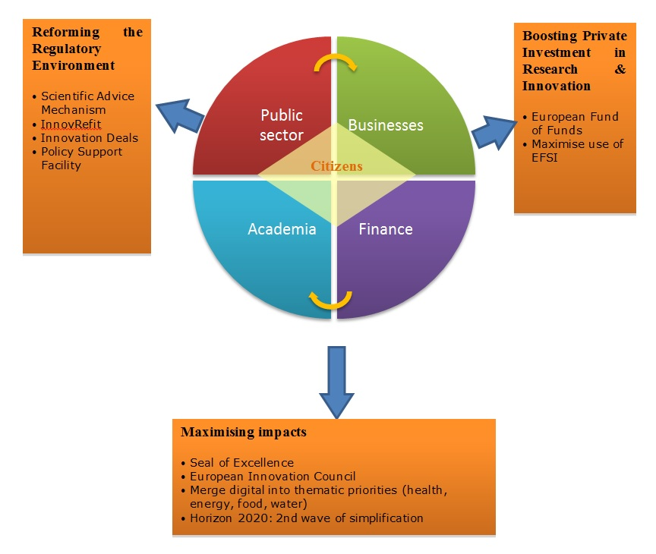
Ecosystem – pillars for action

Slide 8
Pillars for action
1) Reforming the Regulatory Environment;
This pillar is about ensuring that framework conditions are appropriate and regulation is not an obstacle to innovation and that, whenever possible, it favours it. In order to do so, it is essential to identify the ways in which regulation is affecting all elements of the eco-system and their interactions. E.g. Scientific Advice Mechanism, Tech refit/InnovRefit/RegulationBeta/Innovation Investment Deals, Policy Support Facility.
2) Boosting Private Investment in Research & Innovation;
This pillar is about ensuring access to finance for innovative ideas. It shows how it is possible to take action so as to bring different actors of the eco-system together in order to tackle this challenge through dedicated tools and policies. E.g. Fund of Funds, Maximising the use of EFSI.
3) Maximising impacts.
In order to maximise the impact of the policies and R&I programmes (including Horizon 2020), it is essential to boost the creation of an environment where all actors involved in the innovation process can interact and knowledge can circulate purposefully. E.g. Seal of excellence, European Innovation Council, Second wave of simplification in Horizon.

Slide 9
Designing a
European
Innovation Council:

Slide 10
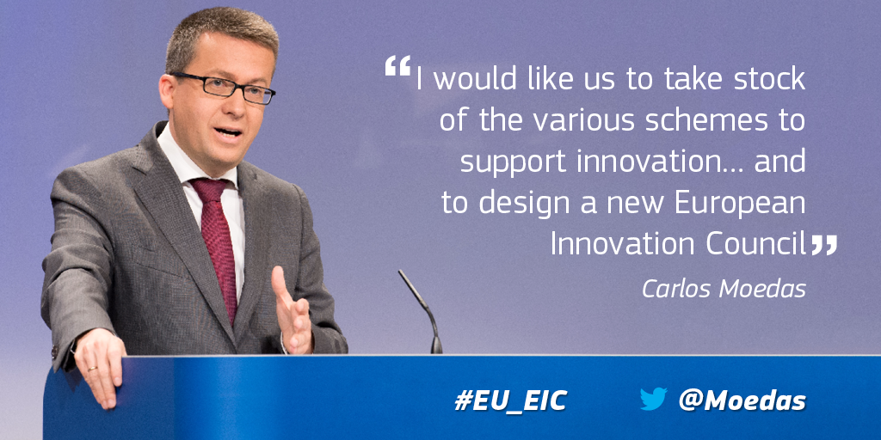
"Europe has excellent science, but we lack disruptive market-creating innovation. This is what is needed to turn our best ideas into new jobs, businesses and opportunities."
Carlos Moedas,
European Commissioner for Research, Science and Innovation

Slide 11
The EU is making major efforts to boost innovation…
Boosting investment (Investment Plan, Capital Markets Union, venture capital Fund of Funds,…)
Improving regulation (Better Regulation, Scientific Advice …)
Strengthening markets (Digital Single Market, Single Market,…)
Funding research and innovation (Horizon 2020)
Building regional capacities (European Investment and Structural Funds)

Slide 12
… but is losing the race on scaling up disruptive, market-creating innovation
On scaling up:
  US: 101 Unicorns
  China: 36 Unicorns
  EU: 19 Unicorns
  Source: Fortune, 'The Unicorn list 2016'; 'Unicorns' are start-ups with a market value > $1 billion
On disruptive, market-creating innovation:
  Innovations that create new markets and jobs - not just improving existing products and services, not just tech (also business model, user based)
  Major new markets led by non-EU companies: Google, Apple, Facebook, Amazon, Alibaba, Tesla, Netflix etc.
  "It's the equivalent of being in 1920 with no car companies." David Galbraith, investor

Slide 13
Guiding principles for possible EU action
EU added value
  Critical mass for scaling up
  Competition for ideas
  Increasing impact from existing initiatives
Top quality & high visibility
  Learning from the success of the European Research Council
  Impact on jobs, growth and investment
Simple
  Responsive to the needs of innovators
  Easy to access

Slide 14
What could a European Innovation Council do?
  Bring together and simplify access to current EU innovation support?
  Fill gaps in current EU support for innovation (e.g. more support for 'scale-ups', mentoring, bridging the 'valley of death')?
  Provide strategic advice to improve innovation environments (e.g. on regulation, policies, practices)?
  ……?

Slide 15
Views received so far…
Strong interest in doing more at EU level for innovation and establishing a European Innovation Council
EU innovation support schemes considered to lack coherence and hard to navigate
Gaps in current support for disruptive innovation and scaling up
Support for a strategic champion for innovation at EU level
Go to ec.europa.eu/research/eic to see more of the views received so far.

Slide 16
A call for ideas :
  How can we overcome obstacles to disruptive innovation and scaling up in Europe?
  What can the EU do about it?
  How could we improve existing EU support for innovation?
  What could be the role and functions of a European Innovation Council?
  Share your ideas at:
http://ec.europa.eu/research/eic
Open until: 29 April 2016
For further information: EC-EIC-ideas@ec.europa.eu

Slide 17

Thank you!

