Slide 1
Western Balkan Countries participation in COST activities
Dr Ronald De Bruin, Director COST Association
Brussels, 23 September 2019

Slide 2
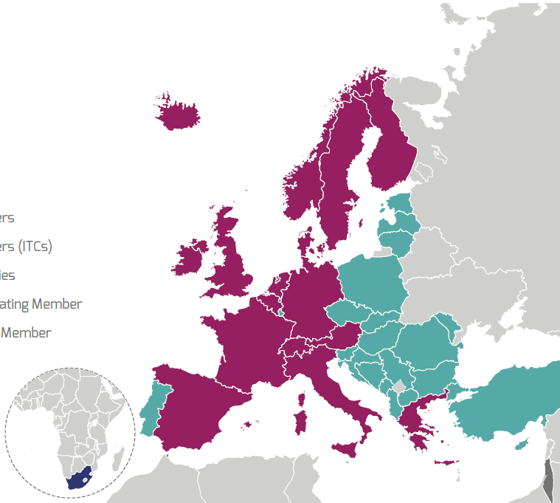
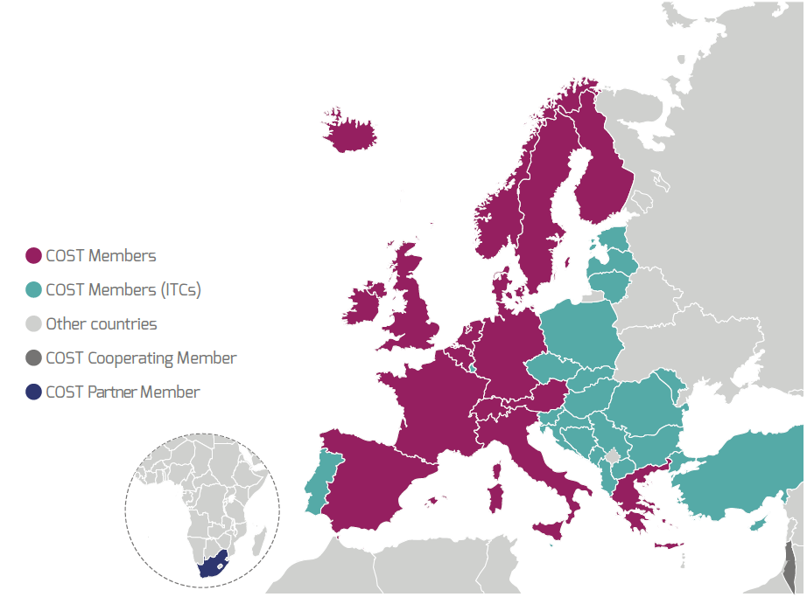
COST - 45 years proven track record in research collaboration
COST Members
  Albania, Austria, Belgium, Bosnia and Herzegovina, Bulgaria, Croatia, Cyprus, Czech Republic, Denmark, Estonia, Finland, France, Germany, Greece, Hungary, Iceland, Ireland, Italy, Latvia, Lithuania, Luxembourg, Malta, The Republic of Moldova, Montenegro, The Netherlands, The Republic of North Macedonia, Norway, Poland, Portugal, Romania, Serbia, Slovakia, Slovenia, Spain, Sweden, Switzerland, Turkey, and United Kingdom
Cooperating Member
  Israel
Partner Member
  South Africa
Near Neighbour Countries
  Algeria, Armenia, Azerbaijan, Belarus,
  Egypt, Georgia, Jordan, Kosovo*,
  Lebanon, Libya, Morocco, Palestine**,
  Russia, Syria, Tunisia and Ukraine
  *This designation is without prejudice to positions on status and is in line with UNSCR 1244/1999 and the ICJ Opinion on the Kosovo declaration of independence.
  **This designation shall not be construed as recognition of a State of Palestine and is without prejudice to the individual positions of the Member States on this issue.
COST Members
COST Members ITCs
Other Countries
COST Cooperating Member
COST Partner Member

Slide 3
COST activities’ involvement compared to the size of the research community

Slide 4
Participation in running Actions 2016-18 (%)
*This designation is without prejudice to positions on status, and is in line with UNSCR 1244 and the ICJ Opinion on the Kosovo declaration of independence.

Slide 5
