Slide 1
Based on the Commission Proposal for Horizon Europe, the common understanding between co-legislators and the Partial General Approach, both approved in April 2019

Slide 2
  Horizon Europe -
  Investing to shape our future

Slide 3

Our vision
A sustainable, fair and prosperous future for people and planet based on European values.
Tackling climate change
(35 % budgetary target)
Helping to achieve Sustainable
Development Goals
Boosting the Union's competitiveness and growth
Credits: https://www.un.org/sustainabledevelopment/sustainable-development-goals/
Notes:
Investing in research and innovation is investing in Europe’s future. It helps us to compete globally and preserve our unique social model and European way of life.
R&I improves the daily lives of millions of people here in Europe and around the world, helping to solve some of our biggest societal and generational challenges.
The Horizon Europe proposal significantly contributes to achieve the Commission's priorities and the global policy priorities.
This includes foremost the Sustainable Development Goals as well as the climate objectives in line with the Union's commitment to implement the Paris Agreement.
Regarding the latter the contribution expected from this programme is increased to 35% to reach the overall target of 25% of the Union expenditure.

Slide 4

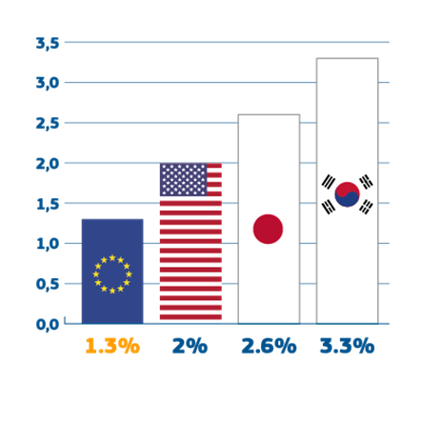
While benefiting from world–class research and strong industries…
Our knowledge and skills are our main resources.
7% of the world's population
20% of global R&D
1/3 of all high-quality scientific publications
→
→
→
…Europe can do better at transforming this into leadership in innovation and entrepreneurship
1.3%
EU business
R&D investment
Notes:
We are at the cusp of a new wave of innovation as a result of the convergence of digital technologies with the physical world. These innovations are already transforming our economies and redefining entire industries. Any economy in the world can only stay ahead of the competition if it stays at the frontier of cutting-edge research and innovation.
Countries around the world are investing massively on research and innovation in all areas of the economy and in particular in technologies that are set to dominate in the future. This is intensifying global competition and threatens the leading competitive position of Europe in key industrial sectors.
Facts:
The level of business R&D investment in Europe is at 1.3% of Gross Domestic Product (GDP) compared to 1.6% in China, 2% in the US, 2.6% in Japan and 3.3% in South Korea.
The EU is home to only 26 "Unicorn start-ups" whereas the US accounts 106 and China 59 (2017 December # of unicorns)
Venture Capital and the size of funds are too small: 20 % venture capital available in the EU compared to the US.
40% of workforce needs digital upskilling

Slide 5
Sibiu recommendations: Europe can shape its future through research and innovation
Focusing research and innovation on the ecological, social and economic transitions and related societal challenges
Leveraging Europe’s scientific strengths into leadership in breakthrough and disruptive innovation
Setting ambitious goals for issues that affect us daily, such as skills development, the fight against cancer, harmful emissions, and the state of the oceans, including plastics
Focusing on cutting-edge research and innovation projects spanning from research and innovation to deployment
Notes:
Commission recently contributed to the EU's next strategic agenda 2019-2024 by setting out policy recommendations as to how Europe can shape its future in an increasingly multipolar and uncertain world in the context of the informal meeting of the heads of state of government in Sibiu on 9 May.
The section on a “Competitive Europe” highlights the need to focus research and innovation on the ecological, social and economic transitions and related societal challenges. In addition:
· It underlines that we also need to leverage Europe’s scientific strengths into leadership in breakthrough and disruptive innovation. And this means EU-wide measures with ambitious goals for issues that affect us daily, such as skills development, the fight against cancer, harmful emissions, and the state of the oceans, including plastics.
· The text stresses that the EU, its Member States and industry should partner up to invest in projects and focus financial resources and skills on cutting-edge research and innovation projects spanning from resource and innovation to deployment.
· And it recalls that the Commission proposed to allocate €100 billion to research and innovation under the next EU budget. And that EU cohesion policy funds will mobilise similar amounts to support the innovation in all regions of Europe. The use of these funds should be closely aligned with our industrial policy and with reforms identified in the context of the European Semester of economic policy coordination.
· Moreover, the Communication highlights that a modern industrial policy will provide the necessary infrastructure, incentivise innovation, facilitate the uptake of new technologies, foster a smart regulatory ecosystem, and support industry at large.
The Communication recalls also that people’s general expectations of the EU can be grouped in seven big blocks, including one on issues surrounding the “dynamic economy” which involves people’s expectations that the EU should bring prosperity, to grow and regulate the technology sector to stay globally competitive. It underlines that people would like the Union to prioritise research, innovation and investment, with a special focus on the circular economy and on the digital economy.

Slide 6



Horizon Europe
The ambitious EU research and innovation framework programme (2021-2027)
  to strengthen the EU's scientific and technological bases and the European Research Area (ERA)
  to boost Europe's innovation capacity, competitiveness
  and jobs
  to deliver on citizens' priorities and sustain our socio-economic model and values
The Commission proposes a budget of € 100 billion for Horizon Europe.
Notes:
For the next long-term EU budget 2021-2027, the Commission proposes "Horizon Europe", an ambitious €100 billion research and innovation programme.
Building on the achievements of previous programmes, Horizon Europe will boost the scientific, economic and societal impact of EU funding, ultimately increasing the prosperity and well-being of Europeans.
A further EURO 4.1 billion are proposed to be allocated for defence research in a seperate proposal for a European Defence Fund.
Background Defence:
The Framework Programmes provides the legal base for a Specific Programme on defence research that is to be set up under the European Defence Fund. Consequently defence research will have an additional and separate budget and will be implemented with specific and separate rules and procedures under the European Defence Fund. [See Art. 5 of FP/RfP]
Synergies with the European Defence Fund will benefit civil and defence research. Unnecessary duplication will be excluded.

Slide 7
Added value through Horizon Europe:
Benefits for Europe
Trans-national collaboration, exchange and networks
Critical mass to address global challenges
Competitive funding promoting excellence
Transnational mobility
Creating new market opportunities
Visibility for leading research and innovation
Attracting the best talents
Strengthened European R&I landscape
Notes:
To address the challenges Europe is currently facing, the Union needs to invest in research and innovation.
Union-funded R&I activities produce demonstrable benefits compared to national and regional R&I support:
Actions at Union level enable trans-national collaboration and world-wide competition to ensure the best proposals are selected. This raises levels of excellence, and it provides visibility for leading R&I. This also supports trans-national mobility and attracts the best talents.
A Union-level programme is best placed to take on high-risk and long-term R&I. It can thus generate a breadth of scope and economies of scale that could not otherwise be achieved.

Slide 8
  Horizon Europe –
  Political agreement

Slide 9
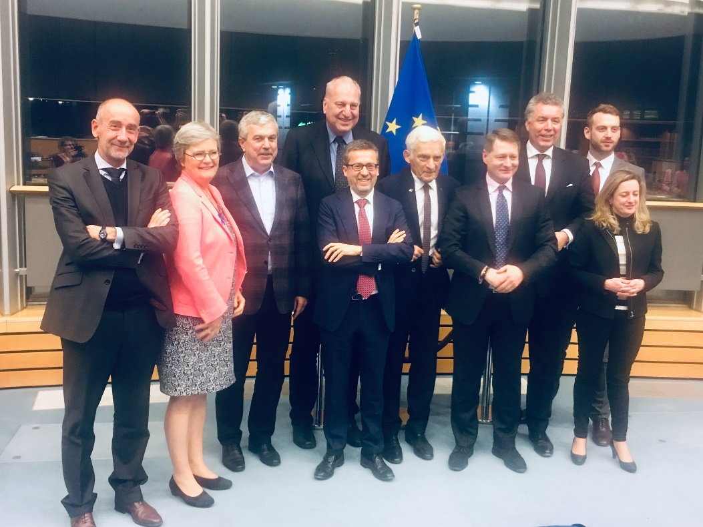
European Parliament and Council reached a common understanding on Horizon Europe on 19 March 2019
Budget, synergies and third country association still pending, depending on the overall MFF negotiations
Commission has started preparations for the implementation of Horizon Europe
Notes:
On 19 March the EU institutions have reached a partial common understanding on the Proposal for the Horizon Europe Framework Programme. The agreement was approved by the Council on a meeting of the Coreper 27 March for the Framework Programme and for the Specific Programme the partial general agreement (PGA) was adopted by the Council on 15 April. The Parliament approved the agreement at the plenary on 17 April 2019 – the last plenary before the parliamentary elections.
Photosource: Cmmr Moedas twitteraccount: https://twitter.com/Moedas/status/1108279722134392834
This agreement allows the Commission to start the preparations for the programme's launch on 1 January 2021
The picture shows the negotiators of the Council, Parliament and Commission after having reached the agreement at the European Parliament the last trilogue meeting in Brussels on 19 March.
From left to right:
Jean-Eric Paquet, Director General of RTD
Lieve Wierinck, shadow rapporteur, Group of the Alliance of Liberals and Democrats for Europe (European Parliament)
Dan Nica, rapporteur for Horizon Europe Framework Programme , Group of the Progressive Alliance of Socialists and Democrats (European Parliament)
Evžen Tošenovský, shadow rapporteur, European Conservatives and Reformists Group (European Parliament)
Carlos Moedas, Commissioner for R&I
Jerzy Buzek, Chair of ITRE Committee, Group of the European People's Party (European Parliament)
Cosmin Boiangiu, Deputy Permanent Representative, Romanian Presidency
Christian Ehler, rapporteur for Horizon Europe Specific Programme, Group of the European People's Party (European Parliament)
Jakop Dalunde, shadow rapporteur, Group of the Greens (European Parliament)
Soledad Cabezón Ruiz, shadow rapporteur, Group of the Progressive Alliance of Socialists and Democrats (European Parliament)

Slide 10



Horizon Europe: Preliminary structure
Pillar 1
Excellent Science
Pillar 2
Global Challenges and European Industrial Competitiveness
Pillar 3
Innovative Europe
European Research Council
Health
Culture, Creativity and Inclusive Society
Civil Security for Society
Digital, Industry and Space
Climate, Energy and Mobility
Food, Bioeconomy, Natural Resources, Agriculture and Environment
European Innovation Council
Marie Skłodowska-Curie Actions
Clusters
European innovation
ecosystems
European Institute of Innovation
and Technology
Research Infrastructures
Joint Research Centre
Widening Participation and Strengthening the European Research Area
Widening participation and spreading excellence
Reforming and Enhancing the European R&I system
Notes:
Horizon Europe is building on the success of Horizon 2020.
So Horizon Europe will keep three pillar structure, be based on excellence and maintain the tested funding rules and procedure of Horizon 2020.

Slide 11
Commission proposal for budget: €100 billion* (2021-2027)
* This envelope includes EUR 3.5 billion allocated under the InvestEU Fund.
Notes:
The proposed budget of €100 billion will make Horizon Europe the biggest EU research and innovation programme ever.
It is one of the few parts of the EU budget that the Commission proposes to increase. This increase to the current programme is 50% when taking into account the EU of 27 Member States.
The proposed €100 billion for 2021-2027 includes €2.4 billion for the Euratom research and training programme.
€3.5 billion will be allocated under the InvestEU Fund. The innovation window of InvestEU will provide loans, guarantees, equity and other market-based instruments in the order of € 11,5 billion to mobilise public and private investment in research and innovation.
[Hence the financial envelope for implementing Horizon Europe will be €94.1 billion.]
The budget will be determined as part of negotions related to the EU „budget“, the Multi-annual Financial Framework (MFF).
Please note that as the slide depicts the Commission proposal for the Horizon Europe budget, the titels of the pillars reflects the Commission Proposal:
Open Science = Excellent Science (Pillar 1)
Global Challenges & Industrial Competitiveness = Global Challenges and European Industrial Competitiveness (Pillar 2)
Open Innovation = Innovative Europe (Pillar 3)
Strengthening ERA = Widening Participation and Strenghtening the European Research Area
*€ 4.1 billion are proposed to be allocated for defence research, in a separate proposal for a European Defence Fund

Slide 12
  Horizon Europe – Central elements

Slide 13






Lessons Learned Key Novelties from Horizon 2020 Interim Evaluation in Horizon Europe
Support breakthrough innovation
European Innovation Council
Create more impact through mission-orientation and
citizens' involvement
R&I Missions
Strengthen international cooperation
Extended association possibilities
Reinforce openness
Open science policy
Rationalise the funding landscape
New approach to Partnerships
Encourage participation
Spreading Excellence
Notes:
For each of the novelties, the impact assessment (IA) assessed the expected impacts, risks and possible mitigation measures.
Response to cluster survey feeding into the Horizon Europe IA:
over 4000 responses and 300 position papers - 94% of all the respondents indicated that their responses referred to EU support for research and innovation.
[Note: the survey related to EU support for (i) Investment, (ii) research and innovation; (iii) SME and entrepreneurship, (iv) Single Market]
Various building blocks were taken into account in designing Horizon Europe, in particular
Interim Evaluation of Horizon 2020 with a broad stakeholder consultation triggering nearly 3500 replies and additional 300 position papers;
Report 'LAB – FAB – APP: Investing in the European future we want', by the High-Level Group chaired by Pascal Lamy;
Recommendations by the High-Level-Group of Innovators in the report 'Europe is back: Accelerating breakthrough innovation';
Report by Professor Mariana Mazzucato entitled “Mission-Oriented Research and Innovation in the European Union – A problem solving approach to fuel innovation-led growth”;
as well as foresight studies ( notably 'New Horizons: Future scenarios for research and innovations policies in Europe') and various other reports.

Slide 14

European Innovation Council
Support to innovations with breakthrough and disruptive nature and scale up potential that are too risky for private investors (70% of the budget earmarked for SMEs)
Helping innovators create markets of the future, leverage private finance, scale up their companies,
European Innovation Council – a one-stop-shop
Innovation centric, risk taking & agile, pro-active management and follow up
Two complementary instruments bridging the gap from idea to investable project
Pathfinder: grants
(from early technology
to pre- commercial)
Accelerator:
grants only & blended finance
(from pre-commercial
to market & scale-up)
Notes:
The EIC will offer a one-stop-shop to high-potential innovators. It will support them in bringing their disruptive innovation ideas to marketable solutions and help them scale up quickly into European or international champions.
The EIC will be implemented primarily through two instruments: the Pathfinder, implemented mainly through collaborative research, and the Accelerator.
EIC: focusing mainly on breakthrough and disruptive innovation, targeting especially market-creating innovation, while also supporting all types of innovation, including incremental”.
With the EIC, we are aiming to do for innovators what the ERC is doing for top researchers. For example, it will focus on individual entrepreneurs and companies, incentivise bottom-up ideas, and keep procedures simple.
The EIC will significantly simplify and streamline current support, and fill any gap between the grant funding in other parts of Horizon Europe and the financial instruments of InvestEU.
Areas of intervention:
Pathfinder, supporting future and emerging breakthrough technologies;
Accelerator, bridging the financing gap between late stages of innovation activities and market take-up, to effectively deploy breakthrough market-creating innovation and scale up companies where the market does not provide viable financing, providing innovative companies with grants (and possibly equity later on) or blended finance (combination of grant and equity, which will be the main use of the EIC Accelerator budget) and;
additional activities such as prizes and fellowships, and business added-value services (e.g. coaching).

Slide 15

R&I Missions
R&I Missions
Relating EU's research and innovation better
to society and citizens' needs; with strong visibility and impact
A mission is a portfolio of actions across disciplines intended to achieve a bold and inspirational and measurable goal within a set timeframe,
with impact for society and policy making as well as relevance for a significant part of the European population and wide range of European citizens.
Horizon Europe defines mission characteristics and elements of governance, and 5 missions areas.
Specific missions will be programmed within the Global Challenges and European Industrial Competitiveness pillar (drawing on inputs from other pillars)
Notes:
Missions will be designed in the context of a strategic planning process [see section 'How?'].
Missions (Art. 7(3) of FP/RfP) shall
have a clear EU-added value and contribute to reaching Union priorities;
be bold and inspirational, and hence have wide societal or economic relevance;
indicate a clear direction and be targeted, measurable and time-bound;
be centered on ambitious but realistic research and innovation activities;
spark activity across disciplines, sectors and actors;
be open to multiple, bottom-up solutions.
'FET Flagships : Activities carried out within the FET Flagships on Graphene, the Human Brain Project and Quantum Technology, which are supported under Horizon 2020, will continue being supported under Horizon Europe through calls for proposals included in the work programme. Preparatory actions supported under the FET Flagships part of Horizon 2020 will feed the Strategic Planning process under Horizon Europe and inform the work on missions, co-funded/co-programmed partnerships and regular calls for proposals

Slide 16





Adaptation to climate change, including societal transformation
Healthy oceans, seas, coastal and inland waters
Mission areas
Cancer
Climate-neutral and smart cities
Soil health and food
Notes:
EP and Council settles 5 areas for possible missions. The missions will be designed in the strategic planning process. The mission design will be spearheaded by the mission boards, one for each mission area. The mission boards, consisting of up to 15 members, will interact closely with Member States, Parliament and a wide range of stakeholders, in order to facilitate the co-design of missions. The mission boards will be set up through an open call for expression of interest in the summer 2019.
Art. 7 – 2a in the HE FP: “During the first three years of the programme, a maximum of 10% of the annual budget of Pillar II shall be programmed through specific calls for implementing the missions. For the remaining part of the programme, and only after a positive assessment of the mission selection and management process, this percentage may be increased. The Commission shall communicate the total budgetary share of each work programme dedicated to missions”.

Slide 17

New approach to European Partnerships
New generation of objective-driven and more ambitious partnerships in support of agreed EU policy objectives
Key features
  Simple architecture and toolbox
  Coherent life-cycle approach
  Strategic orientation
Co-programmed
Based on Memoranda of Understanding / contractual arrangements; implemented independently by the partners and by Horizon Europe
Co-funded
Based on a joint programme agreed and implemented by partners; commitment of partners for financial and in-kind contributions
Institutionalised
Based on long-term dimension and need for high integration; partnerships based on Articles 185 / 187 of TFEU and the EIT-Regulation supported by Horizon Europe
Notes:
Horizon Europe will take a new and more impact-focussed approach to partnerships.
The currently complex and fragmented partnership landscape will be rationalised so that partnerships can continue in a simplified and more transparent form, reach out to a broader set of stakeholders and establish better links with EU and national policies.
This approach aims at a consolidated and rationalised number of partnerships that avoid overlaps and duplication and that are better aligned with Union policy priorities. Horizon Europe will have three sorts of partnerships:
co-programmes (Memoranda of Understanding/contractual arrangements; implemented independently by the partners and by Horizon Europe),
co-funded (joint programme agreed by partners; commitment of partners for financial and in-kind contributions & financial contribution by Horizon Europe),
Institutionalised (long-term dimension and need for high integration; partnerships based on Articles 185 / 187 of TFEU and the EIT-Regulation supported by Horizon Europe).
Key features:
Simple architecture and toolbox: Rationalising the number of labels and instruments used and ensuring coherence and complementarity;
Coherent life-cycle approach: criteria framework, from their selection to implementation, monitoring, evaluation and phasing out;
Strategic orientation: Identification of new or renewed Partnerships is part of the Strategic Programming of Horizon Europe.
Common understanding: The majority of the budget in pillar II shall be allocated to actions outside of European partnerships

Slide 18
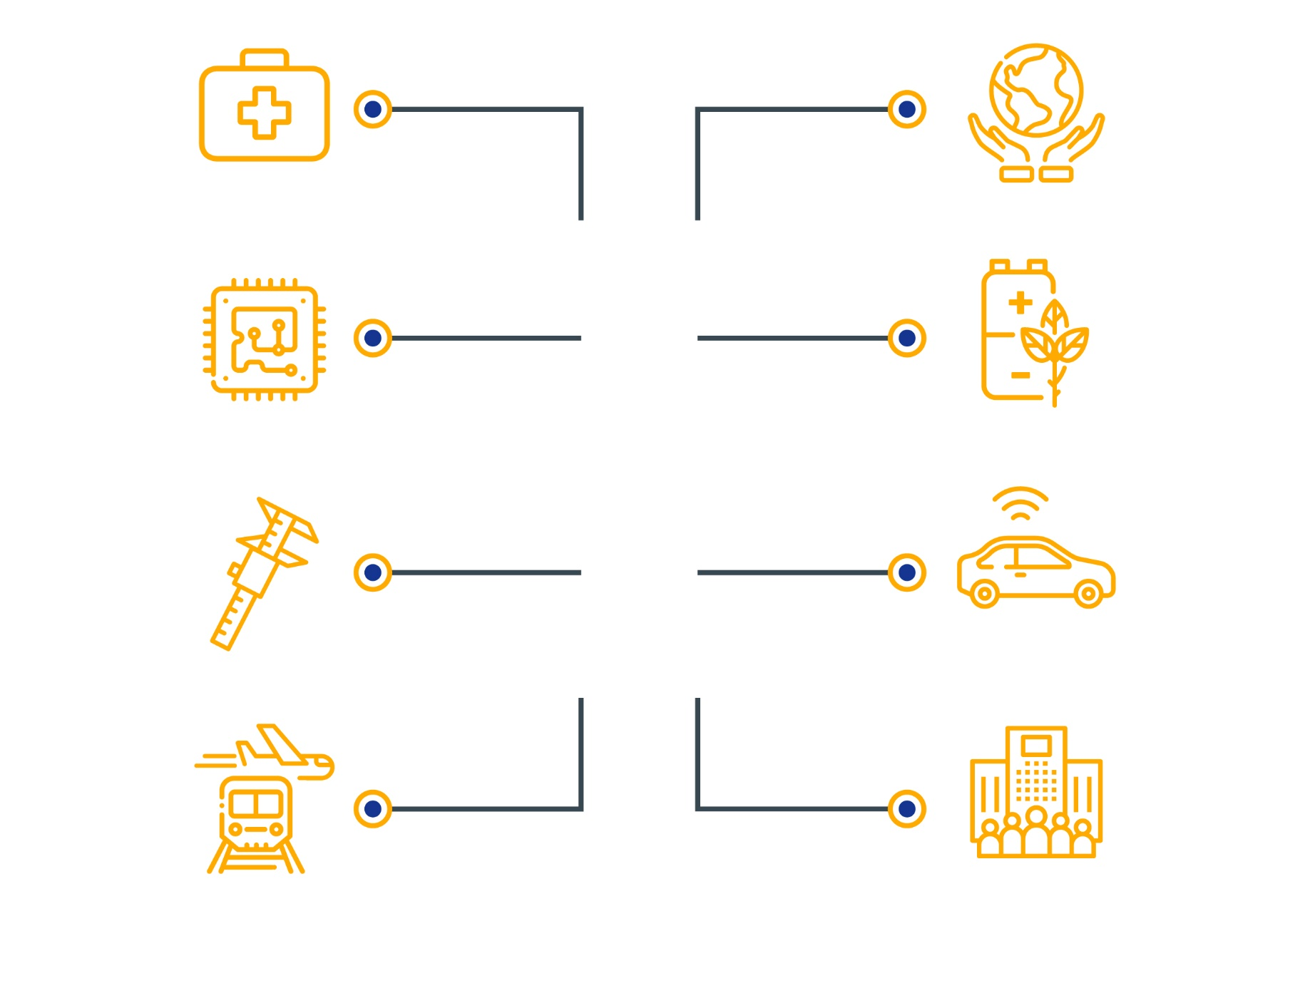
Sustainable bio-based solutions
Health innovations
Hydrogen and sustainable energy storage
Key digital and enabling technologies
Areas for
possible Institutionalised European partnerships
(based on Article 185/7 TFEU)
Clean, connected mobility
Metrology
EU air
traffic, aviation
and rail
Innovative SMEs
Notes:
Horizon Europe will take a more impact-focussed approach to partnership with three sorts:
co-programme (Memoranda of Understanding/contractual arrangements; implemented independently by the partners and by Horizon Europe),
co-funded (joint programme agreed by partners; commitment of partners for financial and in-kind contributions & financial contribution by Horizon Europe),
Institutionalised (long-term dimension and need for high integration; partnerships based on Articles 185 / 187 of TFEU and the EIT-Regulation supported by Horizon Europe).
The fragmented partnership landscape will be rationalised so that partnerships can continue in a simplified and more transparent form. They will reach out to a broader set of stakeholders and establish better links with EU and national policies.
The majority of the budget in pillar II shall be allocated to actions outside of European partnerships.
Partnership features:
Simple architecture and toolbox: rationalising the number of labels and instruments, coherence and complementarity;
Life-cycle approach: criteria framework, from their selection to implementation, monitoring, evaluation and phasing out;
Strategic orientation: Identification of new or renewed Partnerships is part of the Strategic Programming of Horizon Europe.
Full titles:
Partnership Area 1: Faster development and safer use of health innovations for European patients, and global health.
2: Advancing key digital and enabling technologies and their use, including but not limited to novel technologies such as Artificial Intelligence, photonics and quantum technologies.
3: European leadership in Metrology including an integrated Metrology system.
4: Accelerate competitiveness, safety and environmental performance of EU air traffic, aviation and rail.
5: Sustainable, inclusive and circular bio-based solutions.
6: Hydrogen and sustainable energy storage technologies with lower environmental footprint and less energy-intensive production.
7: Clean, connected, cooperative, autonomous and automated solutions for future mobility demands of people and goods.
8: Innovative and R&D intensive small and medium-sized enterprises.

Slide 19

International Cooperation
International
Cooperation
Tackling together global societal challenges; access to the world's best talents, expertise and resources; enhanced supply and demand of innovative solutions
Extended openness to association
Third countries with good capacity in science, technology and innovation
Taking into account objective of driving economic growth in Europe
through innovation
General opening for international participation
Intensified targeted actions
(flagship initiatives, joint calls, etc.)
Notes:
Horizon Europe will intensify its openness to the world while safeguarding Union interest.
Maintaining the general opening for international participation, the programme will also provide for launching targeted actions of unprecedented scale to pursue strategic international cooperation in line with EU priorities and with the strategy for EU international cooperation in R&I.
As in Horizon 2020, international cooperation in Horizon Europe shall be based on common interest and mutual benefit. The programme will invite partners from across the world to join EU efforts for tackling global challenges and contributing to achieve the Sustainable Development Goals (SDGs) while ensuring the interests of the Union.
The programme will extend openness to association of third countries with good STI capacity, taking account of the aim to drive EU economic growth though innovation and striving for reciprocity. [Art. 12 FP/RfP]
The extended scope for association of third countries has led to the introduction of a safeguard of the EU nature in the form of requiring at least one Member State participant in any collaborative action. [Art. 18(2)]
Safeguards for ensuring EU interest include also provisions to restrict participation in specific actions related to EU strategic assets, interests, autonomy or security [Art. 18(5)], and requirements for case by case justification for funding of non-associated third countries, as well as requirements for best efforts to exploit results in particular in the EU while recognising that exploitation in a third country can also be in the Union interest, e.g. for solutions to climate change or to infectious diseases. Art. 35 (1)&(6)]
“Please note that Article 12 on third countries associated to the programme and Article 19 on entities eligible for funding have yet to be agreed between the Co-legislators

Slide 20

Open Science across the programme
Open Science
Better dissemination and exploitation of R&I results and support to active engagement of society
Mandatory Open Access to publications: beneficiaries shall ensure that they or the authors retain sufficient intellectual property rights to comply with open access requirements
Open Access to research data ensured: in line with the principle "as open as possible, as closed as necessary"; Mandatory Data Management Plan for FAIR (Findable, Accessible, Interoperable, Re-usable) and Open Research Data
Support to researcher skills and reward systems for open science
Use of European Open Science Cloud
Notes:
The principle of open science will become the modus operandi across the whole programme.
Open access to publications will be, as in H2020, mandatory. Beneficiaries are required to ensure that they or authors retain sufficient intellectual property rights to be able to comply with the requirement. This change shifts the responsibility for compliance to institutions and empowers them and the authors at the same time to manage outputs.
FAIR and Open data will be the rule (exceptions to the latter are provisioned as with H2020). Data management plans are required for all projects generating data with no exceptions; solid data management will be encouraged across the programme.
Further open science practices are planned to be mainstreamed through requirements in work programmes as appropriate. The use of the European Open Science Cloud, the federation of European data infrastructures will become mandatory in certain work programmes, for the storage and reuse of research data.
Horizon Europe will include activities that enhance researchers’ skills in open science and support reward systems that promote open science. It will in practice support the deployment of a broader and responsible set of indicators for the assessment of research. Finally, it will support research integrity and citizen science.
[See FP/RfP Articles 10 and 35]

Slide 21


Widening participation/spreading excellence
National Contact Point (NCP)
Support
Pre-proposal checks
15 Member States and 9 outermost regions eligible for coordinators
At least 3.3% budget
Recognition of participation
EXCELLENCE
Foster participation
Facilitate collaborative links
Contribute to reducing R&I divide
Match-making
Hop-on
Excellence initiatives
Brain circulation
Teaming
Twinning
ERA-Chairs
COST
Notes:
[On widening]
Building on the Commission's proposal the co-legislators agreed that the budget for widening measures should be at least 3.3% of the overall Horizon Europe budget. They also fixed a list of Member States eligible as coordinators under this Programme part (EU-13 + Portugal, Greece)
While keeping excellence as the main feature of the Programme, Horizon Europe will offer a wide spectre of measures to help lower R&I performing Member States to foster participation and to facilitate collaborative links. It will also contribute to reducing R&I divide.
These measures complement each other and are designed to assist interested entities from the idea of having a proposal to project's implementation.
In preparation phase, we will have a well-functioning National Contact Points system offering direct help and advice to those who would like to participate in the Framework Programme. Potential beneficiaries will have an opportunity for a pre-proposal check. It will be complemented by match-making service which will help in finding entities which could work together.
Measures like teaming, twinning, ERA-Chairs as well as brain circulation and excellence initiatives will help to spread excellence, improve R&I managerial skills and build stable foundations for cooperation with partners across Europe.
Participation in one project might open new opportunities. That is why an official record of participation in "widening participation and spreading excellence" measures will be granted to facilitate participation in other collaborative projects.
Hop-on will help in expending the consortia and will contribute to building collaborative links.
All the measures aimed at facilitating collaborative links will be closely monitored.
[On remuneration]
In Horizon Europe we also recognise the remuneration gap between EU researchers involved in the Programme. It is a fact. It is also a fact that setting attractive salaries for researchers is a national competence. Member States are encouraged to take measures to ensure attractive salaries for researchers and the Commission will start monitoring the evolution of the researchers' salaries in Europe.

Slide 22
  Horizon Europe – In detail

Slide 23
We built a four wheel drive nano-car.
It would not have been possible
without the ERC funding.
Prof. Ben Feringa
Nobel laureate 2016, Davos 2018

Slide 24
Pillar 1
EXCELLENT SCIENCE: reinforcing and extending the excellence of the Union's science base
European Research Council
Frontier research by the best researchers and their teams
Marie Skłodowska-
Curie Actions
Equipping researches with new knowledge
and skills through mobility and training
Research Infrastructures
Integrated and inter-connected world-class research infrastructures
Commission proposal:
€ 16.6 billion
Commission proposal:
€ 6.8 billion
Commission proposal:
€ 2.4 billion
Notes:
Innovation starts with excellent research. The first pillar of the programme, Excellent Science (named Open Science in the Commission proposal), will work with a proposed budget of € 25.8 billion.
It will continue to drive scientific excellence and support the EU's position as a world leader in science through
the European Research Council,
the Marie Skłodowska-Curie fellowships and exchanges,
and investment in world-class research infrastructures.

Slide 25
Horizon 2020
allows my organisation
to demonstrate our research excellence
and our commitment to work
for the benefit of society
on a much larger scale
than would otherwise
be possible!
From a Norwegian Research Institute
Notes:
Example layout with three columns

Slide 26
Pillar 2 - Clusters
Global Challenges & European Industrial Competitiveness: boosting key technologies and solutions underpinning EU policies & Sustainable Development Goals
Commission proposal for budget: € 52.7 billion
Digital, Industry & Space
Civil Security for Society
Health
Food, Bioeconomy, Natural Resources, Agriculture & Environment
Culture, Creativity and Inclusive Societies
Climate, Energy and Mobility
Notes:
The second pillar focuses on Global Challenges and European Industrial Competiveness (named Global Challenges and Industrial Competiveness in the Commission Proposal). With a proposed budget of € 52.7 billion, it's designed to fund research and innovation tackling societal challenges and reinforce technological and industrial capacities.
This pillar contains six clusters that address the full spectrum of global challenges, as seen on the slide. The integration in clusters is designed to incentivise a systemic approach with cross-disciplinary, cross-sectoral, cross-policy and international collaboration, thereby achieving higher impact and better seizing the innovation potential that is often greatest at the intersection of disciplines and sectors.
Here we also introduce an important novelty of Horizon Europe: the research and innovation missions (see section 'What is new').
As part of this pillar, Horizon Europe will also fund activities pursued by the Joint Research Centre, which supports EU and national policymakers with independent scientific evidence and technical support.

Slide 27
Embracing both
research and innovation
under one programme Horizon 2020
has given a boost to bringing
Europe's excellent research to
the market preparing the ground
for the innovations
of tomorrow
University Association
Notes:
Example layout with three columns

Slide 28
Pillar 3
INNOVATIVE EUROPE: stimulating market-creating breakthroughs and ecosystems conducive to innovation
European Innovation Council
Support to innovations with breakthrough and market creating potential
European
innovation ecosystems
Connecting with regional and national innovation actors
European Institute
of Innovation and Technology (EIT)
Bringing key actors (research, education and business) together around a common goal for nurturing innovation
Commission proposal: € 10.5 billion, incl. up to € 500 million for ecosystems
Commission proposal: € 3 billion
Notes:
The third pillar Innovative Europe (named Open Innovation in the Commission Proposal), will help the EU become the frontrunner in market-creating innovation. We propose to equip it with a budget of €13.5 billion.
Here you find the European Innovation Council (EIC) (see section What's new).
This pillar also supports the European Institute of Innovation and Technology (EIT) to foster the integration of business, research, higher education and entrepreneurship in order to strengthen innovation ecosystems that tackle global challenges.

Slide 29
Horizon 2020
has been an exceptional help
in consolidating my career
in my home country
(versus in the USA)
Researcher from Hungary
Notes:
Example layout with three columns

Slide 30
Widening Participation and Strengthening the European Research Area: optimising strengths & potential for a more innovative Europe
Widening Participation and Spreading Excellence, e.g.
Teaming & twinning
ERA Chairs
COST
Support to NCPs
Brain circulation and excellence initiatives
“Hop-on“
Reforming and enhancing
the European R&I system
Scientific evidence & foresight
Open Science
Policy Support Facility
Attractive researcher careers
Citizen science, Responsible Research & Innovation
Gender equality
Common understanding: At least 3.3 % of Horizon Europe budget
Notes:
The three pillars will be supported by activities to optimise the Programme's delivery for increased impact within a strengthened European Research Area.
It will reinforce efforts to bring all parts of the EU on the map of excellent research through the ‘spreading excellence’ part of the programme. It will also cover ‘reforming and enhancing the European research and innovation system’, which will support EU member states in their efforts to make the most of their research and innovation potential. Other activities include monitoring and evaluating the programme, disseminating and exploiting results, modernising European universities, supporting enhanced international cooperation; and science, society and citizens.
See further decription of Widening activities on puzzle slide

Slide 31
Euratom research and training programme (2021-2025)
Objective
Research and training activities to reduce nuclear safety and security risks, development of safe nuclear technologies and optimal radiation protection.
Key novelties
  Increased focus on non-power applications of radiation (medical, industrial, space)
  Opening mobility opportunities for nuclear researchers through inclusion in Marie Skłodowska-Curie Actions
  Simplification: Specific objectives from currently 14 to 4, covering both direct actions (implemented by JRC) and indirect actions
Commission proposal for budget: € 2.4 billion (2021-2027)
Notes:
The Euratom Treaty provides for a 5-year programme (i.e. 2021-2025), but the Commission proposal for the Union long-term budget already sets out the budget for 2021-2027.
In the past an additional 2-year programme was adopted to cover the whole 7-year period.

Slide 32
InvestEU for Research and Innovation (R&I)
Stimulates more investment in research and innovation, notably by the private sector; leverages and complements national/regional initiatives
No market distortion: intervention only to address financing gaps in the R&I delivery chain (notably due to high risk)
Support through:
InvestEU Fund
InvestEU Assistance
InvestEU Portal
Leverages an estimated € 200 bn of investments into R&I; market-based finance for the exploitation and scale-up of European R&I
Notes:
The single investment fund (InvestEU Fund) will support R&I activities with a budgetary guarantee amounting to € 11,25bn.
The budgetary guarantee of the InvestEU – R&I window is expected to trigger investments into R&I actions accounting for €200bn (by beneficiaries of our support, taking into account their own expenditures) .
Background:
With a total amount of guarantees of 11.25, and an average leverage effect (money generated by the guarantee) of 6 to 7, we reach a volume of financial support between € 67 and 79 bn. The multiplier effect (money invested by beneficiaries out of their own resources to complement our support) is 2 or 3, hence an overall investment comprised between 135 and 240, so 200 on average. Even if the multiplier would only be 2, leading only to € 135bn for the R&I window, by adding the probable impact of the SME window on innovative companies (RDI driven), we will also reach €200 bn.
InvestEU Fund is a delivery tool for EU policies; it will foster investments in full synergy with the corresponding EU policies and programmes, such as the Connecting Europe Facility, Horizon Europe, the Digital Europe Programme or the Single Market Programme. It will target investments promoting sustainable infrastructure, research and innovation, digital transformation, access to finance for small and medium-sized enterprises, education, skills, and social infrastructure.

Slide 33
Horizon 2020 is a great
opportunity to strengthen
collaboration and active partnerships
between industry, academia and
the supply chain and
a key driver to maintain
industrial leadership
Company from The Netherlands
Notes:
Example layout with three columns

Slide 34
  Horizon Europe – How?

Slide 35
Simple and fit for purpose rules
Further alignment to the Financial Regulation
Increased use of simplified forms of grants where appropriate (building on the H2020 lump sum pilot experience)
Broader acceptance of usual cost accounting practices
Enhanced cross-reliance on audits benefiting beneficiaries taking part in several Union programmes
      Attractive H2020 funding model, including up to 100% funding rate of direct costs
      Single set of rules principle
while ensuring continuity and consistency for beneficiaries by maintaining
Notes:
To attract the best researchers and the most innovative entrepreneurs, Horizon Europe will strive to keep the administrative burden of participating to a minimum and increase legal certainty.
Horizon Europe aims at further simplification beyond H2020, within the present real cost reimbursement system with its simplified funding model, namely through:
an increased use of project funding against fulfilment of activities (i.e. lump sum based on the lessons learned from the lump-sum pilot under Horizon 2020), unit costs, and other simplified forms of funding allowed by the new Financial Regulation
a wider/greater cross-reliance on audits and assessments, also with other EU programmes, provided that the costs could be audited or assessed against the same set of rules.
broader acceptance of beneficiaries’ usual cost accounting practices is also envisaged in order to reduce the administrative burden on beneficiaries such as for the calculation of costs for internally invoiced goods.
[maintaining the secure electronic system: the Participant Portal will be made mandatory, in accordance with the Financial Regulation. Moreover, it will become a corporate tool, becoming the one-stop shop for applicants, beneficiaries and contractors in all centrally managed Commission programmes and procurements.]

Slide 36

Commission proposal for synergies with other Union programmes
Horizon Europe
Enhanced synergies
Compatibility
Harmonisation of funding rules; flexible co-funding schemes;
pooling resources at EU level
Other Union Programmes, including
LIFE
Erasmus
Common Agricultural Policy
Innovation Fund
ERDF
Connecting
Europe
Facility
Internal Security Fund
Coherence and complementarity
Alignment of strategic priorities in support of a common vision
External Instrument
ESF+
Maritime & Fisheries Fund
Single Market Programme
Digital Europe
InvestEU
Space Programme
Notes:
In developing the next generation of Union programmes the Commission has made a real step change in promoting synergies. Close attention has been paid to enabling synergies from the design stage through, for example, mirroring provision in the respective proposals.
Horizon Europe will promote effective and operational synergies with other future EU programmes and policies
to encourage faster dissemination at national and regional level and uptake of research and innovation results, and
to enable the pursuit of common objectives and common areas for activities (such as partnership areas or mission areas).
For example, the 'seal of excellence' will allow other funders (notably managing authorities involved in European Regional and Development Fund-ERDF and European Social Fund–ESF) to benefit from the Horizon Europe proposal evaluation.
Furthermore, with regard to the implementation, the harmonisation with other EU programmes will be enhanced.
Please note that text on synergies have yet to be agreed between the Co-legislators.

Slide 37
  Horizon Europe –
  Impact, flexibility, co-design

Slide 38
Key impact pathways to track progress
1. Creating high-quality new knowledge
Scientific
Impact
2. Strengthening human capital in R&I
3. Fostering diffusion of knowledge and Open Science
4. Addressing EU policy priorities & global challenges through R&I
Societal
Impact
5. Delivering benefits & impact via R&I missions
6. Strengthening the uptake of R&I in society
7. Generating innovation-based growth
Economic
Impact
8. Creating more and better jobs
9. Leveraging investments in R&I
Notes:
Taking into account the lessons learned, the annual monitoring of the performance of the programme towards its general objectives will be structured according to 9 key impact pathways so that each impact category will be tracked along several pathways.

Slide 39
Strategic Plan for implementing Horizon Europe
The Strategic Plan (new implementing act by the Commission) will prepare the content in the work programmes and calls for proposals for the first four years
Strategic orientation for R&I support, expected impacts
Partnerships and missions
Areas for international cooperation
Issues such as:
  Balance between research and innovation
  Social Sciences and Humanities
  Key Enabling Technologies and strategic value chains
  Gender
  Ethics and integrity
  Dissemination and exploitation
Notes:
The implementation of Horizon Europe will be steered by an inclusive and transparent strategic planning process of the R&I activities that the programme will fund.
On the basis of stakeholder input, foresight, studies and other scientific evidence the Commission will draft a 'Strategic R&I plan'. It will be the basis of extensive consultations and exchange with Member States, the European Parliament as appropriate and stakeholders about priorities (including missions) and the suitable form of implementation, in particular partnerships.
The Strategic Planning Process shall focus in particular on the 'Global challenges and European industrial competitiveness' pillar and cover also relevant activities in other pillars and the Widening Participation and Strengthening the European Research Area part.
The Strategic Plan shall be adopted by the Commission as an implementing act. The Specific Programme (art. 4a) states that the act shall contain the following elements,
a. Key strategic orientations for R&I support, including a description of expected impacts, cross-cluster issues and intervention areas covered.
b. Identification of European Partnerships according to Article 8(1)(a and b) of the [FP Regulation].
ba. Identification of Missions according to Article 5 of the Specific Programme and Article 7 and Annex Va of the Regulation establishing Horizon Europe.
c. Areas for international cooperation, actions to be aligned with Research & Innovation of other nations and regions of the world at major scale, or actions to be carried out in cooperation with organisations in third countries.
d. Specific issues, such as the balance between research and innovation; the integration of Social Sciences and Humanities; the role of Key Enabling Technologies and strategic value chains; gender equality, including the integration of gender dimension in the R&I content; adherence to the highest ethics and integrity standards; priorities for dissemination and exploitation.
Furthermore, the Specific Programme states that The Strategic Plan shall take into account an analysis covering at least the following elements:
a) Political, socio-economic and environmental drivers which are relevant for the EU and Member States' policy priorities.
b) The contribution of research and innovation to the realisation of EU policy objectives, while capitalizing on studies, other scientific evidence and relevant initiatives at EU and national level, including institutionalised partnerships according to article 8(1)(c)of the [Framework Programme Regulation].
11
c) Evidence-base resulting from foresight activities, S&T and innovation indicators, international developments such as the implementation of the SDGs and feedback from implementation, including monitoring the implementation of specific measures with regard to widening participation and sharing excellence and participation of SMEs.
d) Priorities with the potential to be implemented in synergy with other EU programmes.
e) A description of the various approaches for stakeholder consultation and citizen engagement as part of the work to develop Work Programmes;
f) Complementarity and synergies with planning of the KICs of the EIT in accordance with Regulation 294/2008/EC.
5. The strategic planning process shall be complemented by a strategic coordinating process for European Partnerships, with participation of Member States and the Commission on equal footing. It shall function as an entry point for foresight analysis, analysis and advice on the portfolio development, possible setup, implementation, monitoring and phasing out of R&I partnerships and be guided by a comprehensive criteria framework, based on Annex III of the Horizon Europe Regulation.

Slide 40
Strategic plan gives direction to the
work programme
Horizon Europe legislative package
Strategic Plan 2021-2024
Work programme 2021-2022
Calls for proposals
Main Features
Early involvement and extensive exchanges with Member States
    Extensive exchanges with the European Parliament
    Consultations with stakeholders and public at large

Slide 41
Steps towards the first Horizon Europe work programme
Summer
2019
Early involvement and exchanges with Member States, consultation with stakeholders and the public at large Establishment of Mission Boards
Autumn-winter 2019/2020
Co-creation at Research & Innovation Days 24 – 26 September. Extensive exchanges with the new European Parliament.
Establishment of new Commission - envisaged endorsement
of Strategic Plan
2020
Drafting of first Horizon Europe Work Programme on the basis of the Strategic Plan
2021
Start of Horizon Europe
Notes:
In the summer 2019, the Commission launches the first strategic planning and ask all stakeholders to participate in an open and transparent process to define the priorities, including missions and partnerships, for the first work programmes under the Horizon Europe programme that is to start in 2021. The Strategic planning process will result in a Strategic Plan, which will serve as a basis for preparing the content in the work programmes.
Key steps in this process:
Early and extensive involvement of Member States through the Shadow Strategic configuration of the Horizon Europe Programme Committee, which is foreseen to meet monthly (or more often, as necessary) as of May 2019 onwards
Extensive exchanges with Parliament, once established after elections in May
An early, public consultation over the summer 2019
Co-design during R&I Days in September 2019
Endorsement of the Strategic Plan is foreseen early once the new Commission is established – likely to be in the winter 2019/2020
The Strategic Plan will then serve as a basis for drafting throughout 2020 of the first work programmes for Horizon Europe, to be adopted by 1 January 2021.
Please note that the process described on the slide is contingent on an agreement on the MFF.

Slide 42
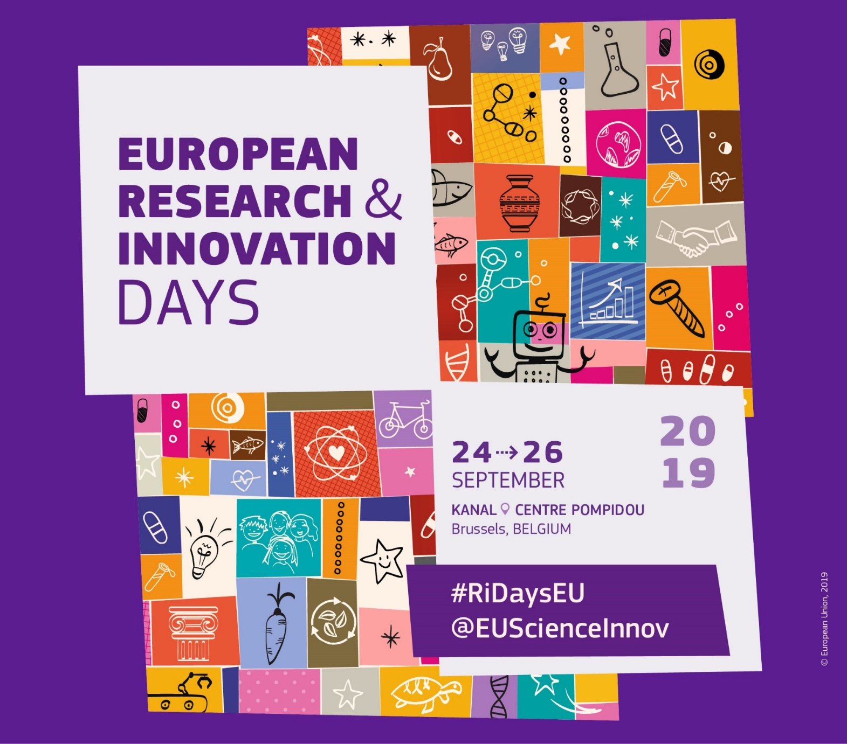

Slide 43
Research and innovation days, 24 – 26 September 2019
Bringing together policy-makers, researchers, innovators, civil society representatives and other interested stakeholders
Three days to debate, solve and innovate – to help shape the future of research and innovation policy
Three key elements of Horizon Europe to be discussed in particular:
  The Strategic Plan,
  Missions
  Institutional partnerships
Notes:
The implementation of Horizon Europe will be steered by an inclusive and transparent strategic planning process of the R&I activities that the programme will fund.
On the basis of stakeholder input, foresight, studies and other scientific evidence the Commission will draft a 'Strategic R&I plan'. It will be the basis of extensive consultations and exchange with Member States, the European Parliament as appropriate and stakeholders about priorities (including missions) and the suitable form of implementation, in particular partnerships.
The Strategic Planning Process shall focus in particular on the 'Global challenges and European industrial competitiveness' pillar and cover also relevant activities in other pillars and the Widening Participation and Strengthening the European Research Area part.
The Strategic Plan shall be adopted by the Commission as an implementing act. The Specific Programme (art. 4a) states that the act shall contain the following elements,
a. Key strategic orientations for R&I support, including a description of expected impacts, cross-cluster issues and intervention areas covered.
b. Identification of European Partnerships according to Article 8(1)(a and b) of the [FP Regulation].
ba. Identification of Missions according to Article 5 of the Specific Programme and Article 7 and Annex Va of the Regulation establishing Horizon Europe.
c. Areas for international cooperation, actions to be aligned with Research & Innovation of other nations and regions of the world at major scale, or actions to be carried out in cooperation with organisations in third countries.
d. Specific issues, such as the balance between research and innovation; the integration of Social Sciences and Humanities; the role of Key Enabling Technologies and strategic value chains; gender equality, including the integration of gender dimension in the R&I content; adherence to the highest ethics and integrity standards; priorities for dissemination and exploitation.
Furthermore, the Specific Programme states that The Strategic Plan shall take into account an analysis covering at least the following elements:
a) Political, socio-economic and environmental drivers which are relevant for the EU and Member States' policy priorities.
b) The contribution of research and innovation to the realisation of EU policy objectives, while capitalizing on studies, other scientific evidence and relevant initiatives at EU and national level, including institutionalised partnerships according to article 8(1)(c)of the [Framework Programme Regulation].
11
c) Evidence-base resulting from foresight activities, S&T and innovation indicators, international developments such as the implementation of the SDGs and feedback from implementation, including monitoring the implementation of specific measures with regard to widening participation and sharing excellence and participation of SMEs.
d) Priorities with the potential to be implemented in synergy with other EU programmes.
e) A description of the various approaches for stakeholder consultation and citizen engagement as part of the work to develop Work Programmes;
f) Complementarity and synergies with planning of the KICs of the EIT in accordance with Regulation 294/2008/EC.
5. The strategic planning process shall be complemented by a strategic coordinating process for European Partnerships, with participation of Member States and the Commission on equal footing. It shall function as an entry point for foresight analysis, analysis and advice on the portfolio development, possible setup, implementation, monitoring and phasing out of R&I partnerships and be guided by a comprehensive criteria framework, based on Annex III of the Horizon Europe Regulation.

Slide 44

Follow us and keep up to date via:
#HorizonEU
@Moedas @EUScienceInnov @EU_H2020 @HorizonMagEU
https://www.facebook.com/EUScienceInnov/
https://www.facebook.com/cmoedas/
Horizon Europe dedicated website
http://ec.europa.eu/horizon-europe
European Innovation Council
http://ec.europa.eu/research/eic
EU budget for the future
http://ec.europa.eu/budget/mff/index_en.cfm

Slide 45




'We are now on track to launch the most ambitious ever European research and innovation programme in 2021, shaping the future for a strong, sustainable and competitive European economy and benefiting all regions in Europe.'
Carlos Moedas, Commissioner, 20/3/2019

Slide 46
Thank you!
#HorizonEU
http://ec.europa.eu/horizon-europe
© European Union, 2019. | Images source: © darkovujic, #82863476; © Konovalov Pavel, #109031193; 2018. Fotolia.com

Slide 47
  Annex with additional material

Slide 48
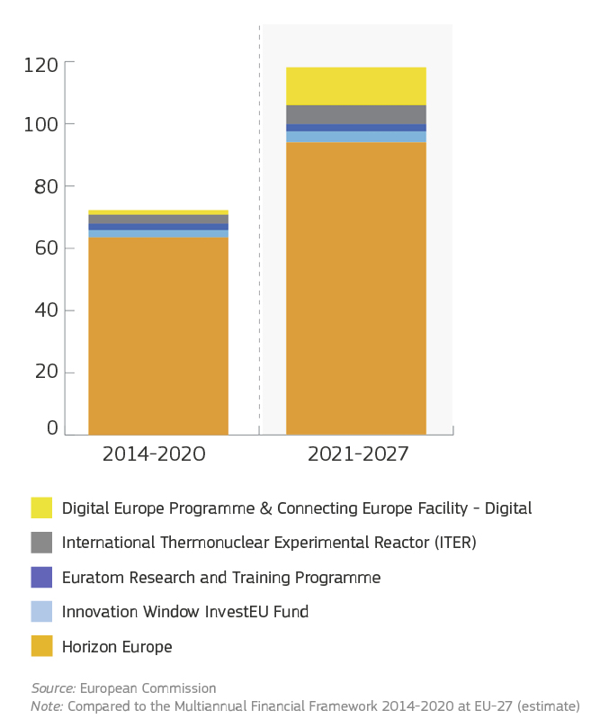
The next long-term EU budget (2021-2027):
Investing in the future
Building on the success of
the EU’s past flagship research
and innovation programmes,
the Commission proposes to increase investment in
research-innovation and digital by allocating € 114.2 billion
for the future Multiannual Financial Framework.
Digital Europe Programme & Connecting Europe Facility - Digital
International Thermonuclear Experimental Reactor (ITER)
Euratom Research and Training Programme
Innovation Window InvestEU Fund
Horizon Europe
Source: European Commission
Note: Compared to the Multiannual Financial Framework 2014-2020 at EU-27 (estimate)

Slide 49

Key elements of the Commission proposal are preserved
Three pillar structure addressing fundamental science, global challenges and innovation
A new cross-sectoral clusters approach
Missions as key novelty for more impact and visibility
EIC as one-stop shop for innovation to help small companies to innovate and scale up
Strategic planning as direction-setting for the work programmes
New approach to partnerships to rationalise the landscape
Impact pathways to track progress with the achievement of the Programme's objectives over time.
Rules for participation aiming at further simplification and a more robust Open Access regime.

Slide 50
Key changes introduced by Council and EP
Cluster inclusive and secure society is split
Fast track procedure in pillar II and in the EIC Pathfinder for bottom-up proposals, small consortia and time-to grant not exceeding 6 months
EIC to provide two types of support: blended and
grants-only
Areas for possible missions and institutionalised partnerships based on Article 185/7 TFEU are listed
Widening participation: additional measures and increased budget prospect
Strategic planning as Commission implementing act to facilitate implementation

Slide 51



New FTI procedure in pillar II and EIC Pathfinder
Separate cluster for security;
Creativity added in the cluster on inclusive society
Structure
(3 pillars; 6 clusters)
Separate PC-configurations on ERC, MSCA, security and widening and ad-hoc meetings on horizontal and/or cross-cutting issues, such as Space and Mobility
+
Principles (new) incl. on assisting widening countries, SSH, INCO, gender, admin. burden, 3% investment target, 35% climate target;
Contribution to reducing of the R&I divide
Objectives
Strengthening collaborative links (specific objective)
Fostering wider participation (operational objective
Dedicated budget to
Widening of 3.3%
(new recital)
Budget
(bracketed;
MFF related)
Space budget “commensurate proportionally” to Horizon 2020 (recital)
EIT budget removed from SP (linked with legal base)
Parliament
Council
Horizon Europe
Commission proposal
Notes:
Slide shows the main issues and the changes that the co-legislators agreed on: the EP (left) and the Council (right).

Slide 52
Missions budget cap (10% of annual Pillar II budget for the 1st 3 years) with assessment
Missions
Identification of missions in the strategic plan
Early involvement of MS
+
Recital on FET Flagships/
Partnership
Partnership budget cap
Grants-only budget corresponding to SMEI in recital
EIC
New EIC Pathfinder provision in FP
EIC Accelerator: mainly blended finance
Areas for possible missions and partnerships in Annex to FP
Co-creation,
co-design, citizens/civil society as programme principle
Strategic Planning
Implementing Act with a “no opinion” clause
Early involvement of MS and extensive consultation of the EP
Parliament
Council
Horizon Europe
Commission proposal
Notes:
Slide shows the main issues and the changes that the co-legislators agreed on: the EP (left) and the Council (right).

Slide 53
+
Fixed list of widening MS in main article
Excellence Initiatives
Widening budget recital ‘at least 3.3%’
Widening participation
(doubling of budget)
Support to NCPs
“Advancing Europe package” with
“hop on” provision
Match making services
Reference to remuneration gap in a recital
MS to take measures on salaries, Commission to monitor the evolution
Remuneration
of staff
Commission proposal of project-based remuneration with a reference to social security charges
Widening budget recital
-
Parliament
Council
Horizon Europe
Commission proposal
Notes:
Slide shows the main issues and the changes that the co-legislators agreed on: the EP (left) and the Council (right).

Slide 54
Clusters in 'Global Challenges and European Industrial Competitiveness‘
Clusters | Areas of intervention
Health | Health throughout the life course Non-communicable and rare diseases Tools, technologies and digital solutions for health and care, including personalised medicine | Environmental and social health determinants Infectious diseases, including poverty-related and neglected disease Health care systems
Culture, creativity and inclusive society | Democracy and Governance Social and economic transformations | Culture, cultural heritage and creativity
Civil security for society | Disaster-resilient societies Protection and Security | Cybersecurity
Digital, Industry and space | Manufacturing technologies Advanced materials Next generation internet Circular industries Space, including Earth Observation Emerging enabling technologies | Key digital technologies, including quantum technologies Artificial Intelligence and robotics Advanced computing and Big Data Low-carbon and clean industry Emerging enabling technologies
Climate, Energy and Mobility | Climate science and solutions Energy systems and grids Communities and cities Industrial competitiveness in transport Smart mobility | Energy supply Buildings and industrial facilities in energy transition Clean, safe and accessible transport and mobility Energy storage
Food, bioeconomy, natural resources, agriculture and environment | Environmental observation Agriculture, forestry and rural areas Circular systems Food systems | Biodiversity and natural resources Seas, oceans and inland waters Bio-based innovation systems in the EU Bioeconomy

Slide 55
Open science across the programme
Art. 10 - Open Science
The approach
Art. 35 - Exploitation and Dissemination
The modalities
Open access to scientific publications to be ensured
Open access to research data to be ensured in line with principle 'as open as possible, as closed as necessary'
Responsible research data management to be ensured in line with FAIR principles
Other open science practices to be promoted and encouraged
Reciprocity in open science to promoted and encouraged in all association and cooperation agreements with third countries
Open access to scientific publications obligatory: sufficient IPR to be retained
Open access to research data, 'as open as possible, as closed as necessary' : exceptions
Responsible research data management in line with FAIR principles; Data Management Plan mandatory; possible obligations (in specific WPs) to use the European Open Science Cloud for storing and providing access to data
Possible additional incentives or obligations through work programmes for other open science practices

Slide 56

The Strategic Planning Process:
The present we
have
The future we want
R&I Strategic Planning of
Horizon Europe
Synergies across the MFF
Synergies across other EU policy interventions
Synergies with the MS actions
… and our strategic plan will attract attention and cooperation at international/global level

Slide 57
Implementation Strategy to shift the focus from administration to content
Enhancing synergies with other EU programmes
Simplifying the model grant agreements and guidance to be beneficiaries
Funding and tenders portal – one-stop-shop for easy access to EU funding and project implementation
Early consultation with stakeholders/programme
ready to start in 2021
Notes:
At implementation level, simplification will be further re-inforced through:
improvements to the proposal submission and evaluation process in view of trying to reduce the 'time to grant' and by improving feedback to applicants
improving interfaces with beneficiaries (Participant Portal, guidance documents, helpdesk, etc.)
reducing the overall number of Model Grant Agreements (MGA), etc.
addressing oversubscription through a broader use of multi-stage submission, in those areas of the Framework Programme where it could seem appropriate.

