Slide 1
The European Commission’s science
and knowledge service
Joint Research Centre

Slide 2
Opening Access to JRC Physical Research Infrastructures
Fabio Taucer, Deputy Head of Unit, A.5 Scientific Development
Western Balkans on Research and Innovation: Research Meeting
Brussels, 23-24 September 2019

Slide 3
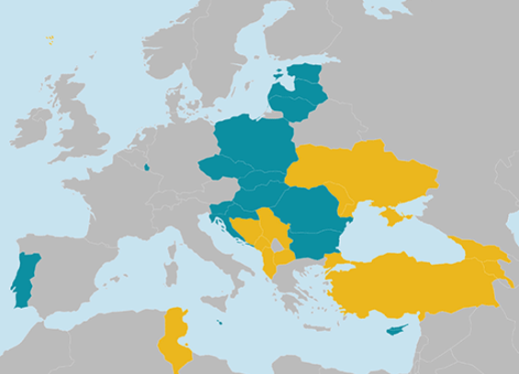
Open Access to JRC Research Infrastructures
Access Modes: Relevance Driven (and Market Driven)
Peer-review selection following a call for proposals
Mainly targeted to academia, research institutions, SMEs
Users charged the additional costs associated (18% overheads)
Open dissemination after an 18 month embargo period
12 laboratories have opened to the JRC since 2016
100 Proposals
280 Users from 100 Institutions
24 Countries (North Macedonia, Turkey)
Training and Capacity Building
Nanobiotechlogy Laboratory
40 Users from Serbia, Armenia, Bosnia and Herzegovina, Switzerland, Turkey
Open to
EU Member States
Countries associated to Horizon 2020
Member States
Countries Associated to H2020
Spreading Excellence and Widening Participation countries
Notes:
Member States: Bulgaria, Croatia, Cyprus, Czech Republic, Estonia, Hungary, Latvia, Lithuania, Luxembourg, Malta, Poland, Portugal, Romania, Slovakia and Slovenia; Associated Countries (subject to valid association agreements of third countries with Horizon 2020): Albania, Armenia, Bosnia and Herzegovina, Faroe Islands, Former Yugoslav Republic of Macedonia, Georgia, Moldova, Montenegro, Serbia, Tunisia, Turkey and Ukraine http://ec.europa.eu/research/participants/data/ref/h2020/wp/2018-2020/main/h2020-wp1820-sewp_en.pdf

Slide 5
Any questions?
You can find me fabio.taucer@ec.europa.eu
andreas.jenet@ec.europa.eu
https://ec.europa.eu/jrc/en/research-facility/open-access

