Slide 1
Open Science
Brussels, 23 September 2019
DG RTD, Unit Open Science
Anette Bjornsson

Slide 2
Holistic Policy Agenda: scope & ambitions
Open Data: FAIR data sharing is the default for funding scientific research
Science cloud: All EU researchers are able to deposit, access and analyse European scientific data through the open science cloud, without leaving their desk
Altmetrics: Alternative metrics (next generation metrics) to complement conventional indicators for research quality and impact (e.g. Journal Impact Factors and citations)
Future of scholarly communication: All peer reviewed scientific publications are freely accessible
Rewards: The European research career evaluation system fully acknowledges Open Science activities
Research Integrity: All publicly funded research in the EU adheres to commonly agreed Open Science Standards of Research Integrity
Education and skills: All young scientists in Europe have the necessary skills and support to apply Open Science research routines and practices
Citizen Science: CS significantly contribute and are recognised as valid knowledge producers of European science

Slide 3
Open Access
In Horizon 2020 Open Access to publications has been mandatory
Since 2017 it has been recommended to let data be open and prepare data management plans. Still possibility for opt-out on the open access to data
In Horizon Europe it will be mandatory that data is FAIR and to prepare data management plans for the projects. It will be possible to opt-out if well justified but it will be harder than today

Slide 4
EOSC 2019-2020: governance
Advise on / inform the implementation
Steer the implementation
Contribute to the implementation
Stakeholder Forum
Governance Board
EU-funded projects
Users, Service Providers, Public sector, Industry, SMEs, etc.
MS/AC delegates and the European Commission
Proposes Monitors
Reports
Reviews Endorses
Orients
Nationally-funded projects and initiatives
Other projects and initiatives
Working Groups
Executive Board
Interact
WG
WG
WG
WG
European stakeholder organisations and individual experts)
Extended Coalition of Doers
Supports
Supports
Supports/ coordinates w.
EOSCSecretariat.eu Coordination and Support Action
Notes:
Users forum
Science Users
Users of PRACE and HPC Centres of Excellence
Industry Users
(b) Technology forum
PRACE, GEANT
Tier-0 supercomputing centres
Industry (ETP4HPC, BDVA PPP, etc.

Slide 5
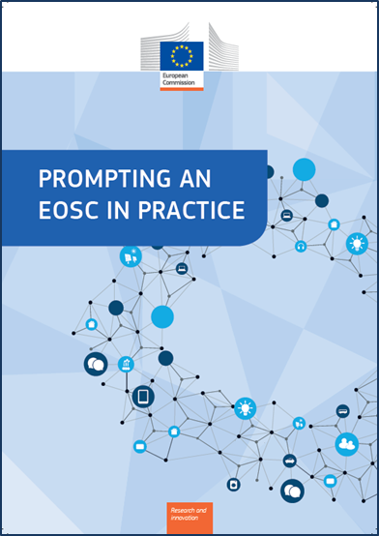
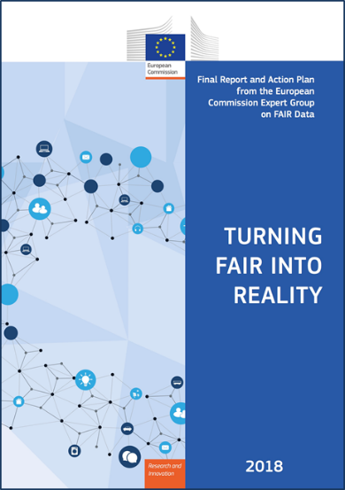
Key issues for the next two years
Key issues for the next two years
The vision (2016)
New governance model and best-fit legal vehicle for after 2020
Financing model(s) to sustain EOSC services in the long run
Rules of participation that will govern future EOSC transactions
Coordination of EOSC-relevant national initiatives
Evolution of the EOSC Portal and its interfaces, expansion of the EOSC service offering to the researchers
FAIR digital objects: turning principles into practice
Widening strategy for the EOSC user base
EOSC in the international context
Turning FAIR into Reality: Report and Action Plan: https://doi.org/10.2777/1524 Prompting an EOSC in practice: https://ec.europa.eu/info/events/2nd-eosc-summit-2018-jun-11_en

Slide 6
Science & Society
Engaging and involving citizens and civil society organisations in co-designing and co-creating responsible R&I agendas and contents
Facilitating participation by citizens and civil society organisations in activities across Horizon Europe
Aims at improving trust between science and society, to maximise the benefits of their interactions, and to strengthen the uptake of scientific results and innovative solutions in society

