Slide 1
Western Balkans Steering Platform on Research and Innovation
Brussels, 23 September 2019
Research in and with Europe
The Marie Skłodowska-Curie Actions
Claire Morel
Head of Unit, European Commission, DG EAC.C2

Slide 2




The MSCA in Horizon 2020 (2014-2020)
Support researcher training and career development
Fund excellent research, bottom-up
Promote researcher mobility
Stimulate international, inter-sectoral and interdisciplinary cooperation
Impact researcher careers, organisations, structures
But…
Number of researchers supported from and to the Western Balkans remains very modest
Low success rates
Most mobility flows take place within the actions RISE and ITN, room for improvement in all actions but specially for IF and COFUND
WBCs organisations have received € 9 million EUR in total, a modest sum compared to the budget available
Need to reach out to researchers in the Western Balkans through parallel initiatives to the MSCA (i.e. Widening Fellowships)
+ European Researchers'
Night

Slide 3
Western Balkans and the MSCA (2014-now*)
* 20 September 2019
336 researchers from WBCs funded
66 WBCs organisations with +100 participations
WBCs receiving € 9 million EUR in total
 | # participations WBCs organisations | Contribution EU to WBCs (thousand €) | Involved WBCs researchers | Researchers going to WBCs
ITN | 18 | 2,382 | 118 | 5
IF | 2 | 380 | 43 | 2
RISE | 35 | 4,740 | 148 | 72
COFUND | 1 | 0 | 27 | 0
NIGHT | 48 | 1,650 | n/a | n/a
TOTAL | 104 | 9,152 | 336 | 79

Slide 4
The MSCA in Horizon Europe
Evolution in the implementation
Streamlined actions
1. MSCA Doctorates → doctoral candidates
2. MSCA Postdocs → postdoctoral researchers
3. MSCA Staff Exchanges → any type of research staff
4. MSCA Cofund → co-funding training programmes
5. MSCA and citizens → public outreach events
Continuation of simplified form of grants
Simpler rules, fine-tuned definitions, harmonised conditions
Designing measures to better manage the demand
  Success rates decrease > Top quality applications are not funded
  Number of applications increase > Complex management of the evaluation
Improved internal coherence & external synergies

Slide 5
Seal of Excellence: Quality label awarded to high-quality proposals (+85 points, Individual Fellowships for MSCA) which were not funded due to budget constraints
  Helps fellows find alternative funding
  Flags fellows for potential funding under national schemes, which take advantage of the Horizon 2020 evaluation process: Funders in 9 countries have created schemes to fund MSCA
  Few proposals from the Western Balkans ranked above threshold
  Structural difficulties to find alternative funding
Widening fellowships: provide specific support to excellent researchers not funded through the MSCA IF call to undertake an individual fellowship in a widening country*
  No researchers in the Western Balkans funded so far
MSCA National Contact Points: provide guidance, practical information and assistance on all aspects of participation in the programme to organisations, stakeholders and potential applicants
  Key role: raise awareness, improve success rates, notably in Widening Countries
  MSCA NCPs are supported and empowered through Net4Mobility+, EU-funded project
  Little or no funding available for their activities, voluntary basis in many cases
  Need to increase their activity and quality of support, notably in the framework of Horizon Europe

Slide 6
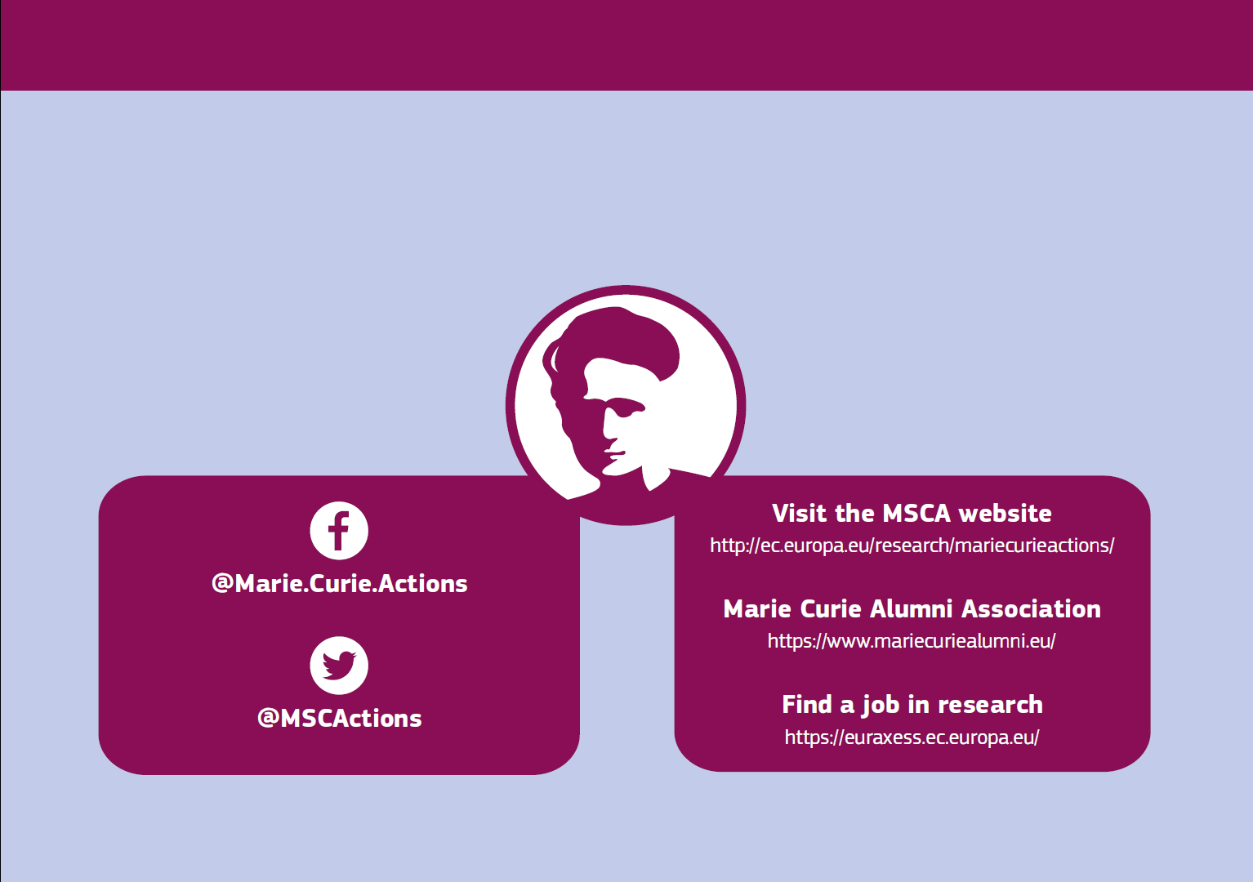
Thank you

