Slide 1
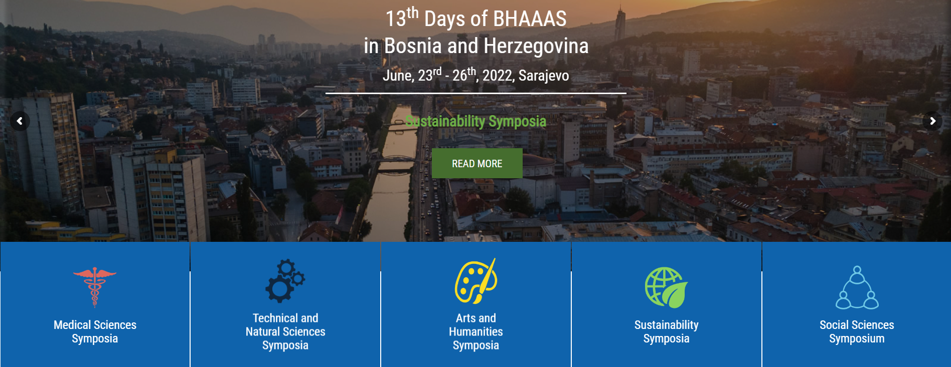
13th Days of BHAAAS
23.-26.6.2022.
Sarajevo

Slide 2
Bosnian-Herzegovinian American Academy of Arts and Sciences (BHAAAS)
non-governmental organization whose purposes are educational, scientific, and charitable.
aims to provide connections between Bosnian-Herzegovinian scientists, artists, and professionals in North America, and build bridges of cooperation with Bosnia and Herzegovina in the spirit of intellectual diversity, free exchange of ideas, and the belief that knowledge is shareable wealth. Within this framework, BHAAAS has for over a decade organized a conference titled Days of BHAAAS, which became the biggest scientific event in the region.

Slide 3
13th Days of BHAAAS
13th Days of BHAAAS, the largest annual science and educational conference in Bosnia and Herzegovina, was held in Sarajevo, 23rd-26th June 2022, and brought together established and emerging scholars from around the world in an effort to exchange ideas and create new initiatives. The conference program consisted of 33 symposia organized in four sections (medical sciences, technical and natural sciences, social sciences, humanities and arts). Apart from this, the presentations were held by prominent experts and students in a variety of special sessions, round table discussions, and workshops.

Slide 4
13th Days of BHAAAS in numbers
1000 participants
Spekars from 26 countries
33 symposia
350 presentations

Slide 5
Events of the conference included:
Symposia (Medical Sciences Symposia; Technical and Natural Science Symposia; Sustainable Development Symposia; Social Sciences Symposia; Art and Humanities Symposia)
Special Events (roundtables, plenary sessions, lectures)
Art and Culture Events (exhibitions, music and literature program)
Student Activities (workshops)

Slide 6
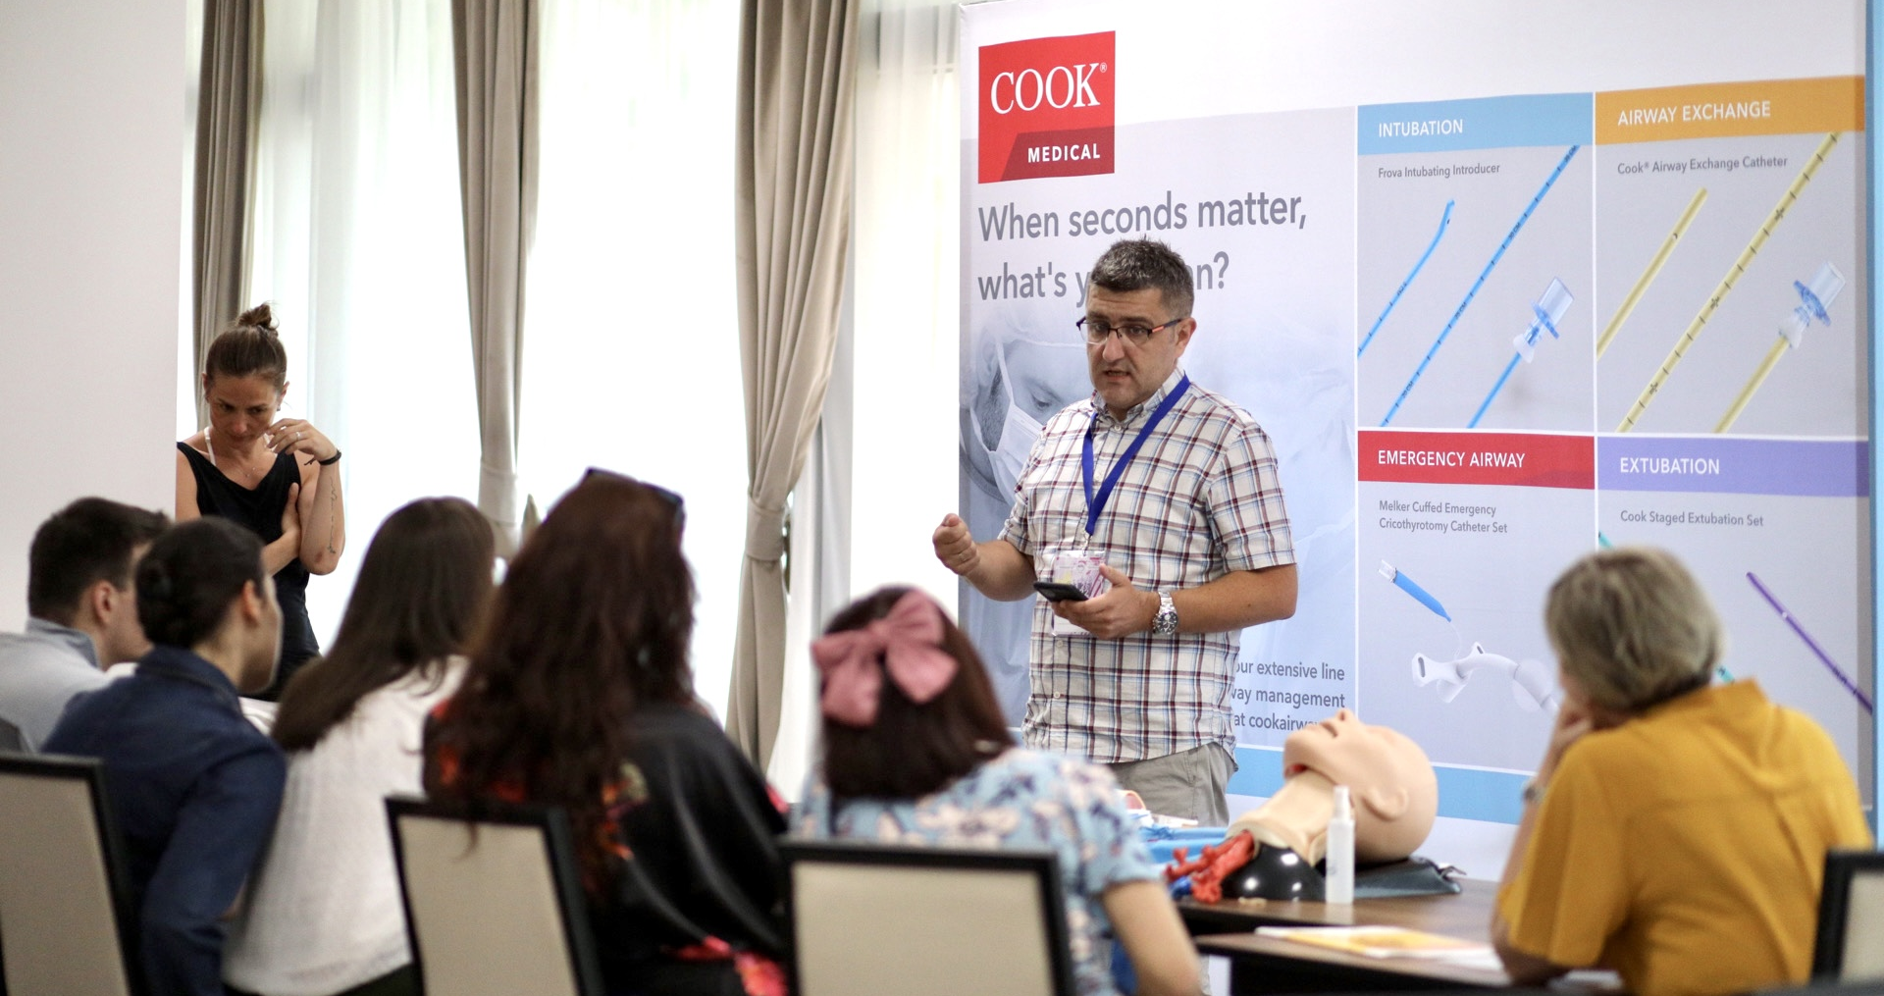
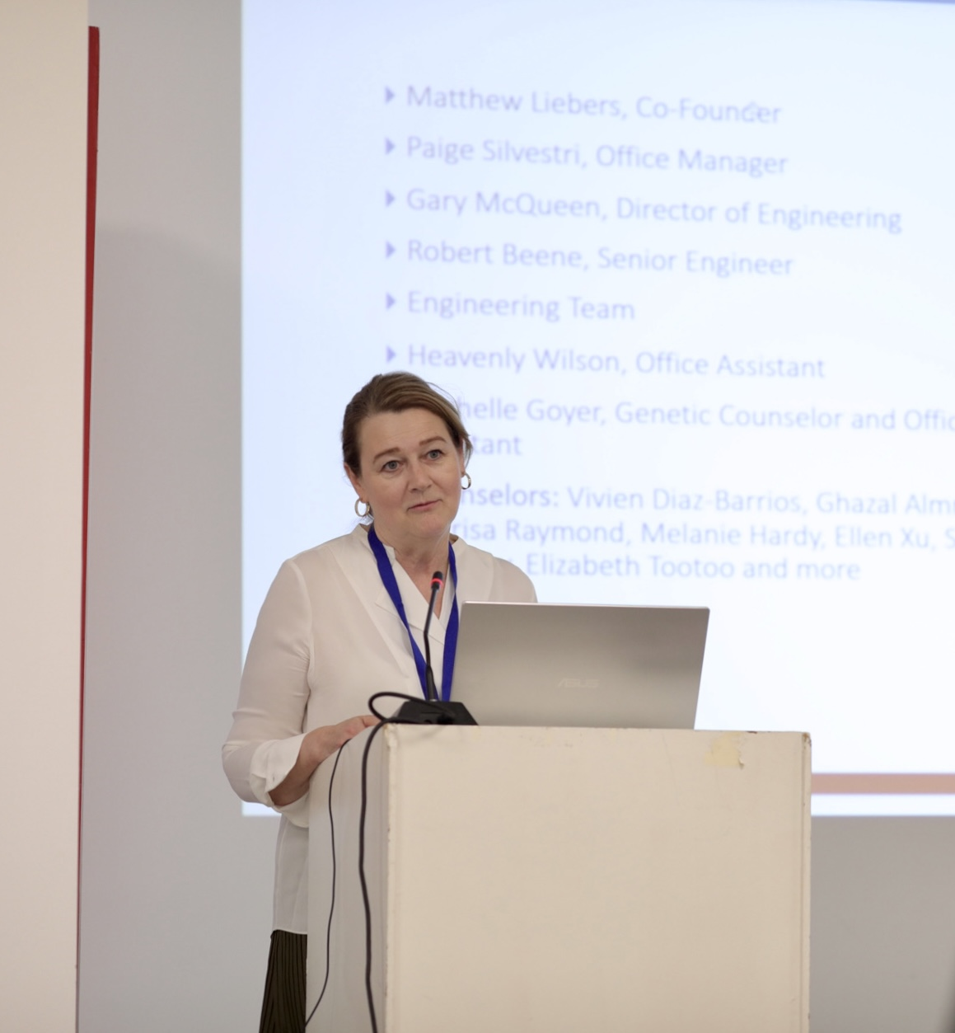
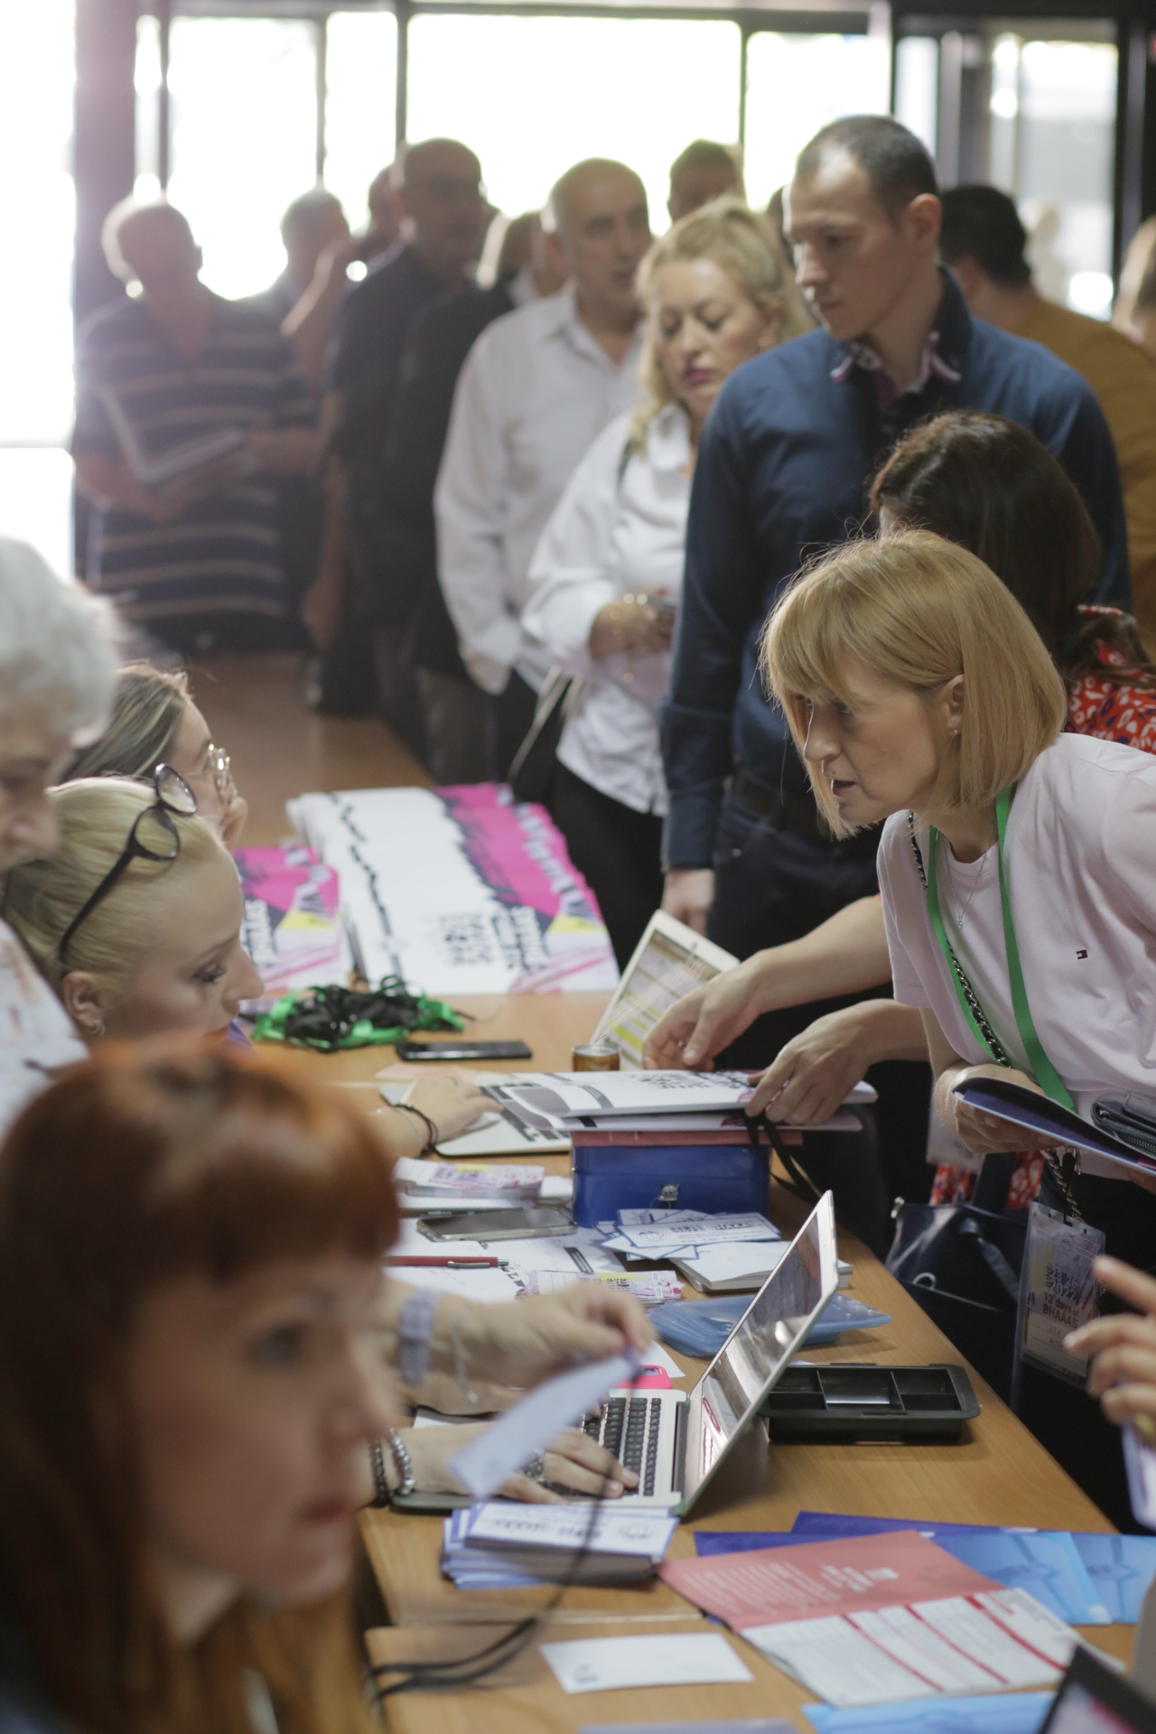
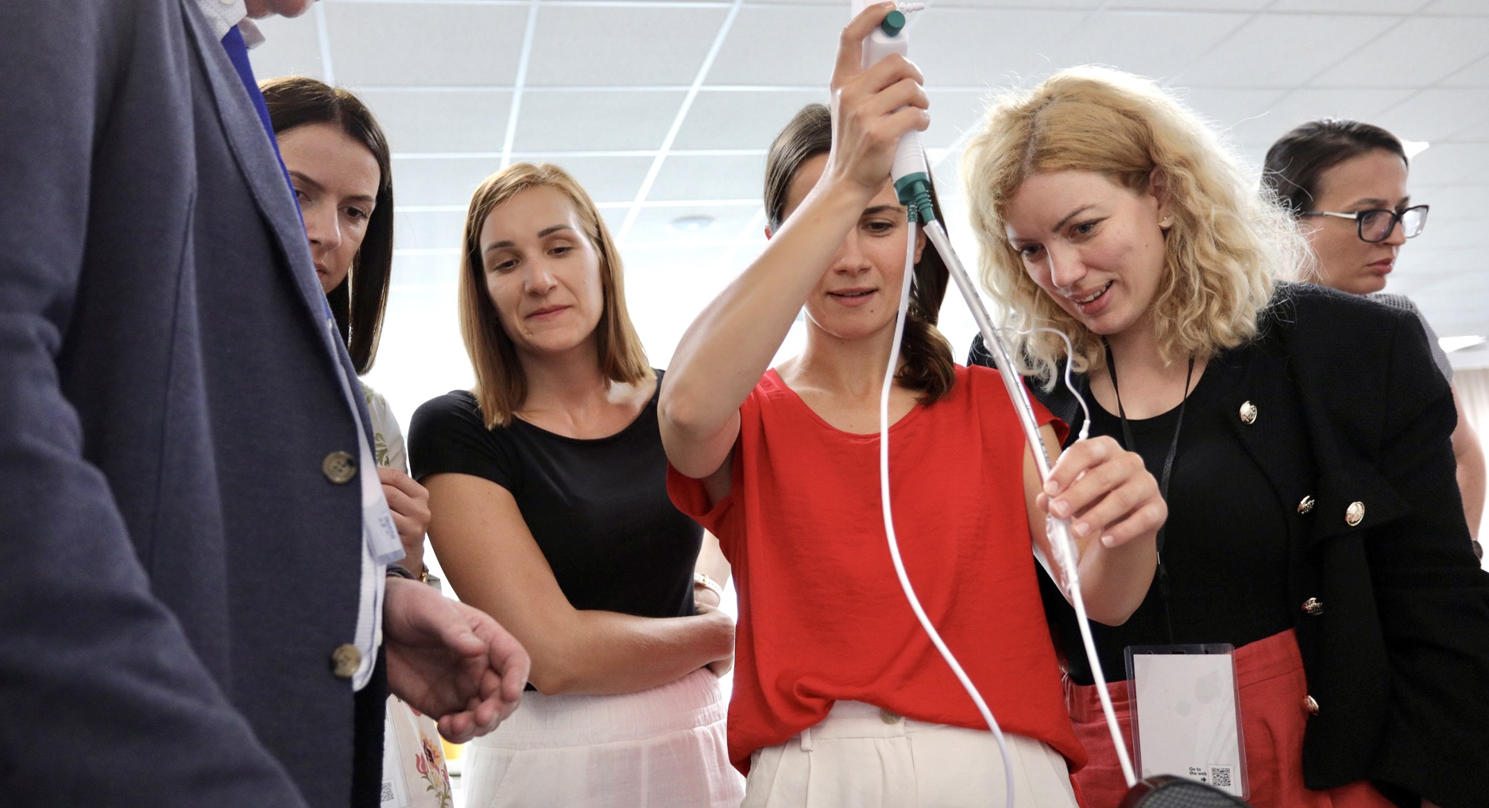
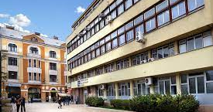
Symposia

Slide 7
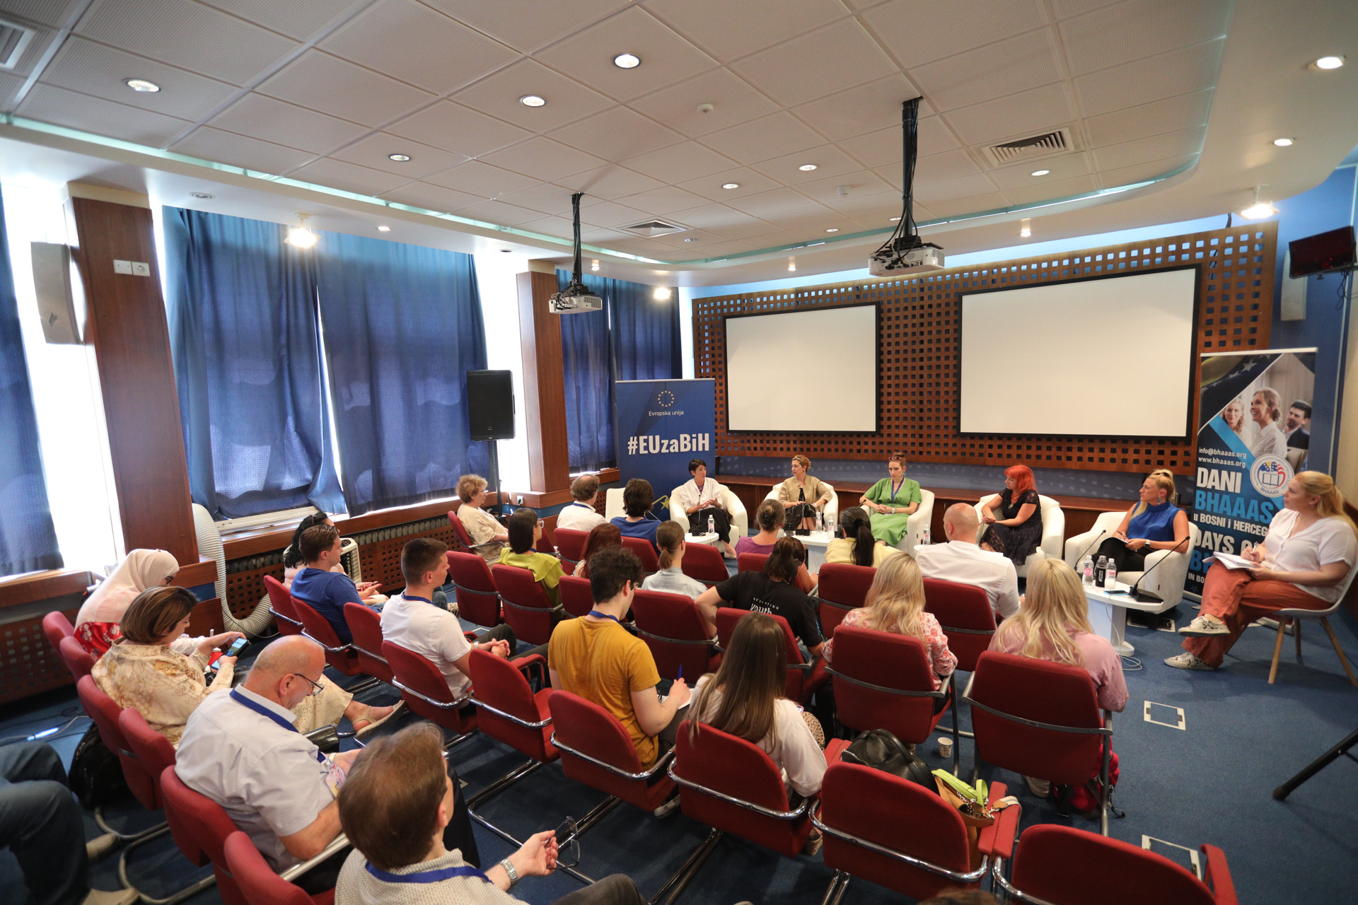
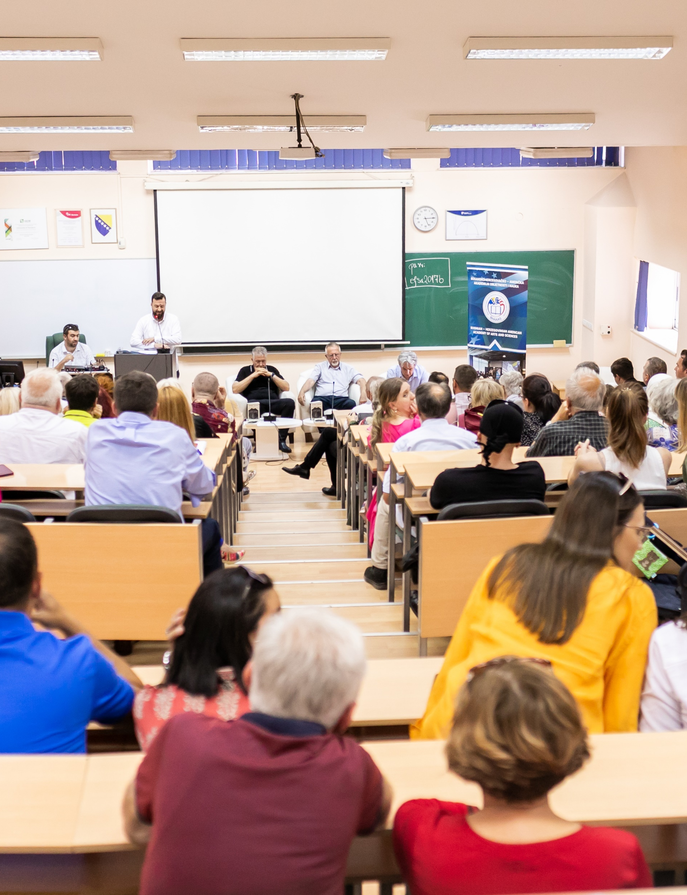
Special Events: roundtables, plenary sessions and lectures

Slide 8
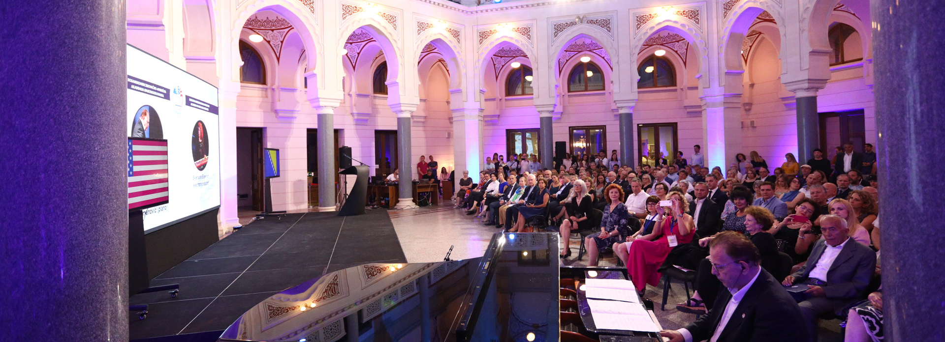
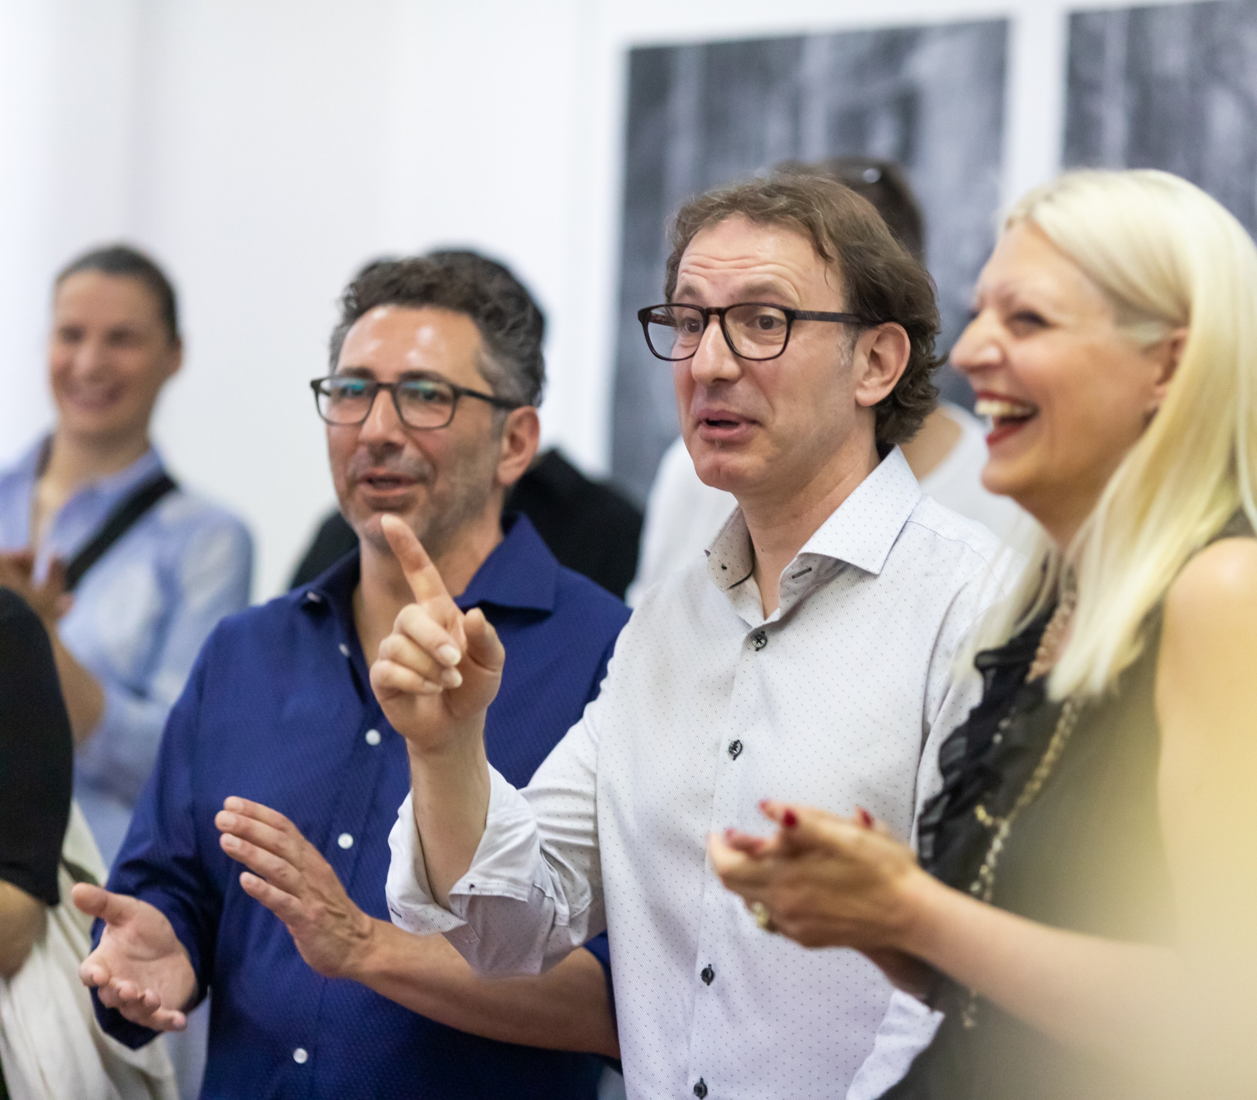
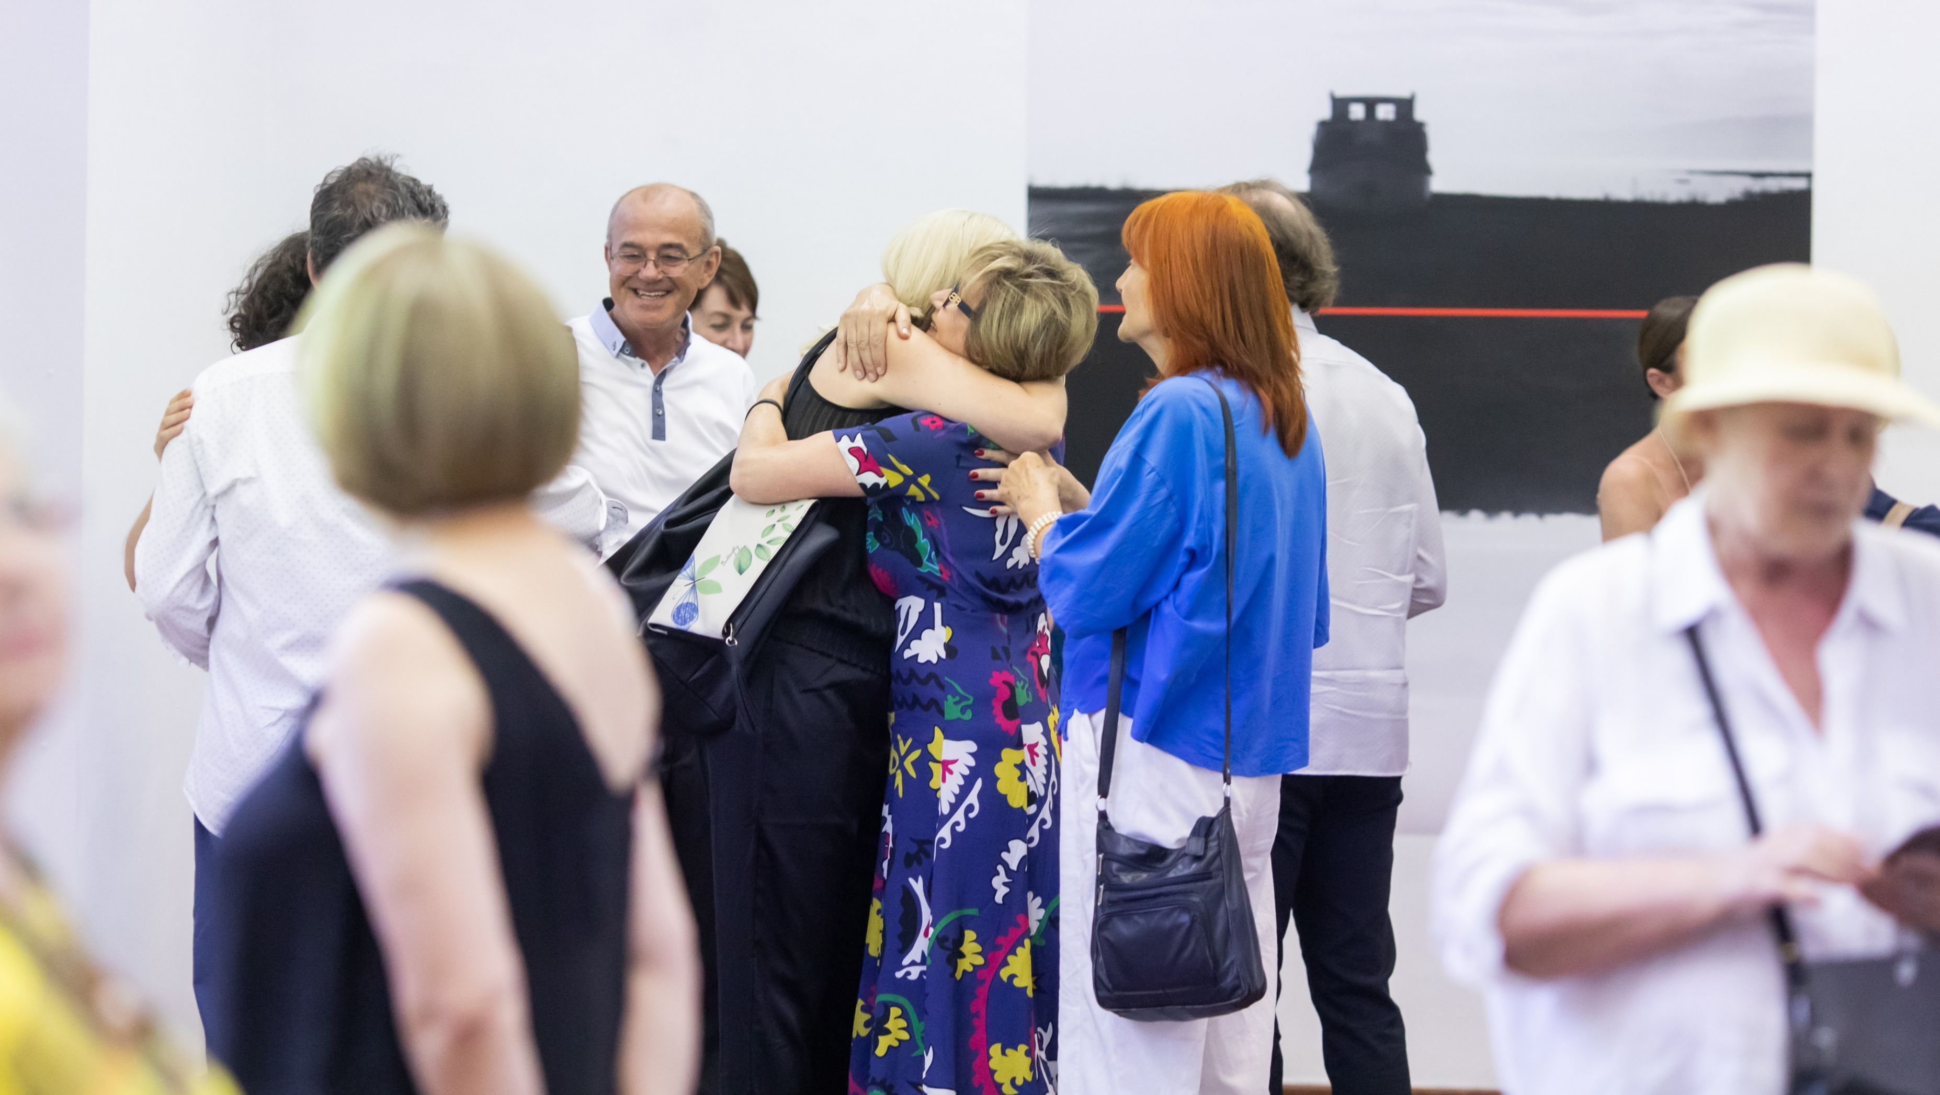
Art and Culture Events

Slide 9
Impact of 13th Days on the community
attracted the attention of Bosnian public and directed it towards the importance of investing in science, culture and arts
enabled exchange of ideas and creation of new initiatives, new projects and collaborations
provided physical and virtual space for the meeting of ideas, whereby continuing to build and strengthen the community of researchers and artists with diverse backgrounds and experiences
provided Bosnian students with much needed opportunity to broaden their perspective, work on personal and academic development in a new way, and meet experts in the field who can be inspiration, mentor or future professional contact

Slide 10
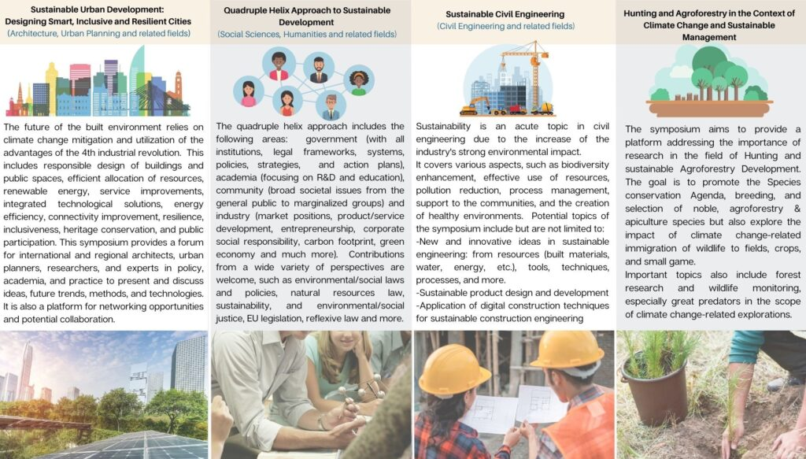
Focus on: Sustainability and Interdisciplinary issues – four symposia
4 specialized scientific symposia:
- Sustainable Urban Development: Designing Smart, Inclusive and Resilient Cities (architecture, urban
planning and related fields)
- Quadruple Helix Approach to Sustainable Development (social sciences, humanities and related fields)
- Sustainable Civil Engineering (civil engineering and related fields)
- Hunting and Agroforestry in the Context of Climate Change and Sustainable Management
and two open-public sessions: Plenary session on SDGs and the New European Bauhaus initiative
https://bhaaas.org/sarajevo-2022/sustainability-symposia/

Slide 11
New European Bauhaus Forum
In the framework of BHAAAS 2022, within the BHAAAS “Sustainable Urban Development: Designing Smart, Inclusive and Resilient Cities”symposium the NEB Forum BiH held a roundtable on the "New European Bauhaus and Us: Context, Purpose, Opportunities"
Session chair: Selma Harrington (ACE; BHAAAS)
Moderators: Tijana Tufek-Memišević and Zina Ruždić
The Round Table presented the work of the New European Bauhaus Forum BiH, which is an official partner in the community of participants in the EU initiative launched under the slogan: Beautiful, Sustainable, Together. This new cross-sectoral network opens a platform for dialogue and collaboration among the creative professionals interested in the synergies in built environment, culture and society in light of the principles of just transition within the sustainable development goals. It is inviting architects and engineers, urban planners and landscape architects, designers and artists to engage together with the civic society and local authority representatives in order to jointly contribute to better development briefs and use of resources which enhance the quality of built environment and social interaction in the urban and rural areas of Bosnia and Herzegovina and beyond.

Slide 12
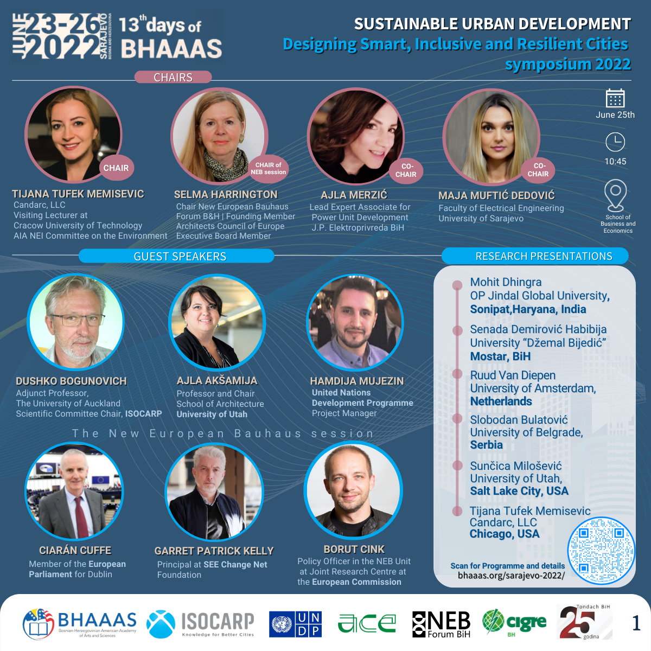
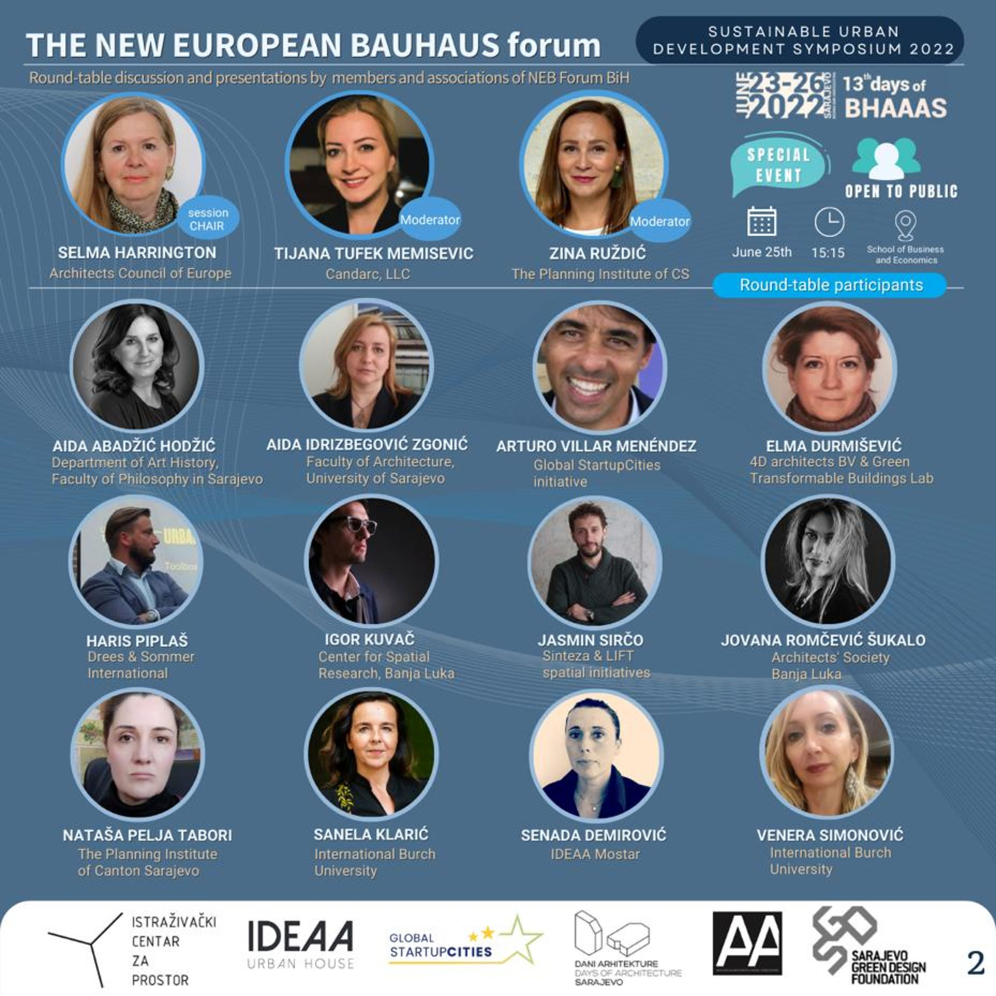

Slide 13
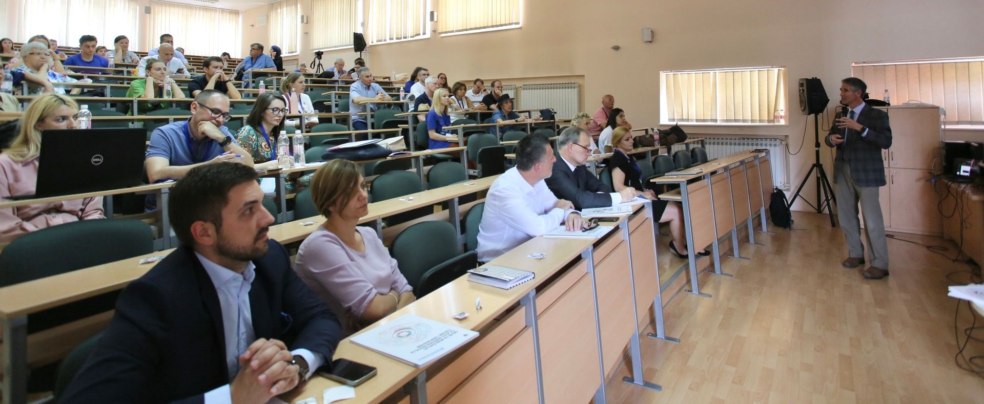
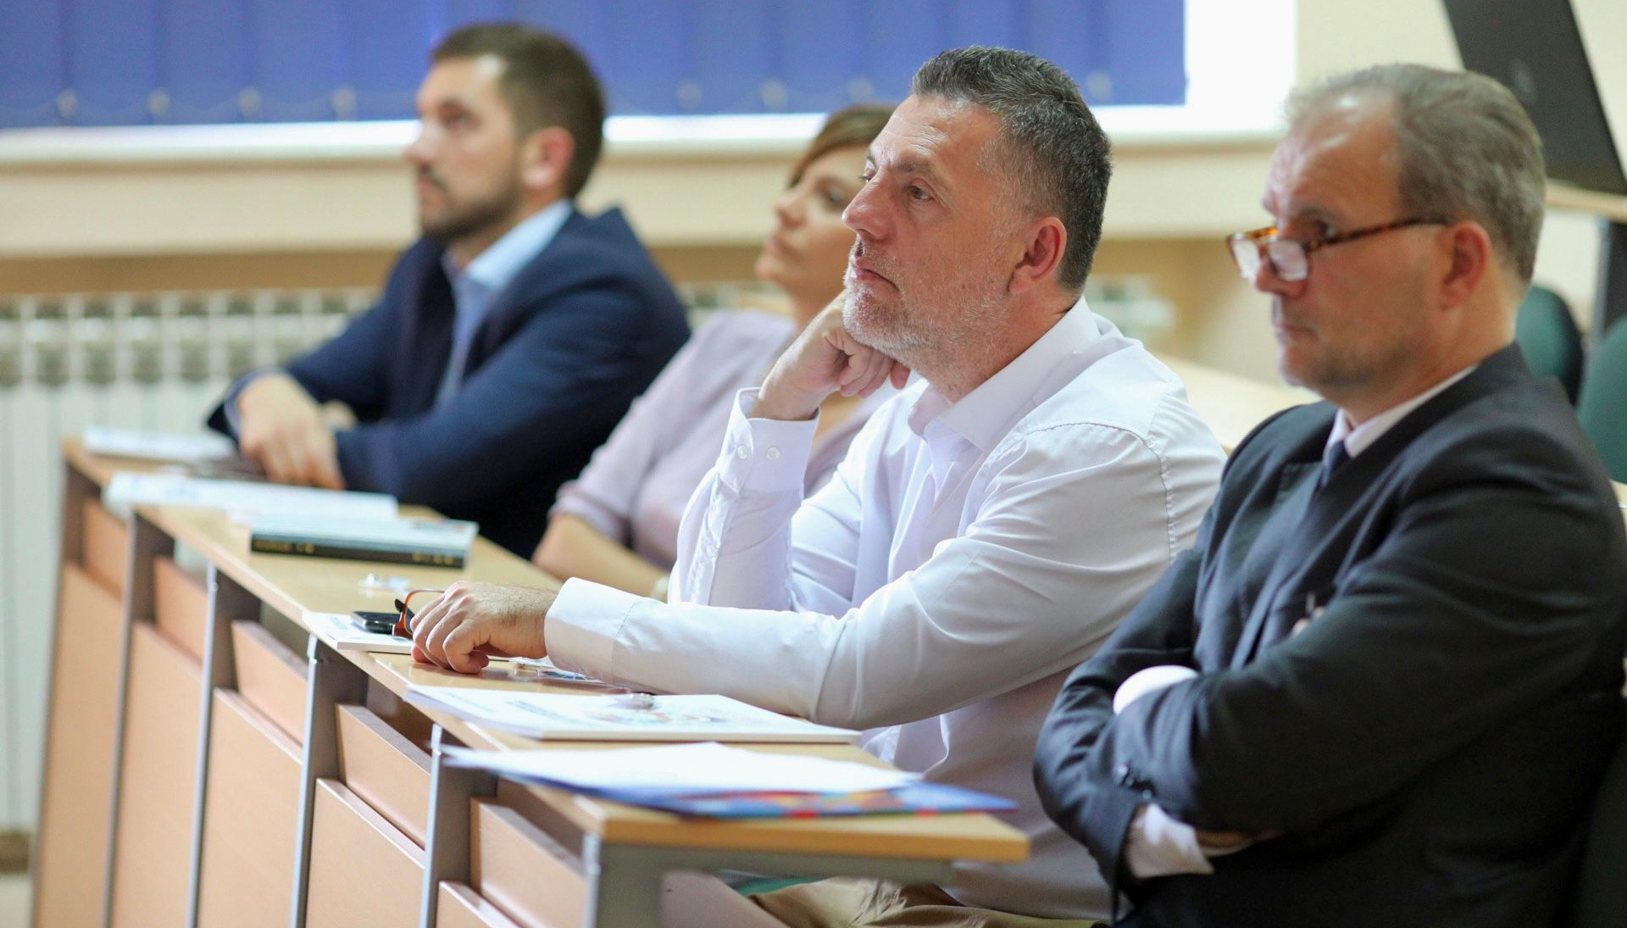
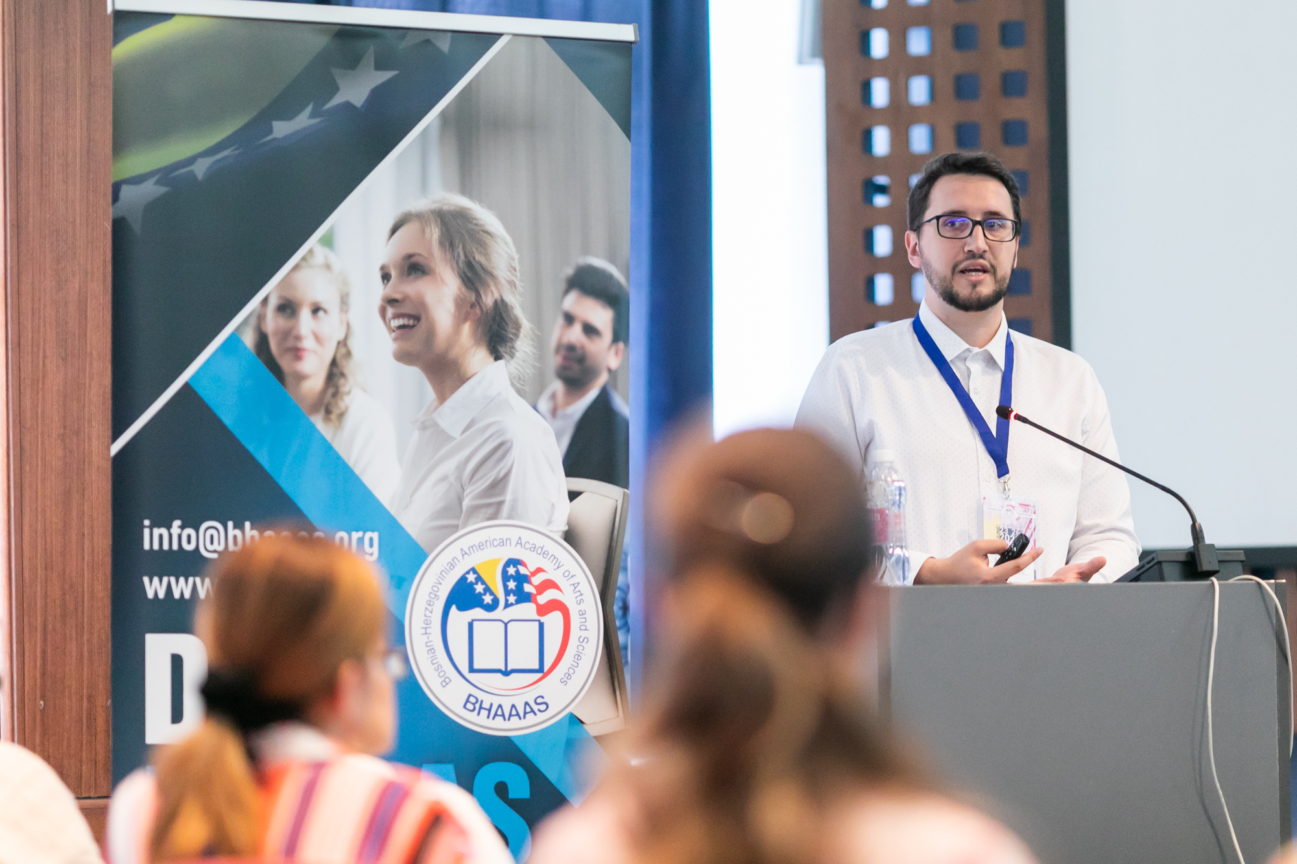
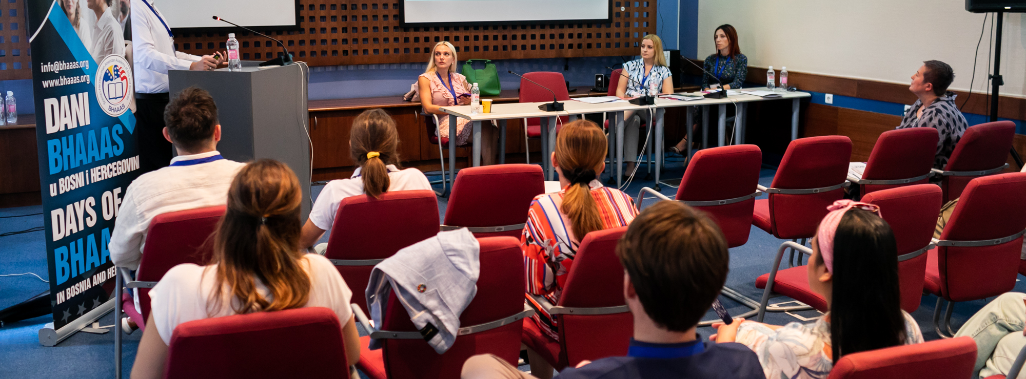

Slide 14
Sustainability Panel
Within BHAAAS conference, a sustainability panel was held
Two keynote speakers
  Keynote #1: Climate Change as Problem and Opportunity
  Jay Turner, Wellesley College
  Keynote #2: Leave No One Behind
  Kinloch Pichat, United Nations Development Programme in BIH, Deputy Resident Representative
Panelists
  Panelists: Jay Turner (Wellesley College), Nemanja Kovačević (Assistant Minister for International Cooperation, Ministry of European Integration and International Cooperation of Republika Srpska), Naida Ademović (University of Sarajevo), Maja Arslanagić-Kalajdžić (University of Sarajevo), Tijana Tufek-Memišević (Candac LLC, USA)
  Moderator: Tijana Tufek-Memišević (Candarc LLC, USA)
Discussion was focused on the SDGs Framework in BiH that was adopted at all levels of government in the country: https://zamisli2030.ba/sdgs-framework-in-bosnia-and-herzegovina/

Slide 15

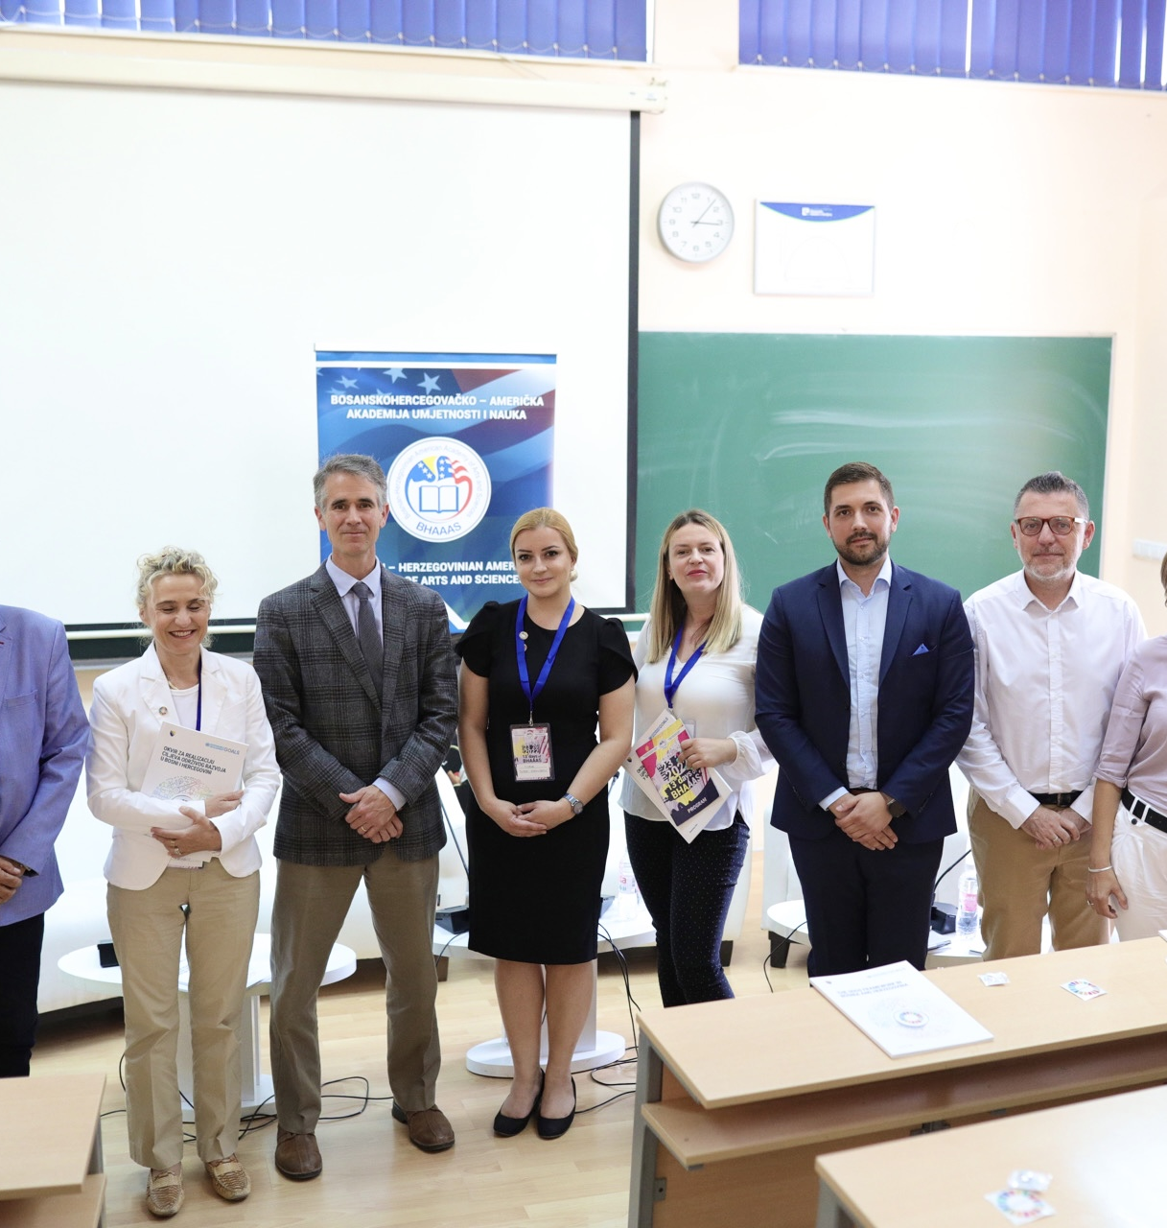
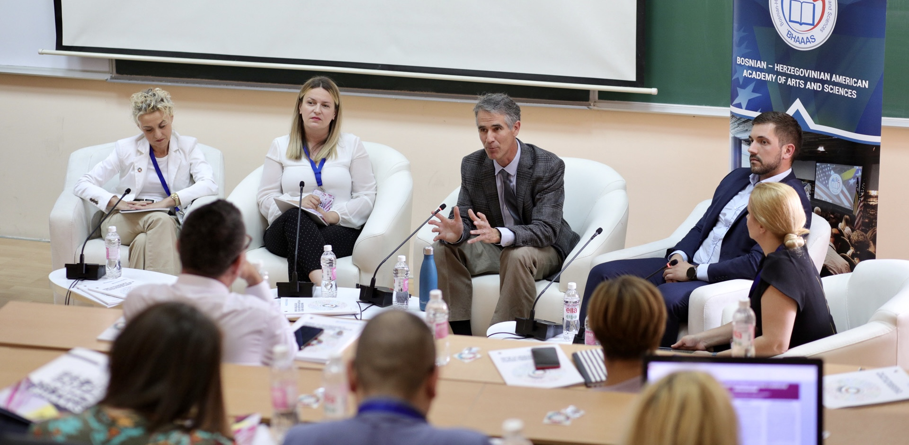

Slide 16
