Slide 1
Promoting Social Innovations for Inclusion in the Western Balkans: key challenges
Paul Stubbs
pstubbs@eizg.hr

Slide 2
The Presentation
On Coats of Paint and MUD
Social Exclusion in the Western Balkans
Promoting Social Inclusion I: state and market
Promoting Social Inclusion II: the social economy
Towards Social Innovations for Social Inclusion

Slide 3
A ‘Coat of Paint’ Theory of Social Exclusion
Following Paul Gilroy (1987) on racism:
“A coat of paint theory” of social exclusion sees it as an aberrant or surface feature of society, and therefore easily removed.
Seeing social exclusion as an integral part of the way contemporary societies are structured, organised and legitimated, offers a very different perspective.
Exploring the institutionalised nature of social exclusion requires understanding how it is embedded in social relations.
The challenge is, therefore, to deal with the complex and diverse ways that diverse forms of social exclusion actually work.

Slide 4
A ‘Moral Underclass Discourse’
Ruth Levitas (1990) expressed concern about the rise of a Moral Underclass Discourse (MUD) at the expense of both a Social Integrationist Discourse (SID) and, in particular, a Redistributive Discourse (RED)
Social exclusion is caused by the moral attitudes and cultural practices of those who are excluded
Responses to social exclusion may promote dependency and reinforce a “cycle of poverty and deprivation”
Programmes for those capable to work should be conditioned in some way to ensure attitudinal and behavioural change

Slide 5
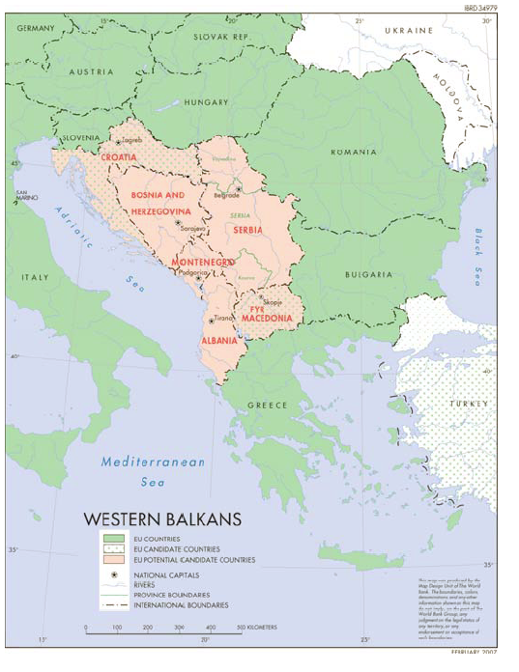

Slide 8
The Myth of High Social Spending
Source: O’Mahony RCC 2011, For EU data EUROSTAT and for WB data IMF and EFPs/PEPs

Slide 9
A Varied Fiscal Envelope
Source: O’Mahony RCC 2011

Slide 10
Drivers of Social Exclusion
Multiple shocks: War/conflicts; Structural transition; Deindustrialisation; Erosion of social capital/solidarities; ‘Captured’ social policies; Economic and Financial Crisis
Distortions caused by ‘locked in’ expenditures (tertiary health care; residential care) and new (informal) marketization
Legacy of category-based (not needs-based) social protection
Stigma, discrimination and over-professionalised approaches
Political will – Fiscal space – Technical capacities

Slide 11
Groups ‘At Risk’ of Exclusion
Multi-dimensionality and inter-sectionality of exclusion (n.b. research and data gaps)
‘At risk’: (Long-term) Unemployed; Older people; Large families; Women; Children; Youth; Low education levels; RDPs; Minorities (esp. Roma but also national minorities and ‘small minorities’); People with Disabilities; People with long-term health issues; Migrants/returnees/left behind
Spatial dimension: Arc of exclusion; Rural – Urban; Zones of exclusion
‘New’ survival strategies eroding long-term capabilities?

Slide 12
Social Innovation: the new ‘magic bullet’
“Social innovation is an important new field which should be nurtured. It is about tapping into the ingenuity of charities, associations and social entrepreneurs to find new ways of meeting social needs which are not adequately met by the market or the public sector. ... As well as meeting social needs and tackling societal challenges, social innovations empower people and create new social relationships and models of collaboration. They are thus innovative in themselves and good for society’s capacity to innovate.”
Europe 2020 Flagship Initiative COM (2010) 546, October

Slide 13
Promoting Social Inclusion: the state/public sector
The role of the state: public goods – bloated bureaucracy – clientelistic rent seeker?
Post-Yu countries – Centres for Social Work
Governance – poor horizontal and vertical co-ordination
Regulation - over legalistic but with many gaps
Human resources - limited skills to meet ‘new’ social risks
Funding - low and inconsistent; little support for non-state actors/providers
Strategy – too many strategies; too little participation; no real M&E; too influenced by international organisations (nb JIM/JAP process)

Slide 14
Promoting Social Inclusion: the market
Few incentives for private, for-profit providers (health, education, social services, ...)
Some development of Corporate Social Responsibility: move from philanthropy to sustainable partnerships
Growth of market ideas within the public sector (new public management)
Informal marketization / commodification of public goods /privatization of public space

Slide 15
Promoting Social Innovation: NGOs
Inverse care law – NGOs where they are needed least
Time-limited, donor-driven funding
Service provision at the expense of advocacy and empowerment?
Projectisation and endless pilot projects
‘The new project class’ and ‘the rise of the meta-NGO’
Innovations are very rarely scaled up or rolled out

Slide 16
Promoting Social Innovation: social entrepreneurship
Lack of definition, understanding and legal framework
Donor-driven model with policy transfer (CEE -> SEE)
Implicit or explicit neo-liberal agenda
SE from below – green, gender, informal networks, etc
New social energy – disability advocacy coalitions

Slide 17
Towards Social Innovations for Soial Inclusion I
Inclusive labour markets (disability; age; gender) and improved returns to education (life-long learning; skills; transitioning e.g school to work)
Holistic and integrated child and family policies (early childhood interventions; universal child benefits; family support services)
Deinstitutionalisation and minimum basket of community-based services
Social pensions within ‘active ageing’ policies
Anti-discrimination laws and practices
Area-based approaches/Action zones

Slide 18
Towards Social Innovations for Soial Inclusion II
Support for ‘evidence-based’ policy making – Strategic Goals; Benchmarks; Indicators; M&E; Impact Assessment (including all stakeholders)
Enhanced ‘social’ dimension of IPA programming
Regional cooperation (modelling OMC-JIM; Peer review/peer learning; common concerns; RCC as bridge to EU/global frameworks?)

