Slide 1
INCLUSION OF FEMALE BUSINESS COMMUNITY IN THE ECONOMIC MAINSTREAM
M.A Sanja Popović-Pantić
Science and Technology Policy Research Center
“Mihajlo Pupin” Institute

Slide 2
Gender gap
Gender gap is still present in many countries, different areas
1. Unequal representation of women in the economic mainstream and consequently, all other inequalities came from that fact.
Participation of women in political life
inequality in sharing of the roles in family life
Participation in decision making position

Slide 3
Gender equality became leverage for socio-economic development and growth
Third Millennium Development goal refers to the need to promote gender equality and empower women
CSR strategies of the MNC gender oriented (Women in the Boards, break of “glass ceilling”-Coca Cola
Main contribution of gender equality to growth is through labour productivity and efficient allocation of human capital.

Slide 4
Women and the growth
Larger and more diversified talent pool
Less corruption and better governance
⇓ ⇓
Sustainable growth
-promotion of the entrepreneurship among women

Slide 5
NEW CHALLANGE
Gender balanced development is not challenge any more
WHAT REPRESENTS NEW CHALLENGE?
Sustainability of female businesses and mainstreaming

Slide 6
ENSURING MAINSTREAMING- statistics
According to the GEM 2007, the scope of female entrepreneurship is significantly less than of male entrepreneurship in all countries involved in GEM research (41 countries globally-145.248 respondent)
Also, statistics show that in EU countries the share of female companies is ranging from 30%-40%)
In Serbia, it is less than average for EU 27, and it is 25,9%

Slide 7
ENSURING MAINSTREAMING- tools
measures to prevent the loss of female companies is to strengthen the innovativeness of female companies as well as their networking, locally, regionally, globally.
One research in Serbia on the sample of 38 companies, shows that women entrepreneurs are aware that investments in innovations are a prerequisite for the market competitiveness. However, due to the current environment, especially limited financial and human resources, it is only possible to have modest investments in the development of information technologies within an enterprise and these are on the basic level.

Slide 8
Benchmark analysis on innovativeness
Good tool to highlight the gap in the institutional measures to encourage innovativeness among female business population
Benchmark analysis of innovativeness between Serbian and German companies show that institutions in pre-accession countries should invest even more effort and probably design specialized programs only for women in order to reach average values of indicators in female entrepreneurship in EU countries

Slide 9
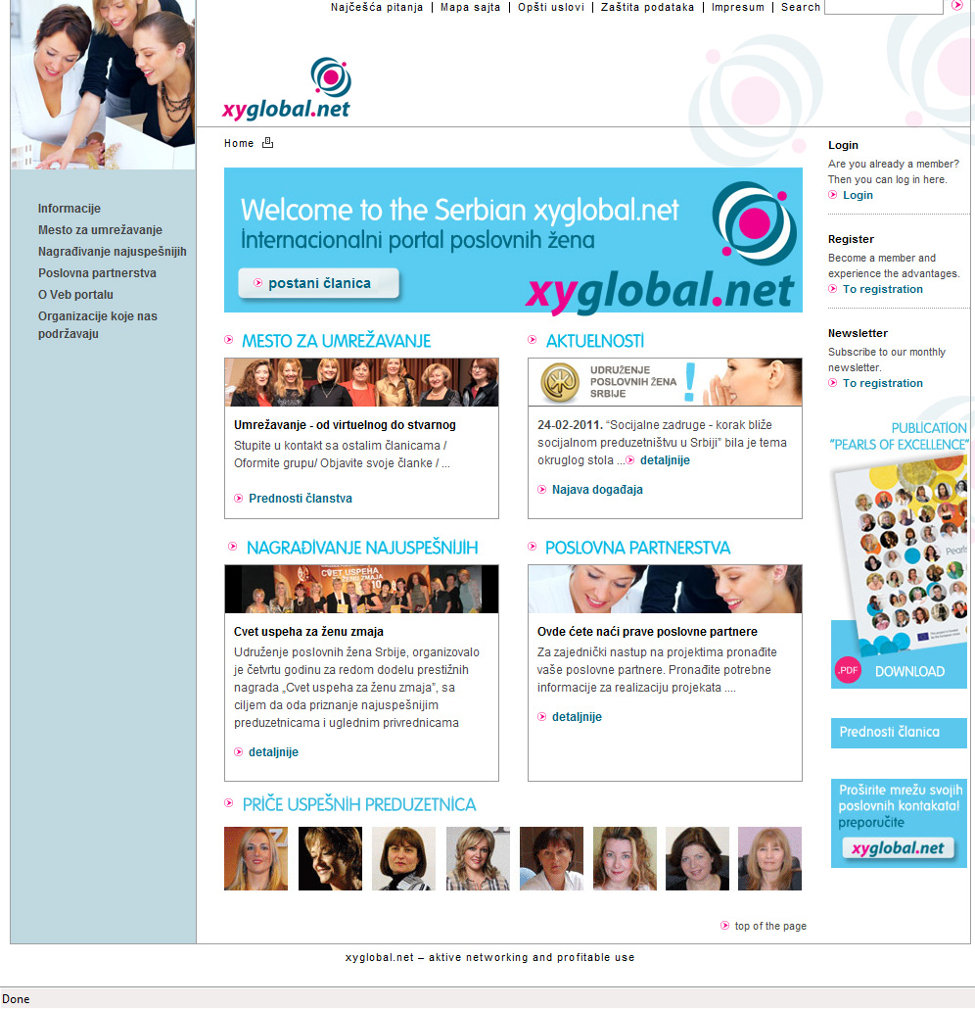
Networking as a tool of mainstreaming

Slide 10
CONCLUSION
Synergy of measures to improve innovativeness and to encourage networking among women entrepreneurs, can ensure inclusion of female business population in mainstream.

